Slide 1

A minimal scenario for the evolution of non-equilibrium order
Arvind Murugan
Associate Professor, Physics

Slide 2
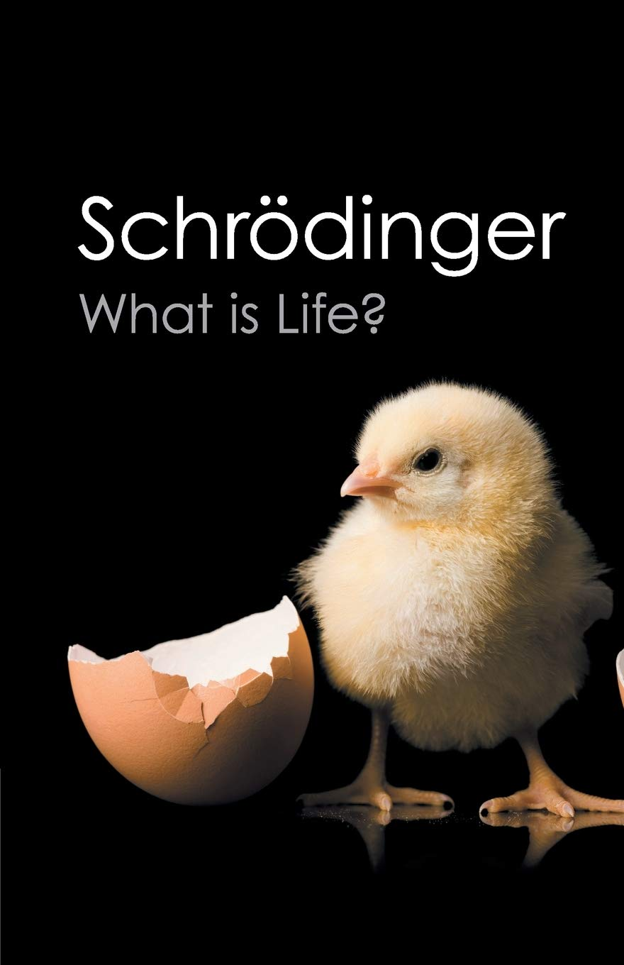
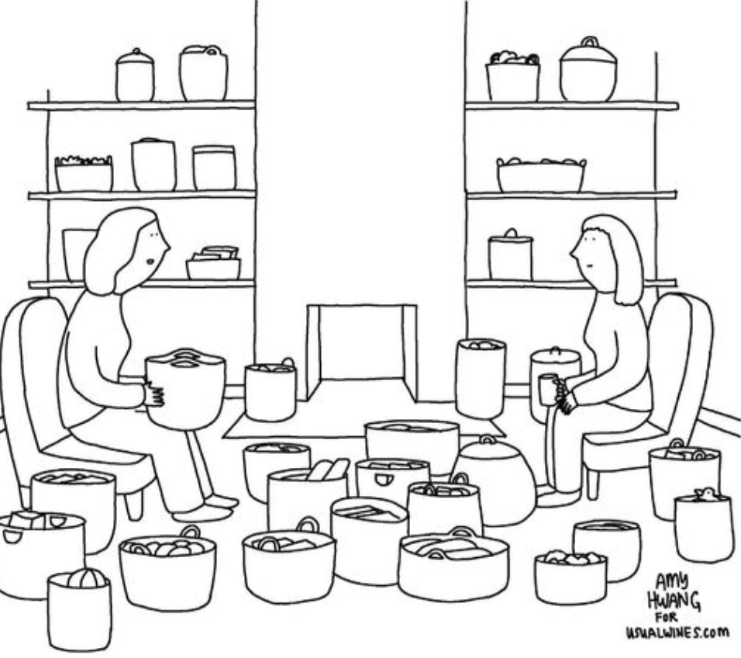
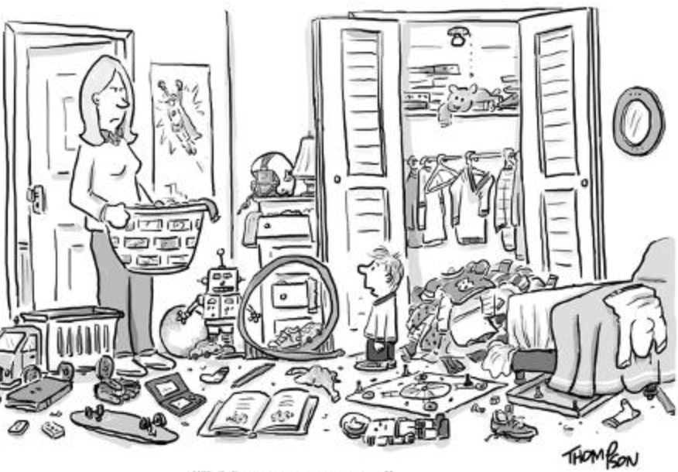
Origin of Maxwell Demons
2nd law of thermodynamics
before
some time later
Things fall apart over time..
Things stay ordered preserve information… Maxwell Demon.
=> Must be polluting elsewhere

Slide 3

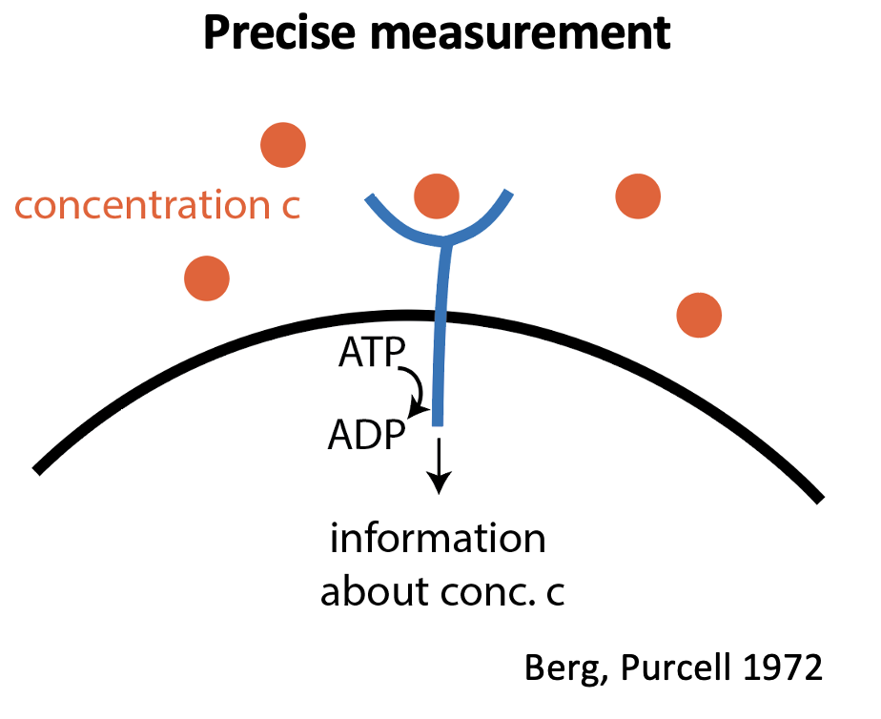
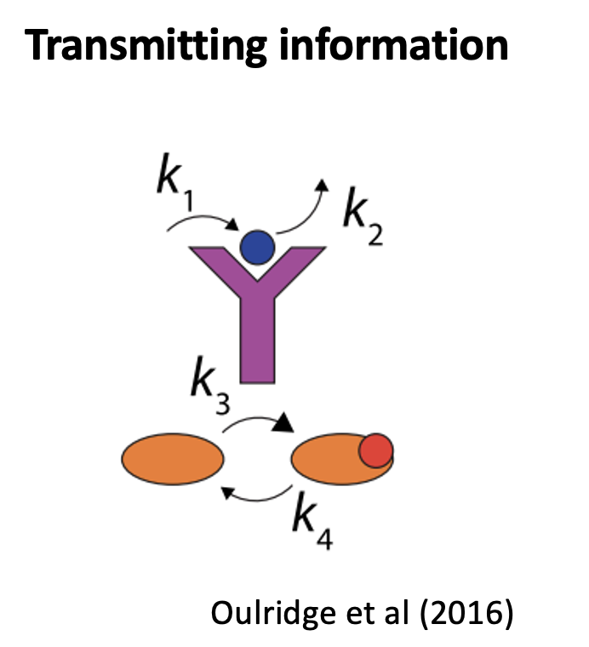
Origin of Maxwell Demons
2nd law of thermodynamics
Living things
before
some time later
Energy source
Heat
Things fall apart over time..
Things stay ordered preserve information… Maxwell Demon.
=> Must be polluting elsewhere
Notes:
This is exciting because we know the 2nd law cannot be violated so easily.. so everytime this happens, we look and find an active procerss which consumes energy and releases heat increasing the entropy of the rest of the universe. We call such active mechanisms a maxwell demon. – think of a little molecular robot.

Slide 4
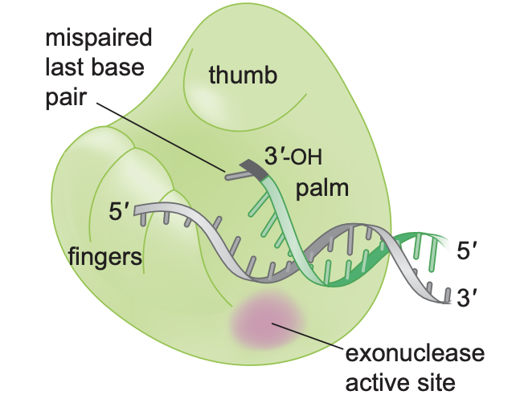
Origin of Maxwell Demons
2nd law of thermodynamics
New question:
When does non-equilibrium coupling spontaneously emerge?
much before
before
later
Energy source
Heat
Things fall apart over time..
Things stay ordered preserve information… Maxwell Demon.
=> Must be polluting elsewhere
Notes:
Today, I want to expand this picture beyond how do these Demons work to create order but ask – under what circumstances do they show up in the first place?
From a physics perspective, a Demon is a house cleaning robot with a battery and you may want to figure out how the robot works. But biologically, the robot and the coupling to a battery itself evolved. my question is – under what conditions will matter evolve to pick up a battery and start creating order in the first place.
I want to focus on one Maxwell Demon - the machine that copies your DNA when you want to have children – both because it is the best experimentally characterized Demon and because it shapes the nature of evolution itself.
Let me explain for those who don’t think about evolution..

Slide 5
Origin of Maxwell Demons
When does non-equilibrium coupling spontaneously emerge?
Physics answer
Spontaneous behavior of all matter
(e.g., Prigogine, England..)
much before
before
later
Our suggestion
Inevitable conseq. of self-replication
(assume no benefit for order)
Energy source
Heat
Usual Darwinian answer
Order confers fitness benefit
Notes:
Today, I want to expand this picture beyond how do these Demons work to create order but ask – under what circumstances do they show up in the first place?
From a physics perspective, a Demon is a house cleaning robot with a battery and you may want to figure out how the robot works. But biologically, the robot and the coupling to a battery itself evolved. my question is – under what conditions will matter evolve to pick up a battery and start creating order in the first place.
I want to focus on one Maxwell Demon - the machine that copies your DNA when you want to have children – both because it is the best experimentally characterized Demon and because it shapes the nature of evolution itself.
Let me explain for those who don’t think about evolution..

Slide 6

Non-equilibrium ordering mechanisms
through fast self-replication
Key ingredient
Non-equilibrium mechanism
Templated replication
Stalling
Proofreading
Geometric frustration
Self-assembly
Dynamic instability
Navigating
high-dim spaces
Highly variable replication times
Resets

Slide 7
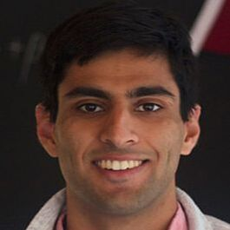
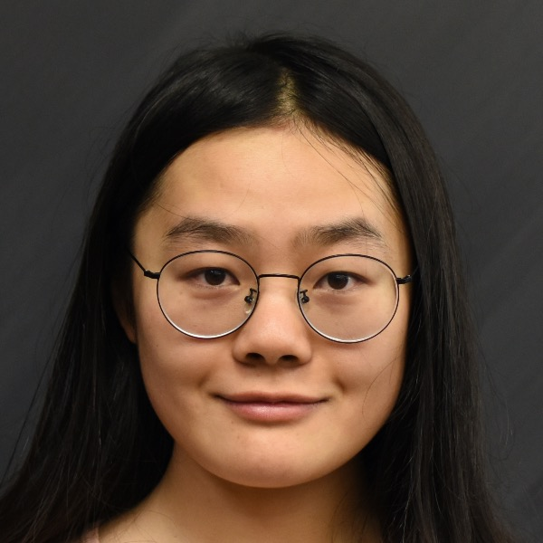


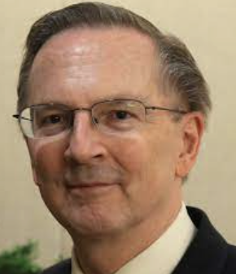
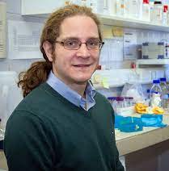
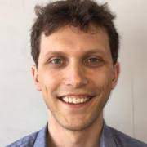
People
Vedant Sachdeva Wanqiang Liu
Riccardo Ravasio
Kabir Husain
(Now faculty at UCL)
Jack Szostak
U Chicago
Marco Ribezzi
ESPCI
Ben Good
Stanford

Slide 8
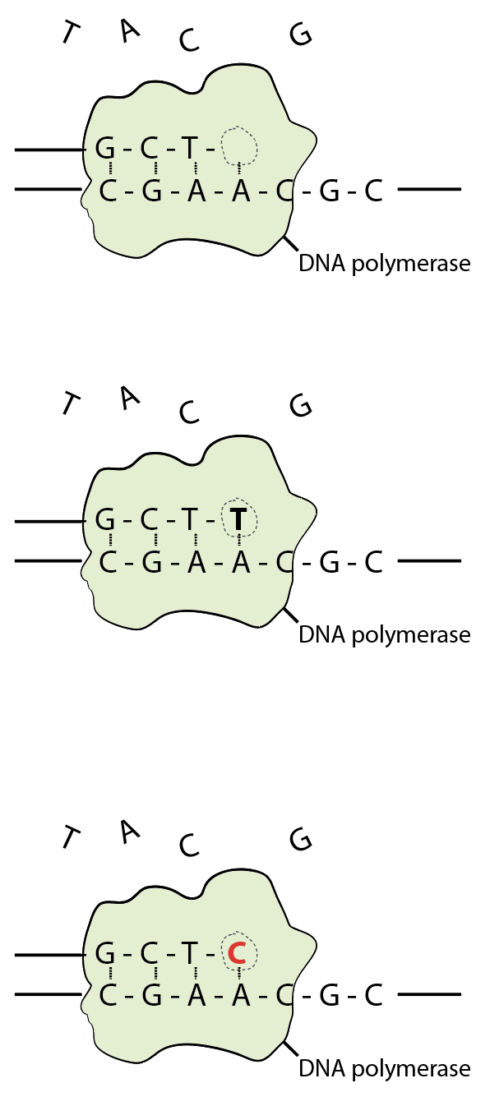
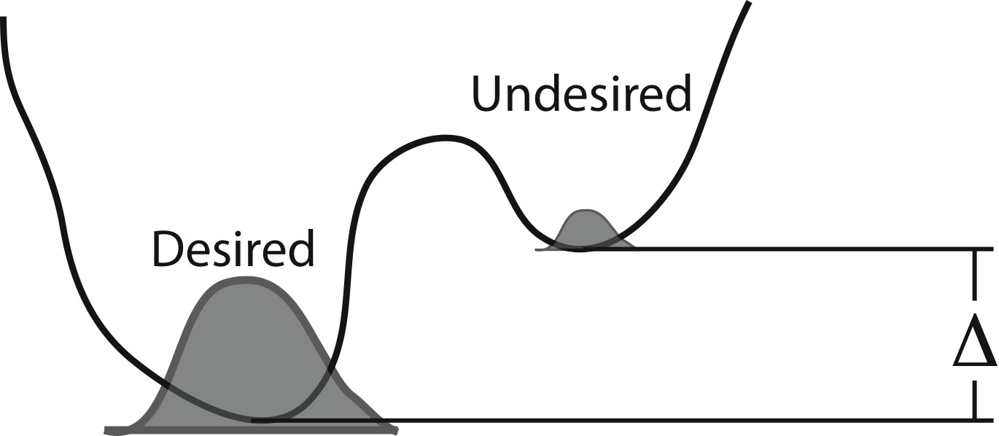
Thermodynamics of variation
A-C
A-T
Notes:
Script:
The polymerase is a machine that walks along the DNA and grabs these floating bases, inserts and joins them to the DNA backbone by catalyzing a bond there. We hope it grabs and inserts T because that’s the right answer but it could also pick up an insert a C.
The only thing preventing that is that the A-C bond is of higher energy than the A-T bond, so A-C is favored. But the energy difference delta is finite, the temperature is non-zero .. So you will make some mistakes.
/Script

Slide 9


Thermodynamics of variation
A-C
A-T
Notes:
Script:
So here is a short simple primer to molecular specificity and a model of what could be happening based losely on the facts..
First, why do polymerases make mistakes in the first place? One model is that the polymerase is going along, making a templated copy. We know the desired or right nucleotide at this spot is T but G is unfavored only by a finite binding energy Delta.. So at finite temperature, you can and will incorporate G at a rate set by the Boltzman factor or worse.
[This isn’t the only discriminatory rxn – in fact, in reality, the catalytic rate of making the phosphodiester bond is also different because..]
The main point is that the wrong stuff is kinetically or energetically less likely to happen but has some finite rate.
/Script

Slide 10
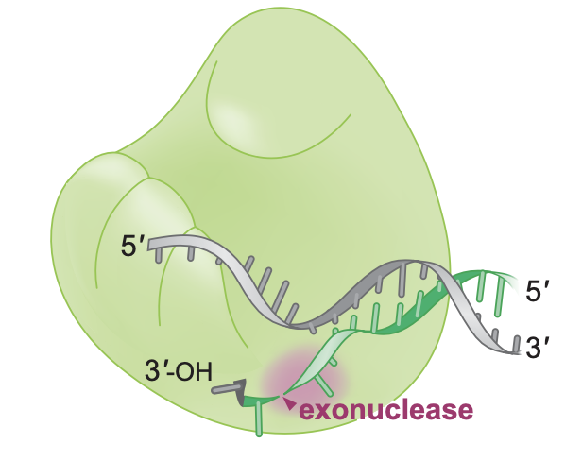
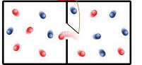
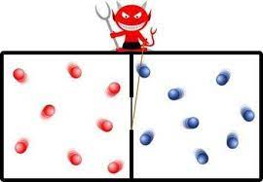
Thermodynamics of variation
Proofreading:
An evolved non-equilibrium mechanism to reduce errors
Uses ATP
A-C
Multistep process – slows reaction
Consumes energy
A-T
Hopfield 1974
Ninio 1975
Notes:
Script:
So here is a short simple primer to molecular specificity and a model of what could be happening based losely on the facts..
First, why do polymerases make mistakes in the first place? One model is that the polymerase is going along, making a templated copy. We know the desired or right nucleotide at this spot is T but G is unfavored only by a finite binding energy Delta.. So at finite temperature, you can and will incorporate G at a rate set by the Boltzman factor or worse.
[This isn’t the only discriminatory rxn – in fact, in reality, the catalytic rate of making the phosphodiester bond is also different because..]
The main point is that the wrong stuff is kinetically or energetically less likely to happen but has some finite rate.
/Script

Slide 11
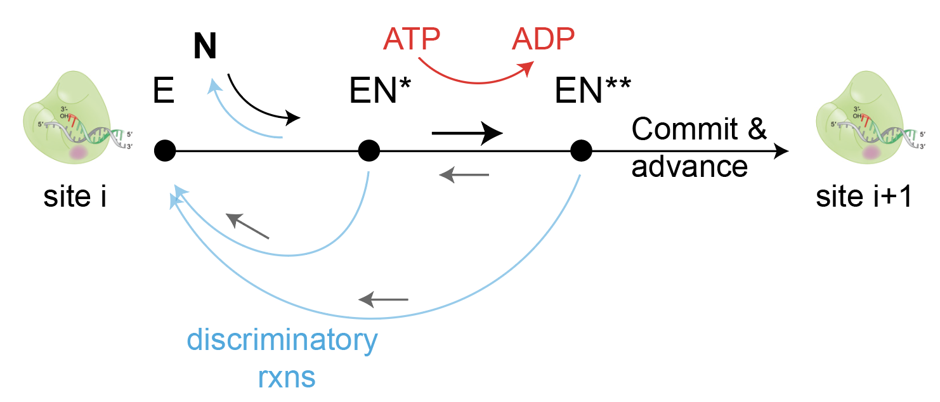
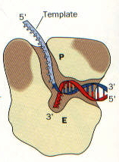
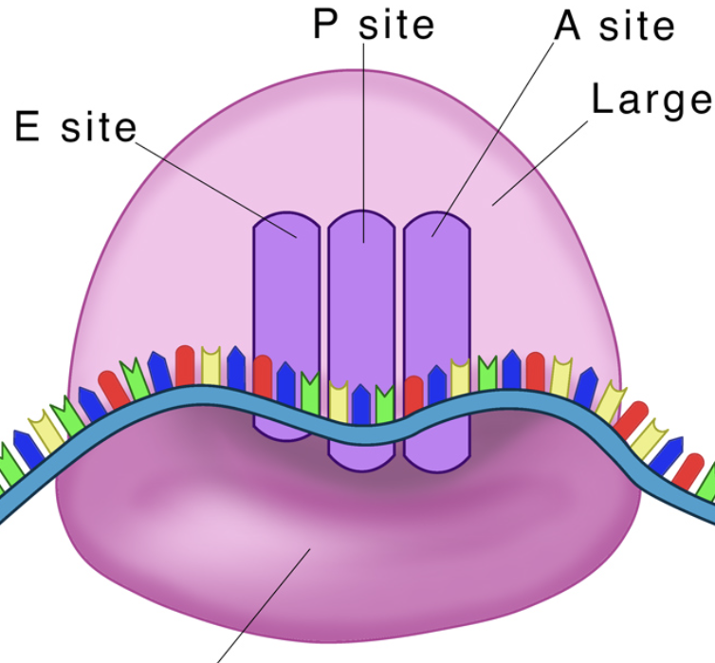
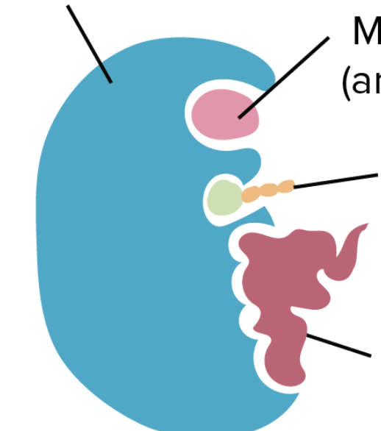
Thermodynamics of variation
Proofreading:
An evolved non-equilibrium mechanism to reduce errors
A-C
Multistep process – slows reaction
Consumes energy
A-T
Hopfield 1974
Ninio 1975
DNA polymerase
Ribosome
tRNA charging
Notes:
Script:
So here is a short simple primer to molecular specificity and a model of what could be happening based losely on the facts..
First, why do polymerases make mistakes in the first place? One model is that the polymerase is going along, making a templated copy. We know the desired or right nucleotide at this spot is T but G is unfavored only by a finite binding energy Delta.. So at finite temperature, you can and will incorporate G at a rate set by the Boltzman factor or worse.
[This isn’t the only discriminatory rxn – in fact, in reality, the catalytic rate of making the phosphodiester bond is also different because..]
The main point is that the wrong stuff is kinetically or energetically less likely to happen but has some finite rate.
/Script

Slide 12
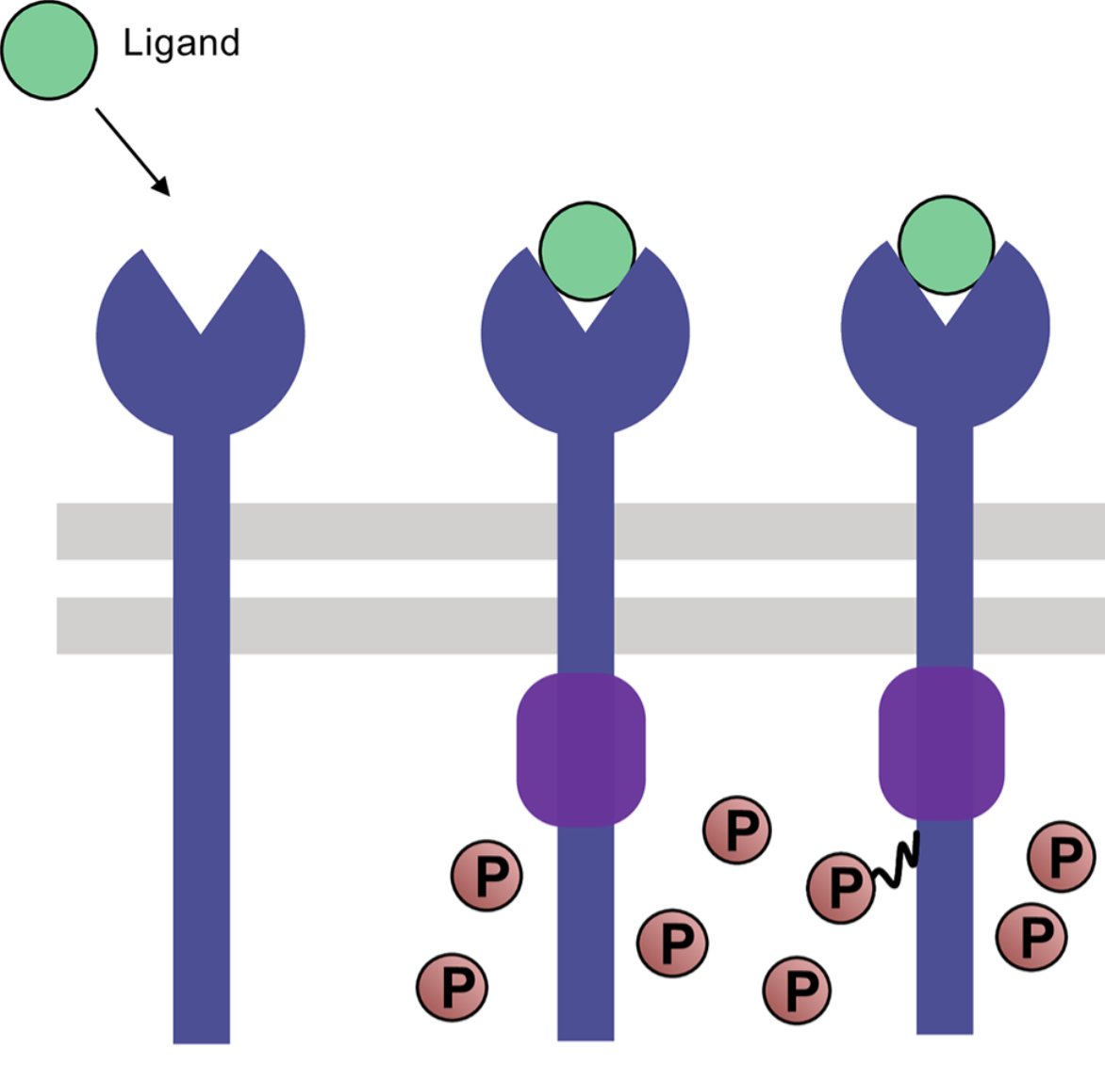
Thermodynamics of variation
All over the Central Dogma…
Proofreading:
An evolved non-equilibrium mechanism to reduce errors
DNA polymerase
Ribosome
tRNA charging
+ other places
Multistep process – slows reaction
Consumes energy
Hopfield 1974
Ninio 1975
T cell receptors
DNA polymerase
Ribosome
tRNA charging
Notes:
Script:
So here is a short simple primer to molecular specificity and a model of what could be happening based losely on the facts..
First, why do polymerases make mistakes in the first place? One model is that the polymerase is going along, making a templated copy. We know the desired or right nucleotide at this spot is T but G is unfavored only by a finite binding energy Delta.. So at finite temperature, you can and will incorporate G at a rate set by the Boltzman factor or worse.
[This isn’t the only discriminatory rxn – in fact, in reality, the catalytic rate of making the phosphodiester bond is also different because..]
The main point is that the wrong stuff is kinetically or energetically less likely to happen but has some finite rate.
/Script

Slide 13
Theory

Slide 14
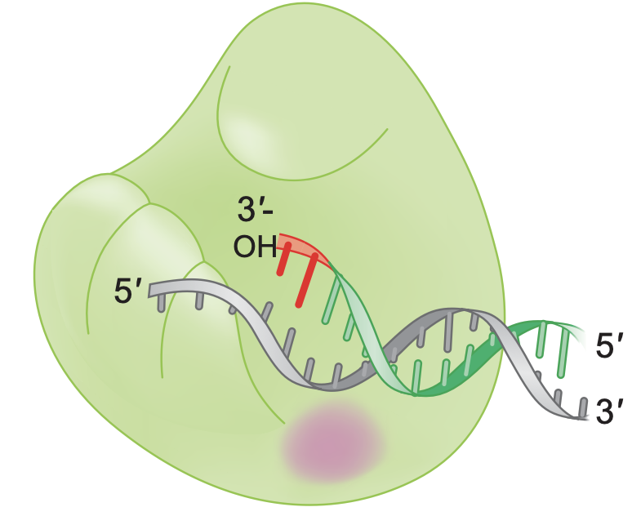
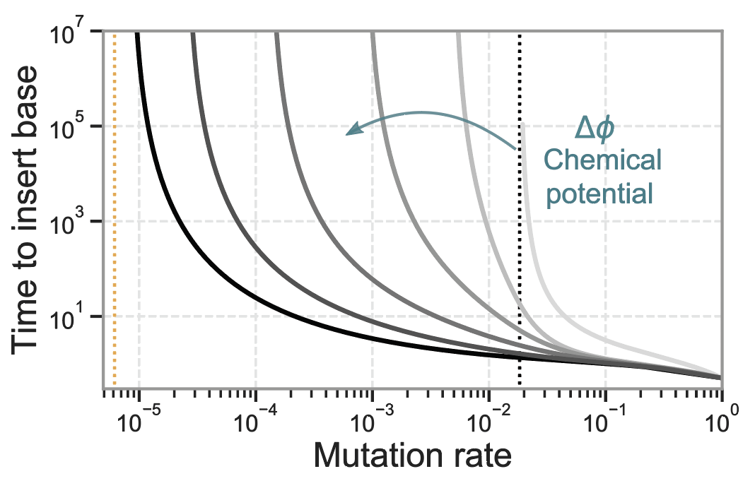
Naïve: Higher accuracy => lower speed
Hopfield 74, Ninio 75,…
Will you seek out energy sources to lower mu due to need for speed?
Notes:
Script:
Now for the more non-equilibrium proofreading enzymes which is what our experiments are with. The bottom line is that these non-equilibrium effects also give you a speed-error tradeoff for single nucleotides as earlier.. but the curves are softer, i.e., they stay flat for longer, because the origin is different. More energy consumption, more non-eq steps, flatter the curves. So when you combine that with the stalling line, the turn-around point is much later.. so you get a bigger blue region where faster means more accurate.
I’ll give you just a sense of how this comes about.
Proofreading essentially involves the enzyme and nucleotide going through multiple intermediates EN*, EN** etc shown before the polymerase actually commits and advances to the next site.
Each of these intermediates allows for the rxn to fall apart and be reset back to the start.. And such resets are a little more likely to happen for the wrong nucleotide than the right one.
It’s a non-trivial idea because as suggested by the figure the discriminatory rxns are all in parallel and not series.. And yet these filtering events add up in series.
Now all of this requires several rxns here to be nearly irreversible or more technically, breaking detailed balance in the loops of this network, so you need ATP coupling.
…
/Script
Now proofreading polymerases changes this picture in one important way.

Slide 15
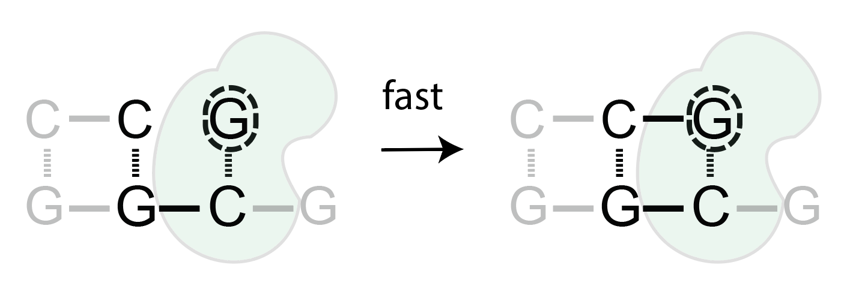
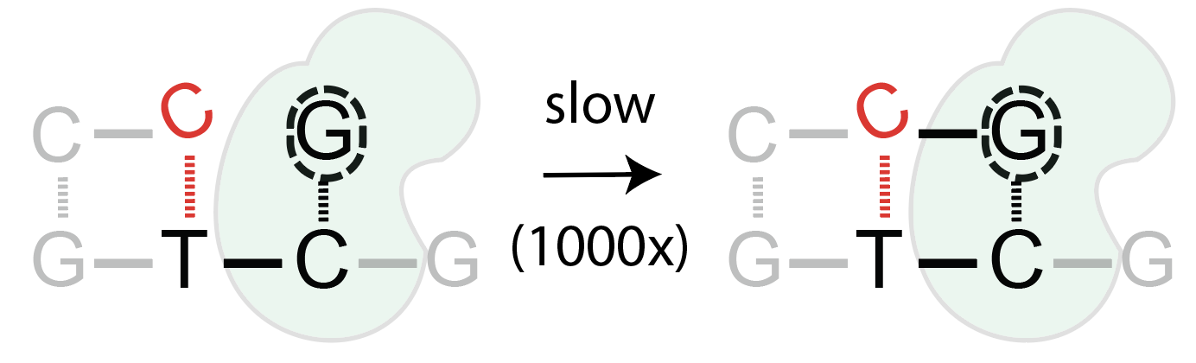
Stalling
vs
DNA polymerases: Johnson & Beese 2004 + others
RNA polymerases: Sydow et al 2009 + Shaevitz et al 2003 + others
Non-enzymatic replication: Chen + Szostak
Rajamani et al 2010

Slide 16
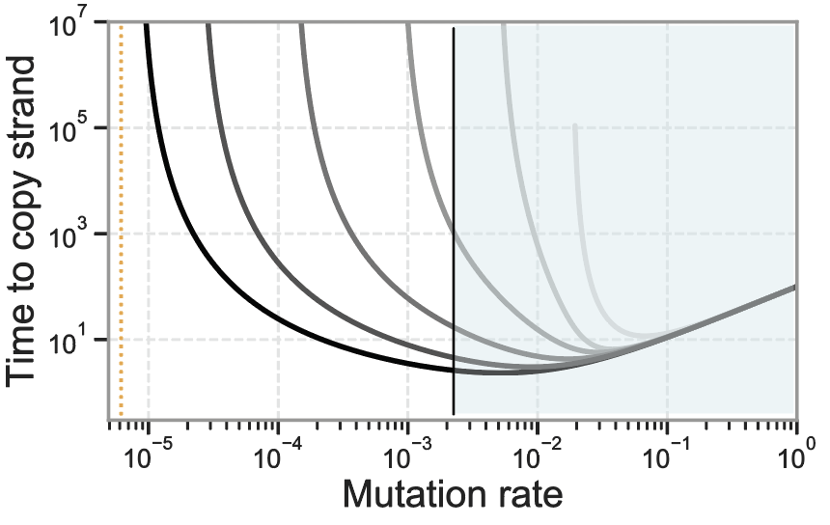

Stalling : Higher speed => higher accuracy
Conclusion: Slower <=> more accurate
Stalled time
Conclusion: Faster <=> more accurate
Evolve proofreading through
selection for higher speed???
Mut rate
Will you seek out energy sources to lower mu due to need for speed?
Notes:
Script:
Now for the more non-equilibrium proofreading enzymes which is what our experiments are with. The bottom line is that these non-equilibrium effects also give you a speed-error tradeoff for single nucleotides as earlier.. but the curves are softer, i.e., they stay flat for longer, because the origin is different. More energy consumption, more non-eq steps, flatter the curves. So when you combine that with the stalling line, the turn-around point is much later.. so you get a bigger blue region where faster means more accurate.
I’ll give you just a sense of how this comes about.
Proofreading essentially involves the enzyme and nucleotide going through multiple intermediates EN*, EN** etc shown before the polymerase actually commits and advances to the next site.
Each of these intermediates allows for the rxn to fall apart and be reset back to the start.. And such resets are a little more likely to happen for the wrong nucleotide than the right one.
It’s a non-trivial idea because as suggested by the figure the discriminatory rxns are all in parallel and not series.. And yet these filtering events add up in series.
Now all of this requires several rxns here to be nearly irreversible or more technically, breaking detailed balance in the loops of this network, so you need ATP coupling.
…
/Script
Now proofreading polymerases changes this picture in one important way.

Slide 17
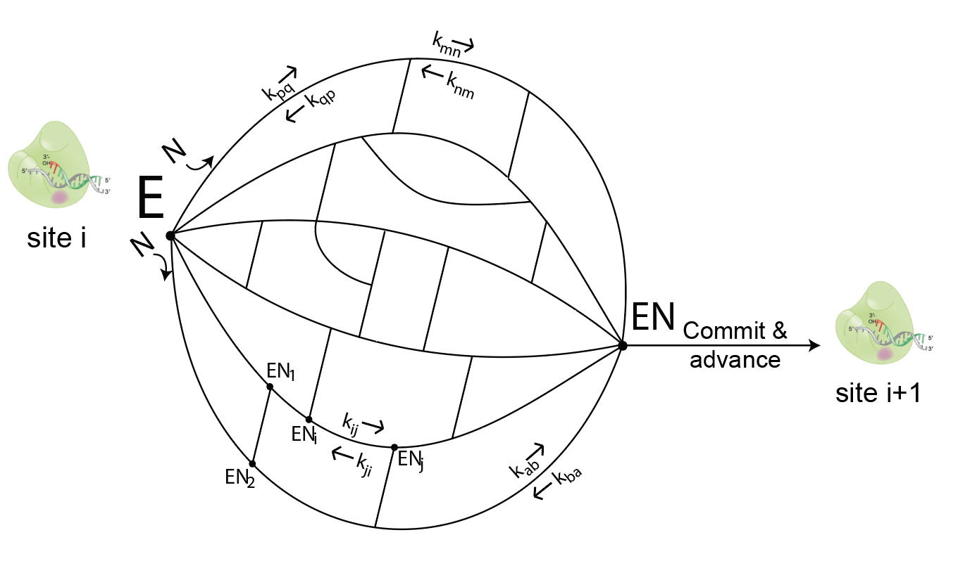
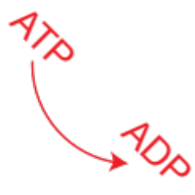

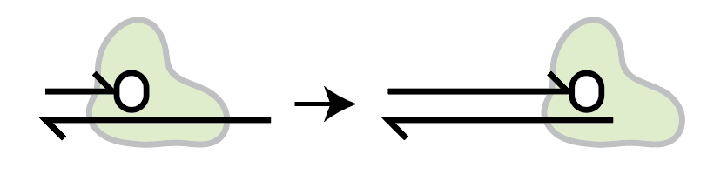
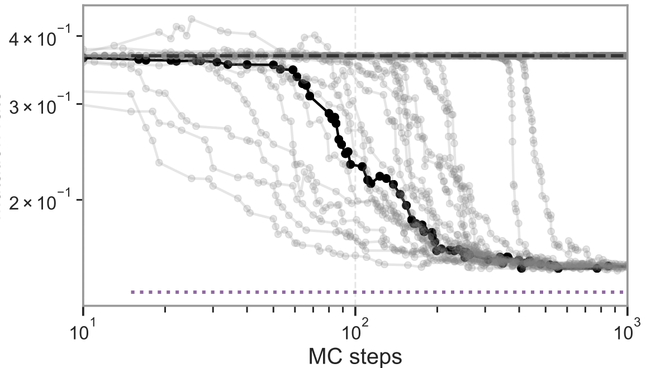
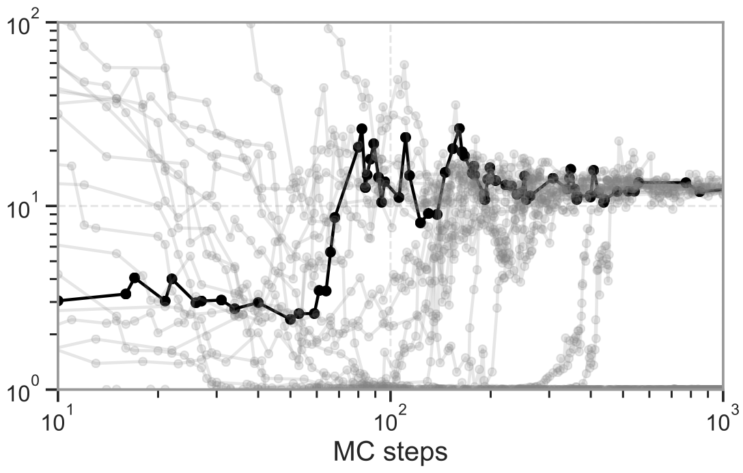
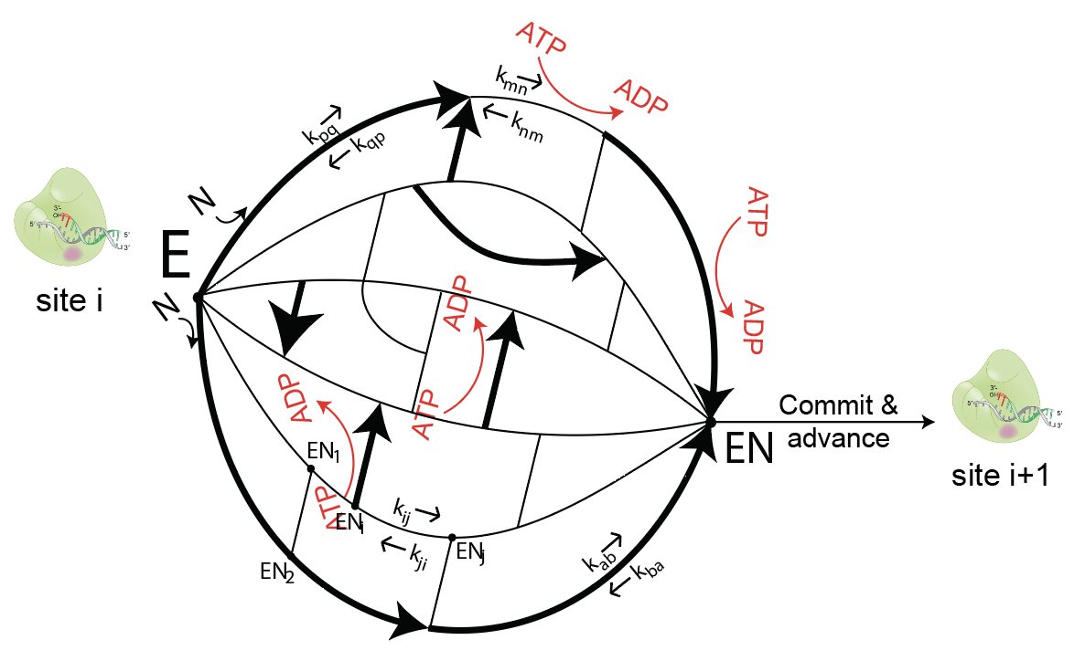
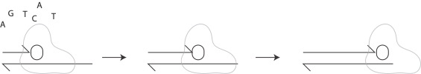
In-silico evolution of a polymerase for speed
Initial condition: Random kinetics w/ Detailed Balance
Allowed `mutations’:
All Kinetic rates
ATP-ADP coupling to any rxn
Fitness function:
Time[
]
N.B: We don’t care what the resulting sequence is
Result:
Mutation rate
Time per base
To be fast, be slow and accurate (i.e., proofread)

Slide 18
Copy a 100-word essay as fast as possible
Rules:
I will not read it
Score = time to copy full essay
Proofreading
Not proofreading
(5 sec/word)
(1 sec/word)

Slide 19
Copy a 100-word essay as fast as possible
Rules:
I will not read it
Score = time to copy full essay
Proofreading
Not proofreading
(5 sec/word)
(1 sec/word)
These laws
These laws, taken in the largest sense, being growth with reproduction

Slide 20
Copy a 100-word essay as fast as possible
Rules:
I will not read it
Score = time to copy full essay
Proofreading
Not proofreading
(5 sec/word)
(1 sec/word)
These laws, taken
These laws, taken in the largest sense, being growth with reproduction variability from the indirect BANANA

Slide 21
Copy a 100-word essay as fast as possible
Rules:
I will not read it
Score = time to copy full essay
Proofreading
Not proofreading
STALLED!
(5 sec/word)
(1 sec/word)
These laws, taken in the largest sense, being
These laws, taken in the largest sense, being growth with reproduction variability from the indirect BANANA

Slide 22
Copy a 100-word essay as fast as possible
Rules:
I will not read it
Score = time to copy full essay
Proofreading
Not proofreading
STALLED!
(5 sec/word)
(1 sec/word)
These laws, taken in the largest sense, being growth with reproduction; inheritance which is almost implied by reproduction; variability from the indirect and direct action of the conditions of life, and from use and disuse; a ratio of Increase so high as to lead to a struggle for life, and as a consequence to natural selection, entailing divergence
These laws, taken in the largest sense, being growth with reproduction variability from the indirect BANANA

Slide 23
Copy a 100-word essay as fast as possible
Rules:
I will not read it
Score = time to copy full essay
Proofreading
Not proofreading
(5 sec/word)
(1 sec/word)
These laws, taken in the largest sense, being growth with reproduction; inheritance which is almost implied by reproduction; variability from the indirect and direct action of the conditions of life, and from use and disuse; a ratio of Increase so high as to lead to a struggle for life, and as a consequence to natural selection, entailing divergence
These laws, taken in the largest sense, being growth with reproduction variability from the indirect BANANA direct action of the conditions

Slide 24
Copy a 100-word essay as fast as possible
Rules:
I will not read it
Score = time to copy full essay
WINNER OF SPEED CONTEST!
Proofreading
Not proofreading
(5 sec/word)
(1 sec/word)
These laws, taken in the largest sense, being growth with reproduction; inheritance which is almost implied by reproduction; variability from the indirect and direct action of the conditions of life, and from use and disuse; a ratio of Increase so high as to lead to a struggle for life, and as a consequence to natural selection, entailing divergence of character and the extinction of less improved forms.
These laws, taken in the largest sense, being growth with reproduction variability from the indirect BANANA direct action of the conditions of life, and from use and disuse; a ratio of Increase so high as to lead to a struggle for life, and

Slide 25
Experiments

Slide 26
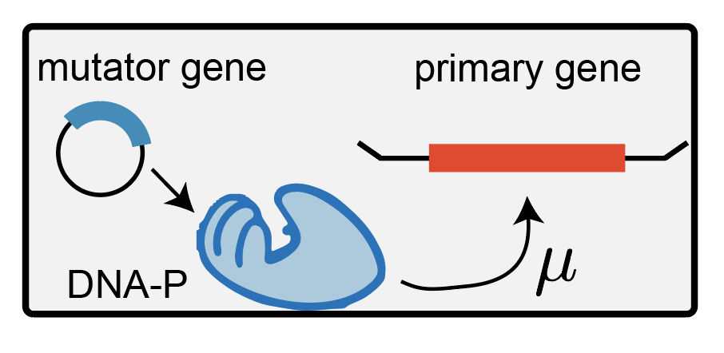
Orthorep – ideal setup for polymerase evol.
‘Indirect’ directed evolution of polymerases
Direction selection
Primary gene
Known fitness landscape
Mutator gene
Proofreading DNA polymerase
Notes:
Script:
To study the evolution of such a polymerase experimentally, you need a system like this where the polymerase is copying something like the neck length gene in red about which you know everything and can control selection. e.g., you should be able to select on longer or shorter necks to different extents and also know exactly how many mutations will let this neck gene will result in longer necks.
You never know these things in most natural contexts.. but just before the pandemic …
/Script:

Slide 27
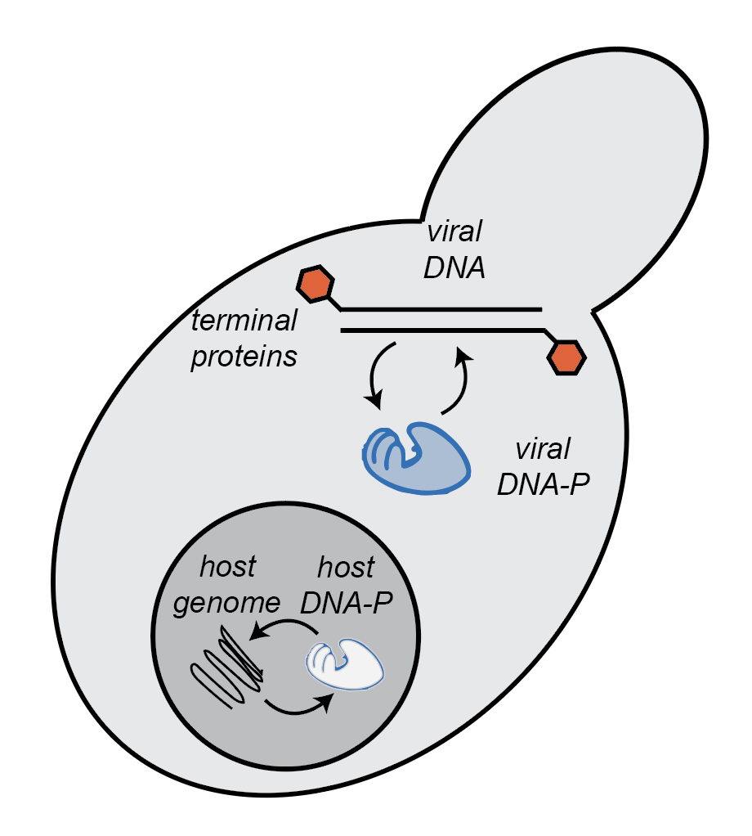
Controlled evolution of DNA polymerases
S. cerevisiae
Primary gene
Known fitness landscape
Mutator gene
Proofreading DNA polymerase
Orthogonal self-replicative plasmid in yeast
(Orthorep)
C. Liu lab, Cell 2018
BETTER IMAGE WITH YEAST
+ IMAGE OF DNA VIRUS WITH TP
Notes:
Script:
But shortly before the pandemic, Chang Liu's lab at UC-I published on this natural system that we could co-opt for exactly this.
Some strains of yeast have this piece of DNA of viral origin in the cytoplasm that essentially a von Neumann model of life; this DNA codes for a DNA polymerase shown in blue which copies this DNA. The yeast DNA in the nucleus codes for its own machines that copy that DNA. And these two are completely orthogonal and so this little piece can evolve its copying machinery and mutation rate independently.

Slide 28
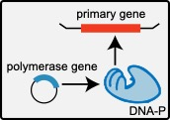
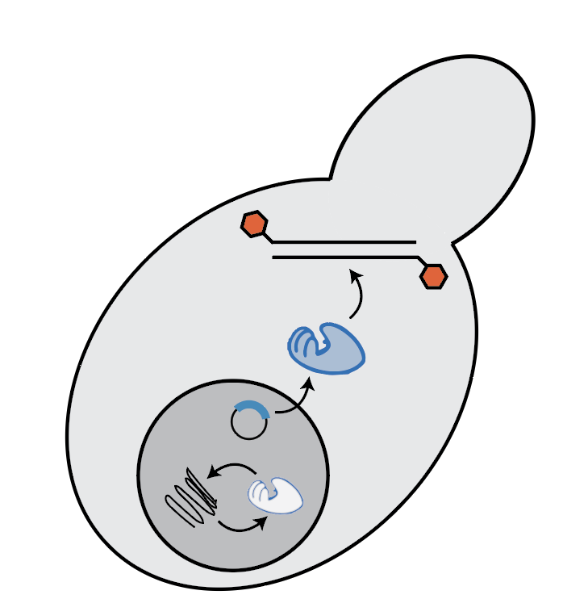
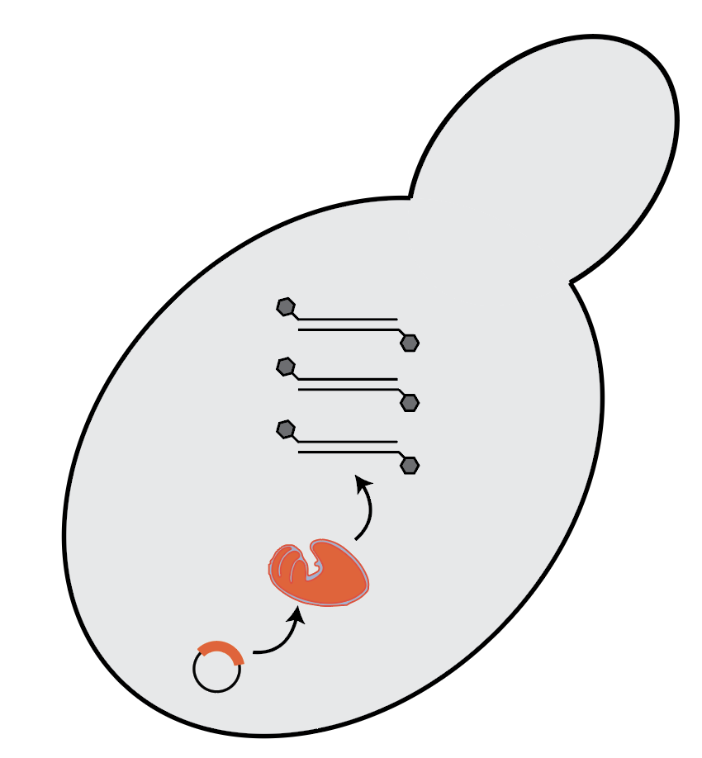
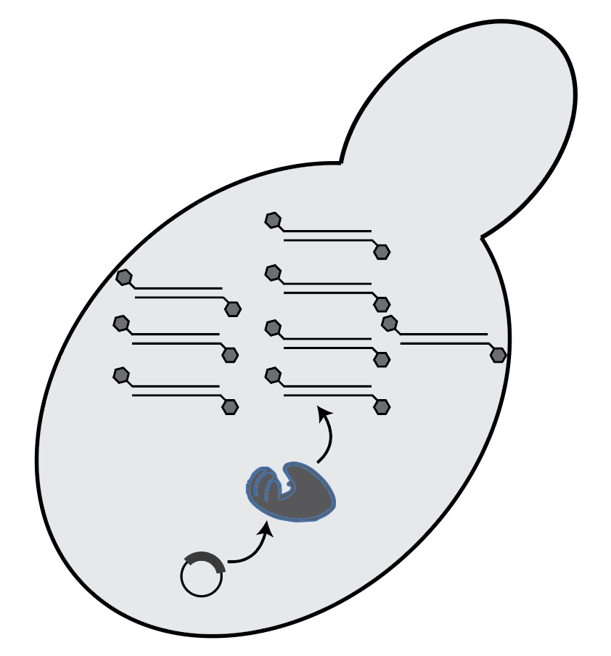
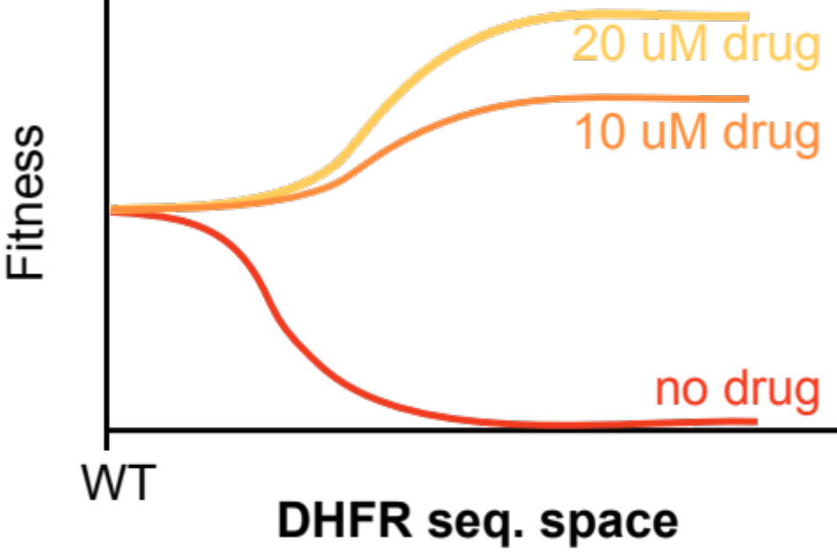
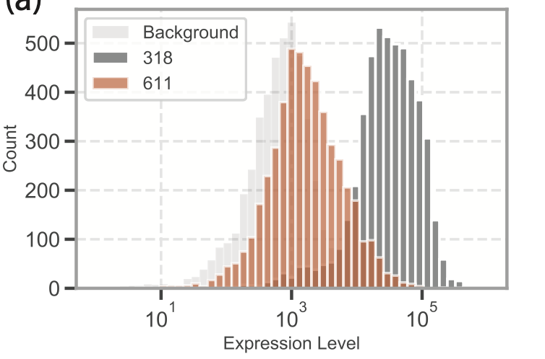
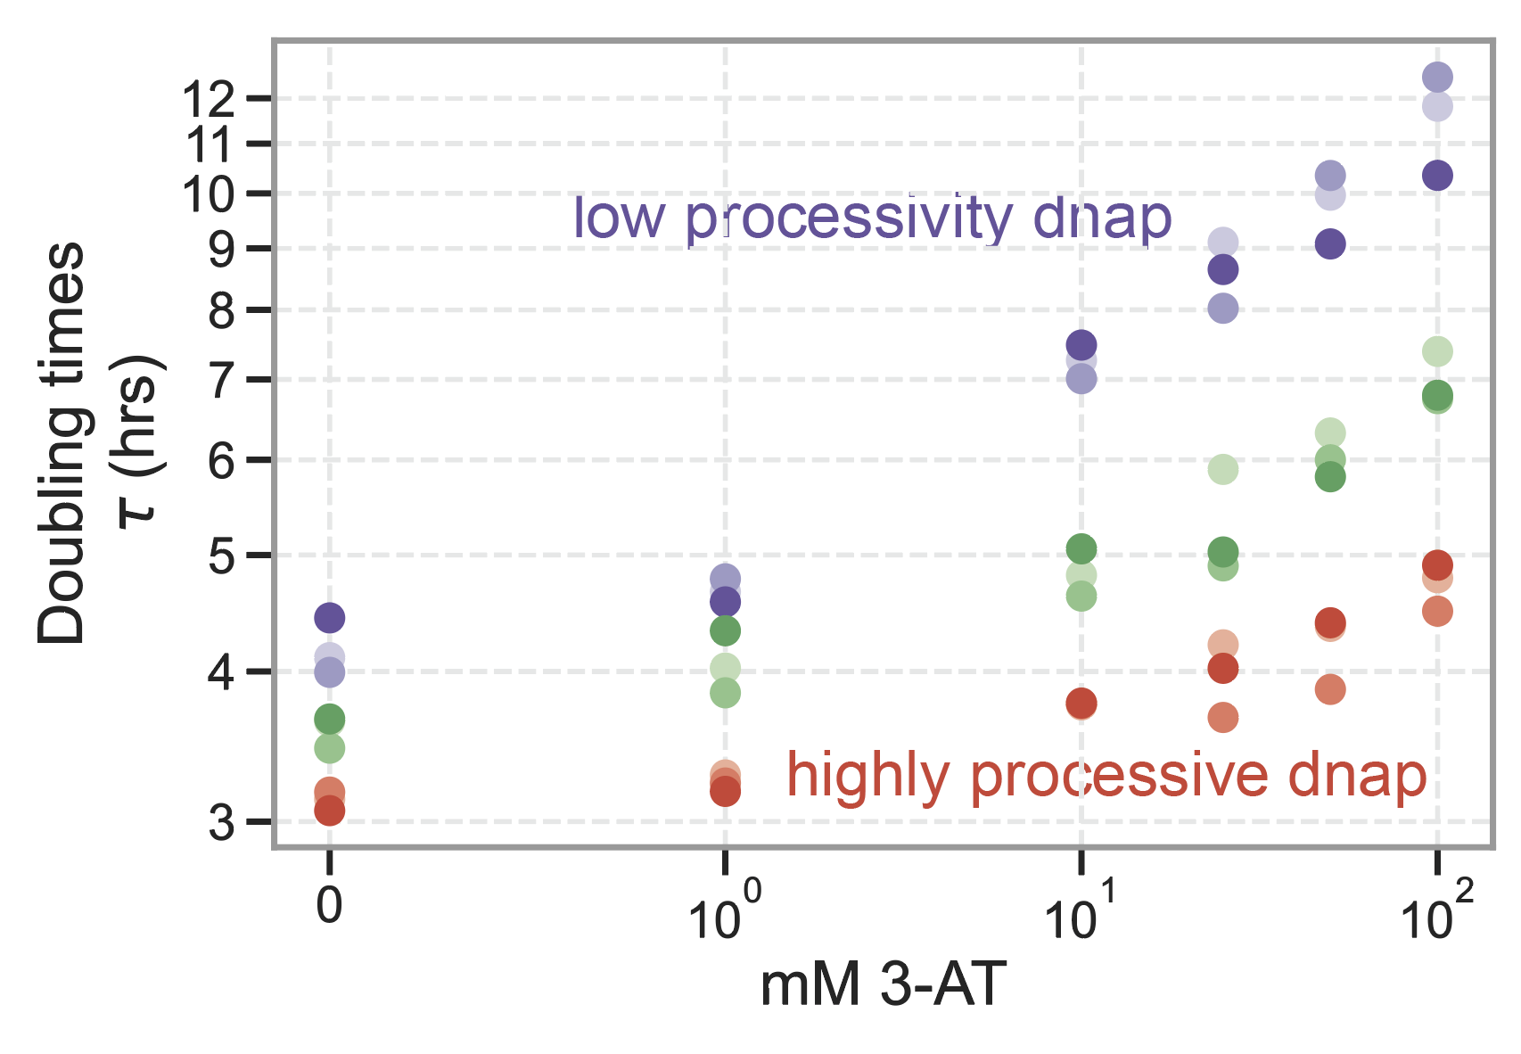
Controlled evolution of DNA polymerases
Direct
selection
Mutator gene
Proofreading DNA polymerase
Known genes
Slower DNA-Ps =>
Lower DNA copy number
his3 – ura3*
=> Lower primary expression
Functional
metabolic gene
Metabolic gene
disabled by stop codon (*)
+3AT
-uracil
Select for
speed
Select for
accuracy
Protein expression level
Notes:
Script:
So we adapted this system a bit and put the equivalent of neck length genes in the orange DNA.
Final detail – yeast don’t have necks like giraffes. So instead, we put a gene important for metabolism about which we know everything but the idea is the same thing. Much like necks can get longer, these metabolic enzymes can get better at what they do which will let those yeast cells have more children and take over.
Essentially, to most people in the field, the left is a technical detail and a tool to study the right hand side because they care about things like metabolic enzymes. We put in a well-characterized metabolic enzyme, so we study the evolution of the left.

Slide 29
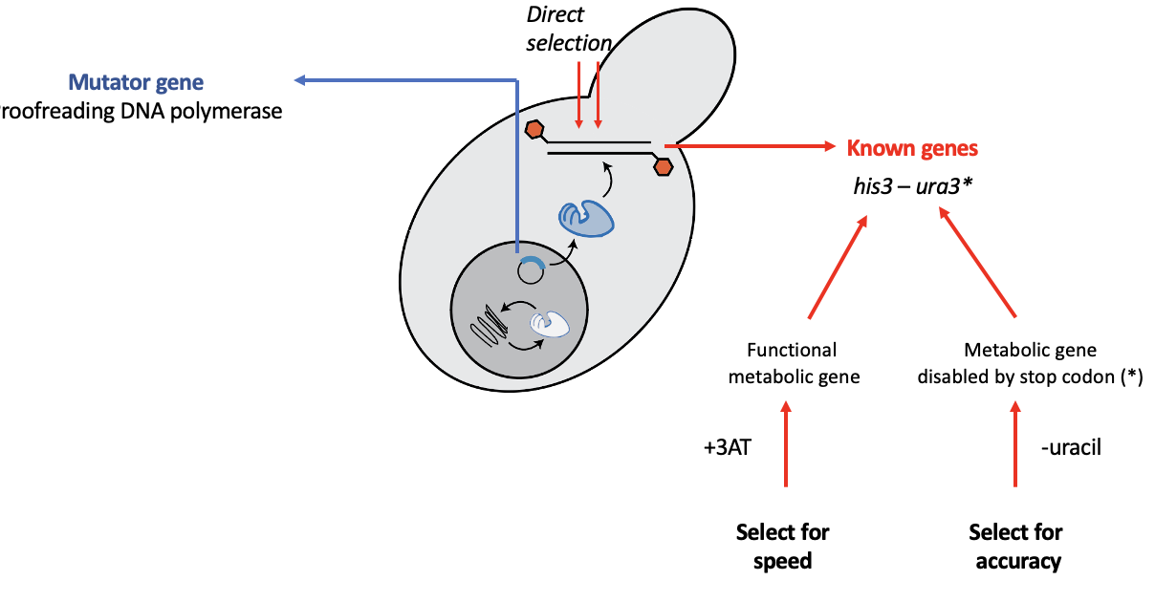
Controlled evolution of DNA polymerases
Orthorep
Chang Liu, Cell 2018
Notes:
Script:
So we adapted this system a bit and put the equivalent of neck length genes in the orange DNA.
Final detail – yeast don’t have necks like giraffes. So instead, we put a gene important for metabolism about which we know everything but the idea is the same thing. Much like necks can get longer, these metabolic enzymes can get better at what they do which will let those yeast cells have more children and take over.
Essentially, to most people in the field, the left is a technical detail and a tool to study the right hand side because they care about things like metabolic enzymes. We put in a well-characterized metabolic enzyme, so we study the evolution of the left.

Slide 30
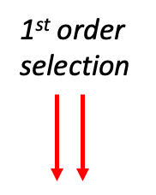
Controlled evolution of DNA polymerases
Known genes
2nd order selection
his3 – ura3*
Functional
metabolic gene
Metabolic gene
disabled by stop codon (*)
+3AT
-uracil
Orthorep
Chang Liu, Cell 2018
Select for
speed
Select for
accuracy
Notes:
Script:
So we adapted this system a bit and put the equivalent of neck length genes in the orange DNA.
Final detail – yeast don’t have necks like giraffes. So instead, we put a gene important for metabolism about which we know everything but the idea is the same thing. Much like necks can get longer, these metabolic enzymes can get better at what they do which will let those yeast cells have more children and take over.
Essentially, to most people in the field, the left is a technical detail and a tool to study the right hand side because they care about things like metabolic enzymes. We put in a well-characterized metabolic enzyme, so we study the evolution of the left.

Slide 31
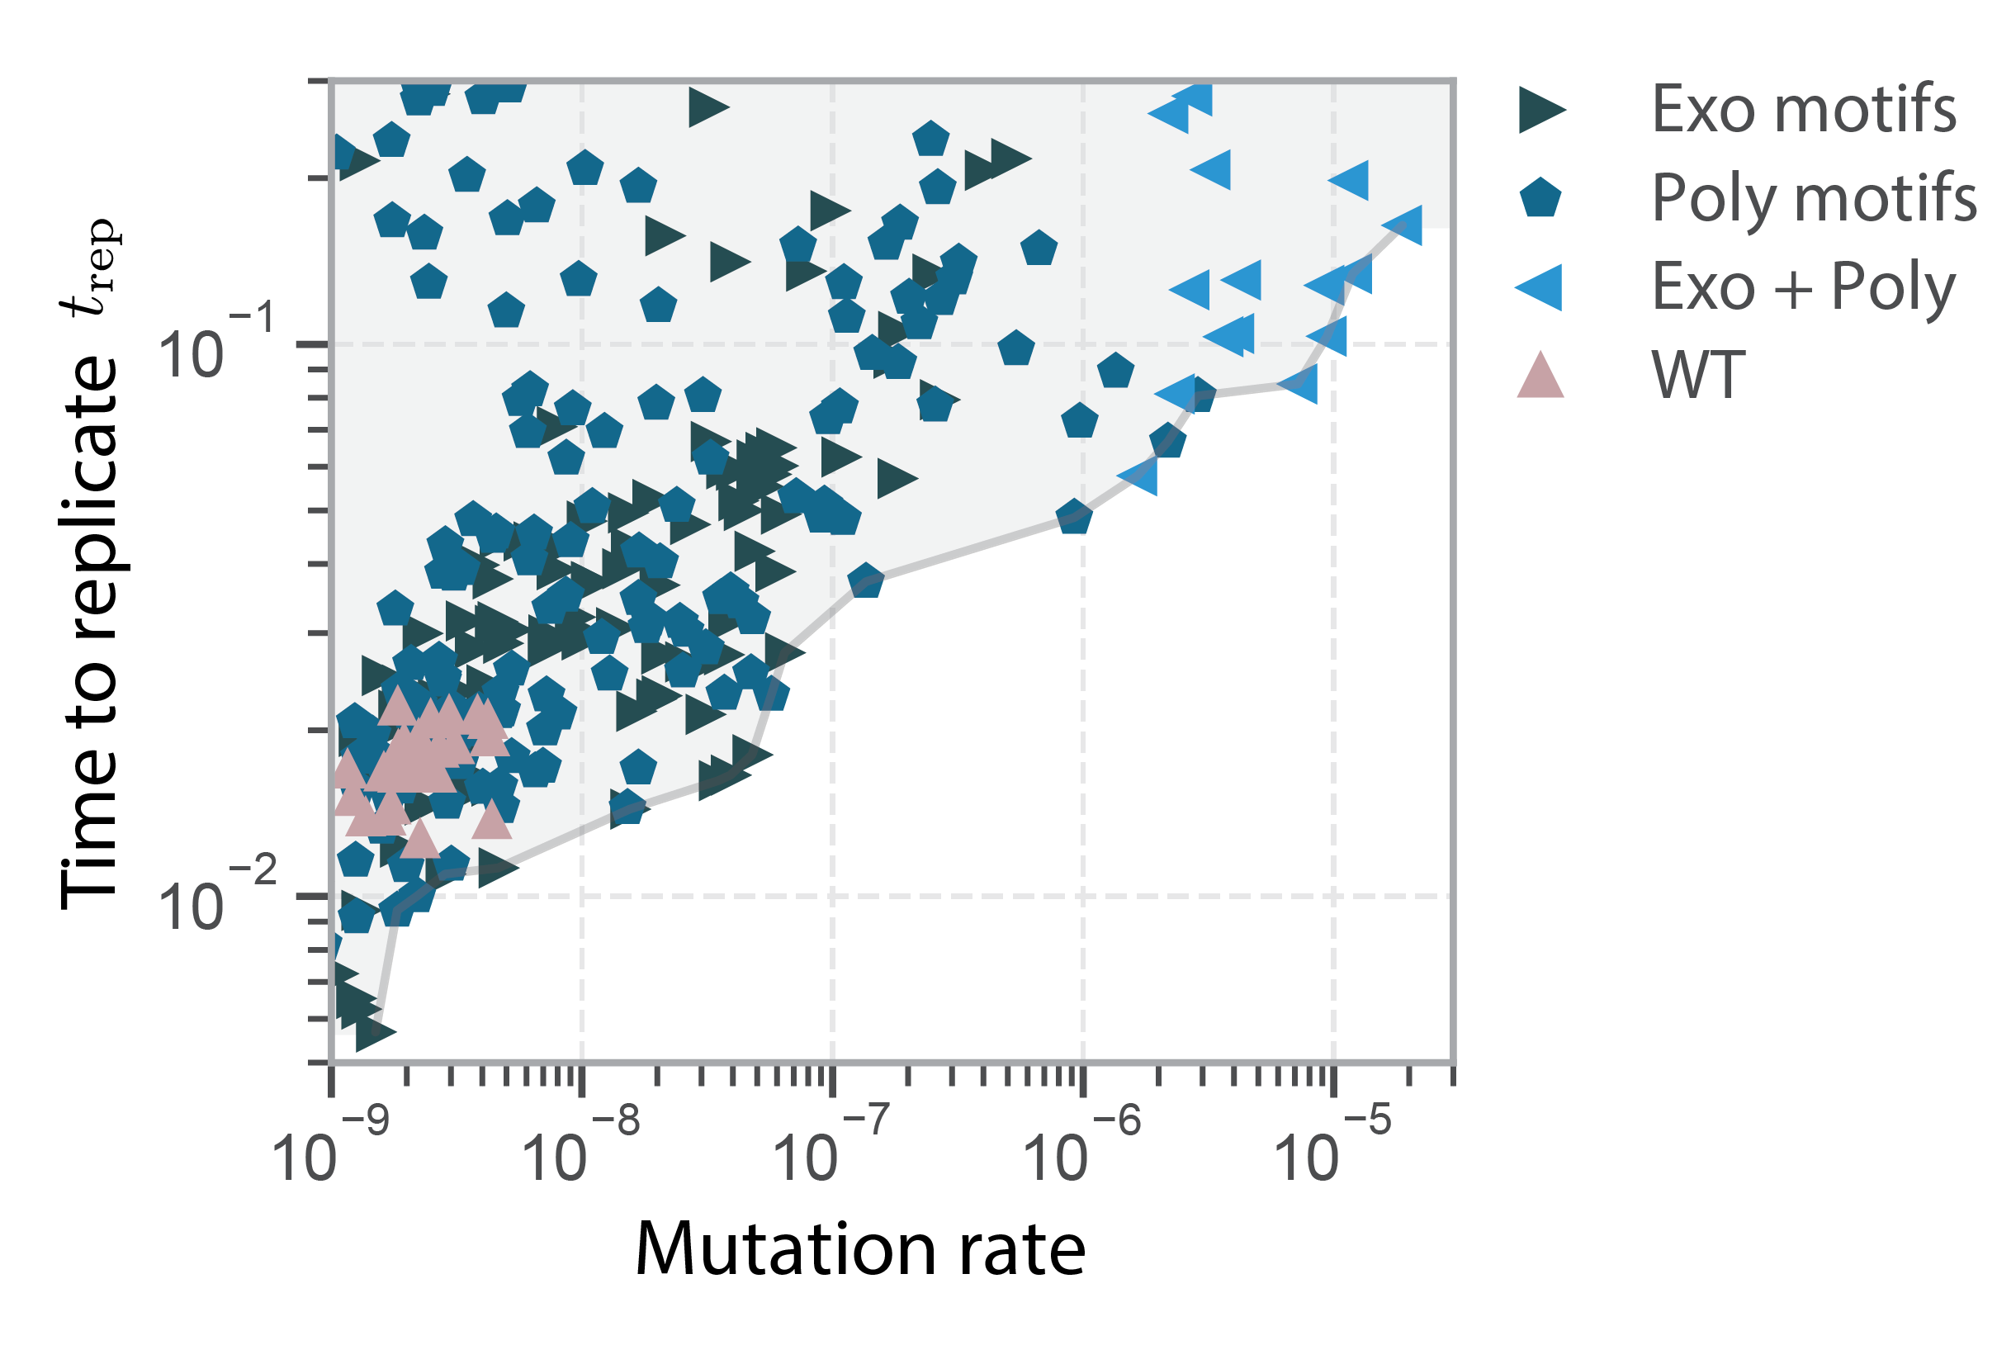
Controlled evolution of DNA polymerases
Accurate and slow = OK
Accurate and fast = OK
Inaccurate and fast = not OK
Ask inaccurate machine to go fast
=> Must become accurate
Orthorep
Chang Liu, Cell 2018
Notes:
Script:
So we adapted this system a bit and put the equivalent of neck length genes in the orange DNA.
Final detail – yeast don’t have necks like giraffes. So instead, we put a gene important for metabolism about which we know everything but the idea is the same thing. Much like necks can get longer, these metabolic enzymes can get better at what they do which will let those yeast cells have more children and take over.
Essentially, to most people in the field, the left is a technical detail and a tool to study the right hand side because they care about things like metabolic enzymes. We put in a well-characterized metabolic enzyme, so we study the evolution of the left.

Slide 32
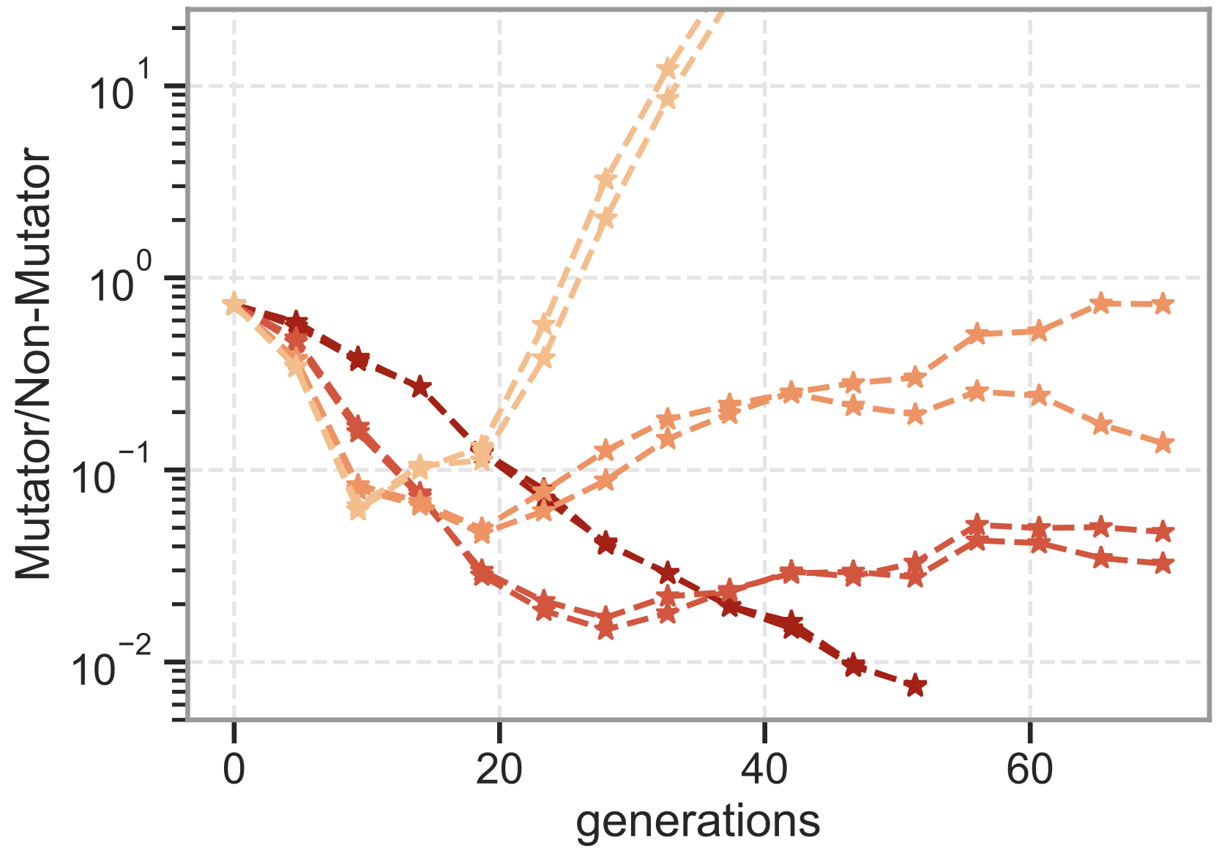
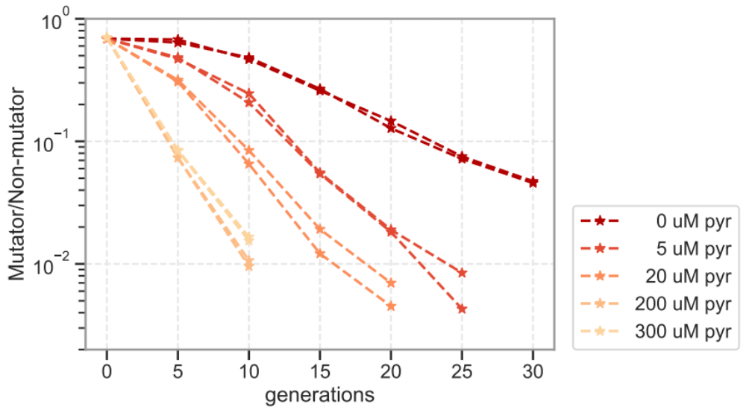


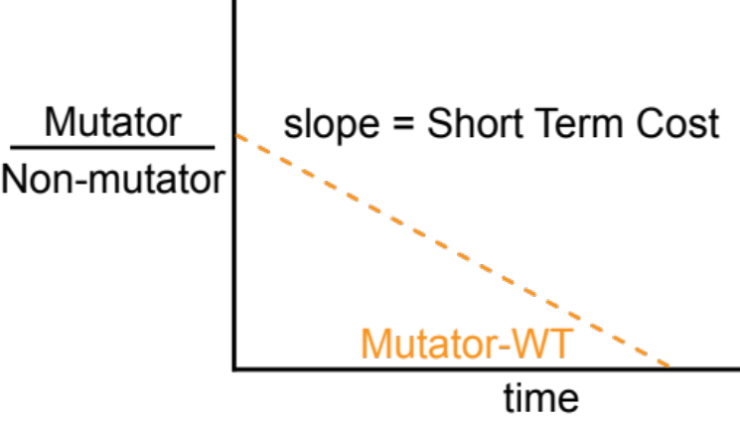
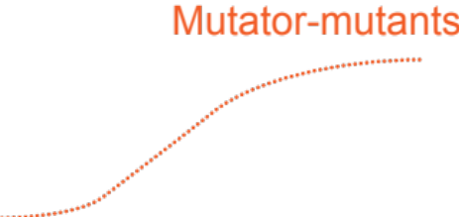
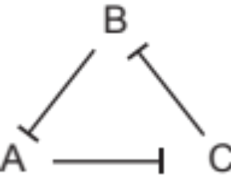


1. Conflict between 1st order (speed),2nd order (accuracy) selection
vs
Broadly true..
Poor proofreader
Enhanced proofreader
Long-term benefit
drug levels
(I)
0 uM
100 uM
Short term
cost
(II)
Data from C. Liu lab, Cell 2018
Rock-paper-scissors
(no “best” strain)
Notes:
Script: (problem) [Bring up tension between lineage and individual effects. Say LTB is a lineage level thing but STC is an individual level thing]
The result was a surprise. We see that Tom’s lineage does win under high pressure to improve metabolism (i.e., more drug).. But strangely, he always begins by losing before then taking over. In fact, the faster he loses, the faster his lineage wins.
It’s useful to separate out two features of this graph. The slope at long times when Tom does win, i.e., the long term benefit, has to do with improvements to his metabolism that his lineage discovers through faster evolution.
But there seems to be something else going on in the short term that makes Tom himself suffer relative to me. What could that short term cost be?
---
There has to be something else going to give this additional turnaround timescale..
That means mutation rate is only long term half the story: Sure, my higher mutation rate will help my children’s children discover improvements to metabolism. But there is a short term cost I have less of those metabolic enzymes.. that's going to affect me and my immediate children, making us lose to Tom's lineage initially, setting this initial downward slope... but eventually my great grand children pick up better metabolism and sweep up to fixation.
And those two distinct numbers explain why my mutator lineage must almost lose before it wins.
Classical pop. gen. theories aren't about this kind of funny situation but one can modify it to get a predictive model for what mutators will win.
/Script

Slide 33


Selecting for speed selects for accuracy
Select speed
Growth rates
vs
WT
WT + mutation
(reduced proofreading)
Select speed
Pairwise competition
vs
Mutator + Mutation
Mutator
(increased accuracy)

Slide 34
Selecting for speed selects for accuracy
Select speed
vs
WT
WT + mutation
(reduced proofreading)
Select speed
Data from C. Liu lab, Cell 2018
vs
Evolve proofreading through
selection for higher speed???
Mutator + Mutation
Mutator
(increased accuracy)

Slide 35





Next step
High-throughput Luria Delbruck (HiDenSeq)
Deep mutational scans of DNA polymerases
Nelson, Physical models
Kabir Husain
(Now faculty at UCL)

Slide 36



Are you just saying ….
… correcting errors takes time?
..stalling leads to proofreading?
.. mutations tend to “break” polymerases?
Don’t fix mistakes => Faster
(e.g., don’t use the exo)
Stall less => Less accurate and faster
1. Does not apply to non-WT DNAPs
2. Both traits should degrade independently
(assume such mutations exist)
=> Faster is less accurate
Not needed in our model mechanistically
Polym mistakes => stall => more likely to use exo
  => more accurate poly =>
No!
No!
No!
Parameters:
  Bare mutation rate (made by polymerase)
  How often exo-nuclease is called
  How long exo-takes to work
  Stalled time in catalyzing next base.
  Prob. of backtracking upon stalling and excising
None of these models predict faster is more accurate

Slide 37










Luria Delbruck x100000
Luria-Delbruck
Kabir Husain
Nelson, Physical models
Traditional LD
HiDenSeq (High Density LD by Seq.)
Tally barcodes
1945 Luria Delbruck: 87 replicates
Select
on plates
Sequence
barcodes
Replicates ~ 10^5 – 10^8
1945 Data: 87 replicates
Current record ~ 745 (Lang/Murray)?

Slide 38



Luria-Delbruck’s tail reveals evolutionary capacitors
Kabir Husain

Slide 39
Non-equilibrium ordering mechanisms
through fast self-replication
Key ingredient
Non-equilibrium mechanism
Templated replication
Stalling
Proofreading
Geometric frustration
Self-assembly
Dynamic instability
Navigating
high-dim spaces
Highly variable replication times
Resets

Slide 40

Self-replication limited by self-assembly

Slide 41



Self-assembly can stall due to kinetic traps
Red = off-target interactions

Slide 42



Self-assembly can stall due to kinetic traps
Off-target interaction
Tiles
Interaction matrix
C. Evans

Slide 43
Self-assembly can stall due to kinetic traps
Off-target interaction
Tiles
Interaction matrix
Stalled
C. Evans

Slide 44
Self-replication + disorder => Non-eq order
Red = off-target interactions
Assume:
  Random interactions
  Combinatorially many structures possible
  Cells divide when size(structure) > L
Claim:
Cells divide when size(structure) > L
=> Selects for speed
=> Selects ‘reset’ mechanisms (e.g., dynamic instability)
=> Selects for fastest trajectories
=> Results in order (i.e., specific structure)
Known:
  Wide distribution of assembly times (‘stalling’)
Show stalled configuration
+ going past stall

Slide 45
Off-target interaction
Cells dividing
Tiles
Interaction matrix
Photo
C. Evans

Slide 46
Stalled and not stalled assembly..

Slide 47





Fast self-replication => dynamic instability-based error correction

Slide 48



A twist on crystal annealing
Error free
Error free
Melt anneal cycles
Slow
Fast

Slide 49

Not only DNA replication:
Selection for speed in self-assembly leads to dynamic instability and order
Selection for speed alone
Non-equilibrium dynamic instability
Dynamic instability
Order
Stalled
Insert graphs
C. Evans

Slide 50
Non-equilibrium ordering mechanisms
through fast self-replication
Key ingredient
Non-equilibrium mechanism
Templated replication
Stalling
Proofreading
Geometric frustration
Self-assembly
Dynamic instability
Navigating
high-dim spaces
Highly variable replication times
Resets

Slide 51



Self-replication limited by navigating a high dim. state space
Cell divides after completing N actions in any sequence/combination
trajectory time
(replication time)
R. Phillips

Slide 52



Fast self-replication selects for resetting demons
Fast self-replication

Slide 53



Fast self-replication selects for resetting demons
Resetting Demon:
Timescale T: if system not at Division, reset to Birth.
Blind to current state
Faster replication!!
Reduced entropy
of trajectories
More order!!
Less variance in DNA sequences, self-assembly, metabolic tasks, …

Slide 54



Takeaway
Resetting demon
Reduced entropy of trajectories
=
=
+
Proofreading, checkpoints, dynamic instability…
More predictable, stereotyped behavior

Slide 55


Navigating high-dimensional state spaces
Cell divides after completing a set of actions in any sequence / combination
cell
R. Phillips

Slide 56
Fast self-replication selects for resetting demons
Notes:
Need to say that (i) resets reduce times, but also reduce the entropy of possible paths --> reproducible paths

Slide 57


Exponential self-replication:
Select for replication speed
Resetting demons reduce entropy of realized paths
For wide enough distributions:
Selection for speed alone
Non-equilibrium reset mechanisms
Faster
Reduce the entropy of realized paths
Notes:
Need to say that (i) resets reduce times, but also reduce the entropy of possible paths --> reproducible paths

Slide 58
Exponential self-replication:
Select for replication speed
Resetting demons reduce entropy of realized paths
For wide enough distributions:
Selection for speed alone
Non-equilibrium reset mechanisms
Faster
Reduce the entropy of realized paths
Notes:
Need to say that (i) resets reduce times, but also reduce the entropy of possible paths --> reproducible paths

Slide 59





Implications
Speed-accuracy tradeoffs, broadly
Evolution of mutation rates
Collision of 1st vs 2nd order selection
Origin of non-eq fidelity
Ribosomes, self-assembly,…
Polymerases,
methyl-transferases…
B beats A
Rubisco, …
A beats B
Inevitable consequence of exponential growth
When are speed and accuracy compatible?
Predicts lower-than-expected mutation rates
No effective fitness when 1st and 2nd order fitness collide
Ramped drug
e.g. 0 – 50 uM,
3 days

Slide 60



Implications : Origin of life
New idea
*
Joyce lab
2024
Select on speed
Start from mismatch
Fidelity ~ 0.9
Length = 182 nt
Hope:
Learn to go backwards while still winning the forward race
Currently: No known prebiotic chemistry for going backwards in RNA

Slide 61
Thank you!
Vedant Sachdeva Wanqiang Liu
C. Evans
Riccardo Ravasio
Kabir Husain
(Now faculty at UCL)
Rob Phillips
Caltech
Jack Szostak
U Chicago
Marco Ribezzi
ESPCI
Ben Good
Stanford

Slide 63
Different kinds of stalling/not
No stalling
Stalling in exo-nuclease
Stalling in exo-nuclease
Stalling in exo-nuclease
Intuition:
Intuition:
Avoiding mistakes takes time (equilibration)
Fixing mistakes undoes right stuff too.
Fixing mistakes
takes a while.
Intuition:
Intuition:
Only applied to W.
Applied to a fraction of all W.
Prior (uncorrected) mistakes
slow down the future
Prior (uncorrected) mistakes
slow down the future
Assume mutations can change everything
Assume mutations only change: bare mistakes made. Not: how often exo is used.
Math:
Math:
Parameters:
  Bare mutation rate (made by polymerase)
  How often exo-nuclease is called
  How long exo-takes to work
  Stalled time in catalyzing next base.
  Prob. of backtracking upon stalling and excising
Faster <=> less accurate
Faster <=> less accurate
Faster <=> less accurate

