Slide 1



Machine-Precision Neural Networks for Multiscale Flows
Wang & Lai, J. Comput. Phys. (2024)
Wang, Lai, Gómez-Serrano, Buckmaster, Physical Review Letters (2023)
Ching-Yao Lai
Stanford University
Image generated by Generative AI: Firefly
Notes:
Today I will talk about the work my group has been working on to enhance the representation accuracy of NN. I hope I can convince you that it is problematic that vanilla NN suffers to represent multiscale data, which motivate us to develop machine precision NNs. The work I will discuss today was also published in JCP and PRL.

Slide 2
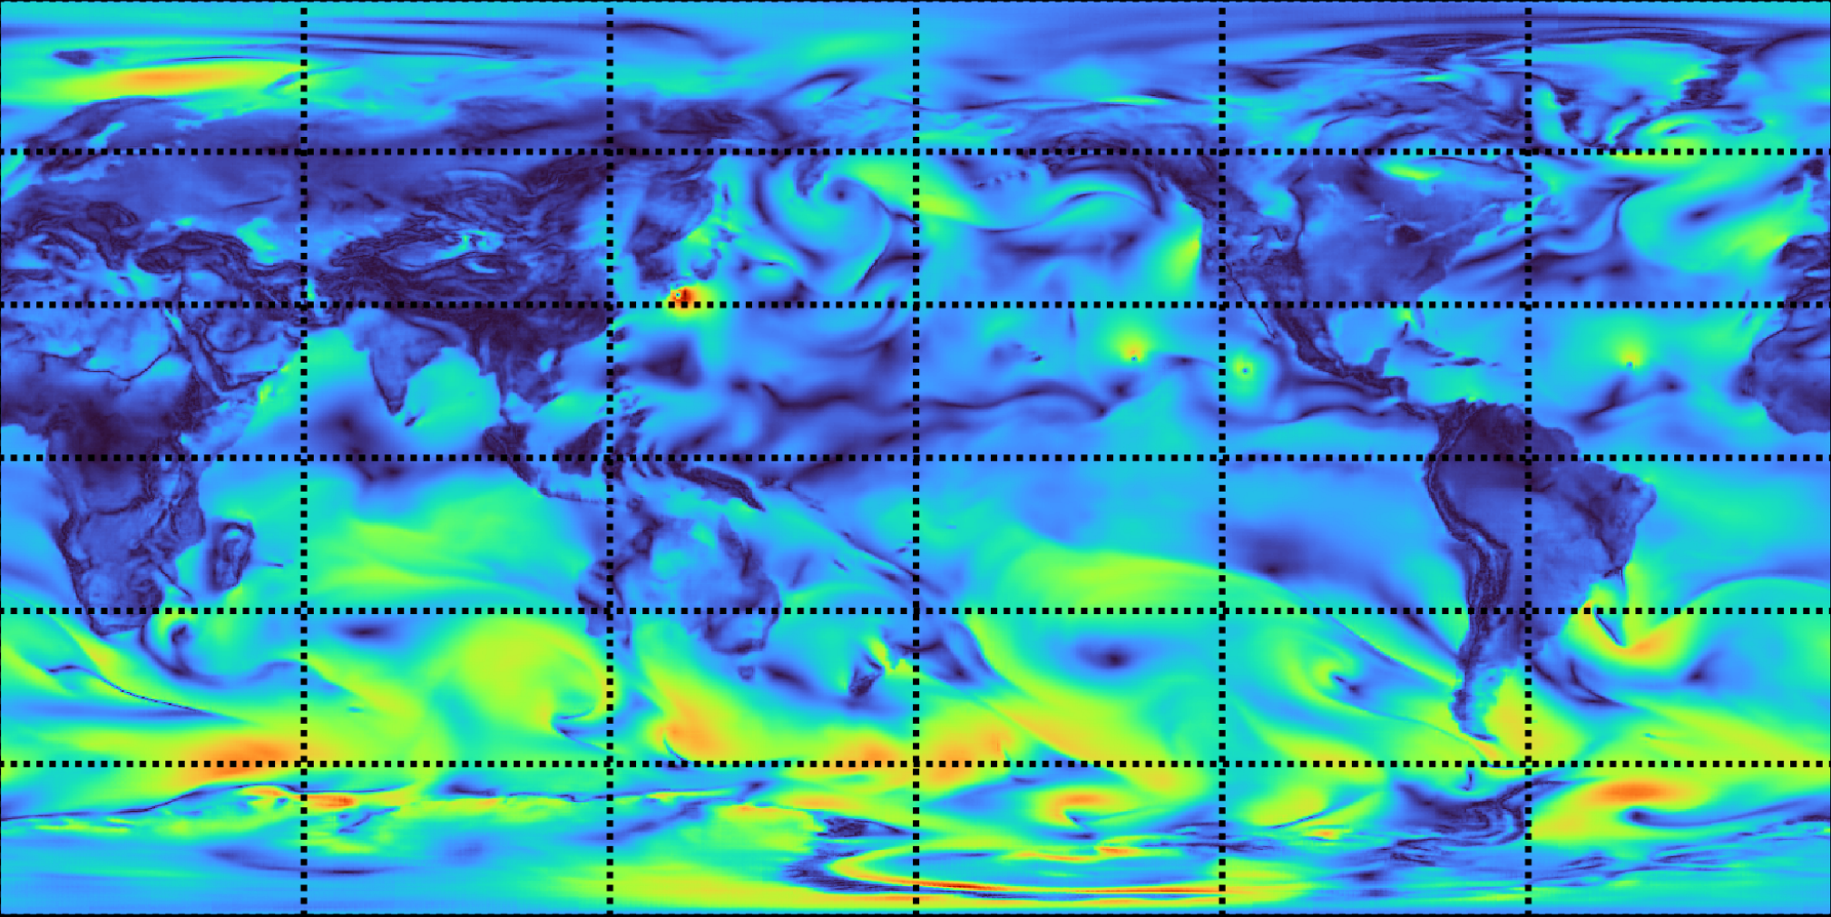
ML weather forecast models
Neural networks are used to emulate the planetary fluid flow (Pangu-Weather: Bi et al. (2023), Nature)
Notes:
This is an image of a NN-represented global wind fields from one of the recent ML weather forecast model

Slide 3
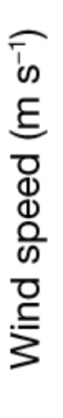
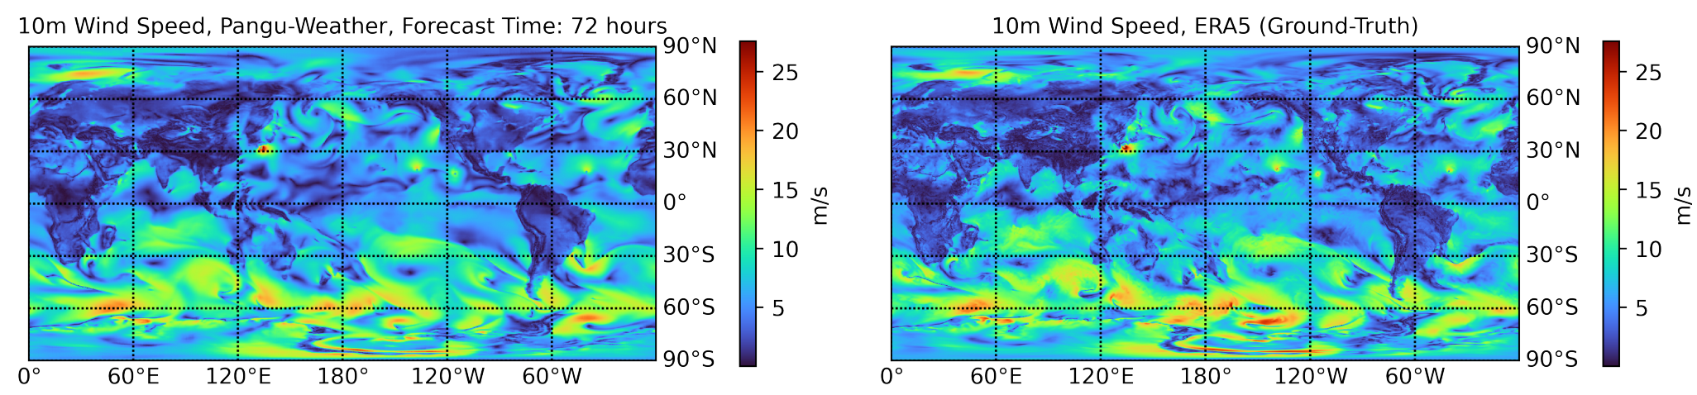
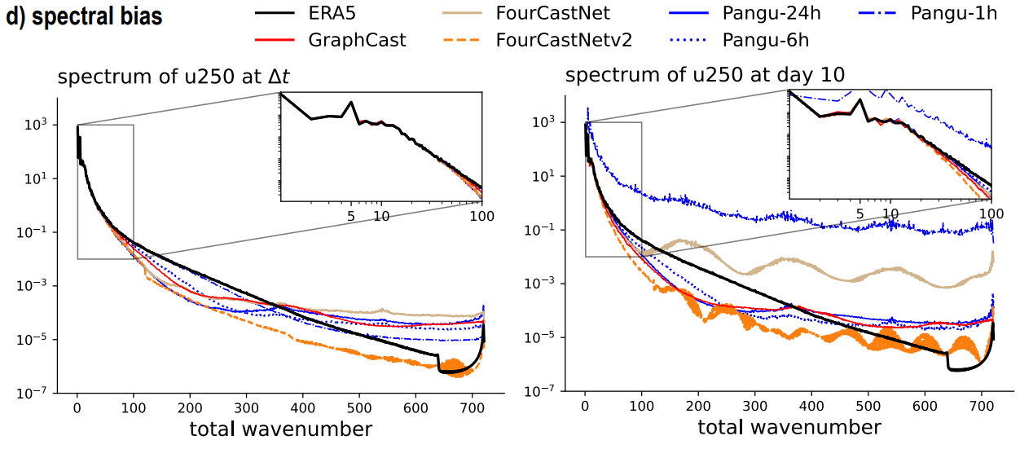

Some challenges and progress
AI weather forecast
Training data (Re-analysis)
Bi et al (2023) Nature
Spectral bias of NN:
Lai et al, Annu. Rev. Condens. Matter Phys. (2024)
Notes:
Compared with the ground truth training data from numerical weather prediction, you can see that the NN can well capture the large-scale features, but miss a lot of the fine-scale high frequency details.

Slide 4
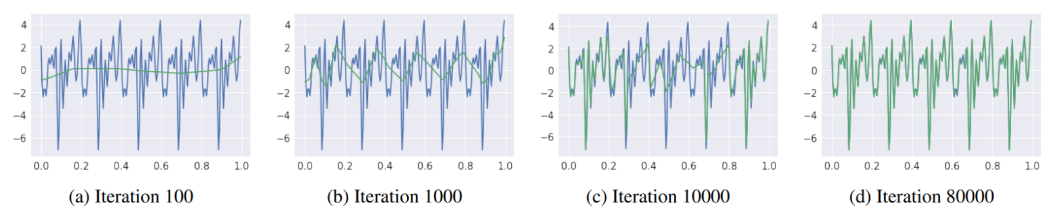
Spectral bias is bad for multiscale problems
AI weather forecast
Training data (Re-analysis)
Bi et al (2023) Nature
Spectral bias of NN: Rahaman et al (2019), Frequency Principle: Xu et al (2020)
Notes:
This is likely related to the spectral bias of the NN, which refers to NNs tendency to prioritize fitting functions with a certain frequency range. As demonstrated in this 2019 paper, the NN marked in green first fit the low-freq fn and takes a lot longer iter to fit the high freq signals in the blue target fn.
This is a bad news because Problems in fluid mechanics, often exhibit multiscale features. Neural network are used due to its property as a universal function approximator. However, in practice NN often fail to capture fine-scale details due to its spectral bias.

Slide 5
Outline
Machine-precision NN algorithm for tackling the spectral bias
Applications to finding PDE solutions numerically
Applications of finding singularities in fluids

Slide 6
Outline
Machine-precision NN algorithm for tackling the spectral bias
Applications to finding PDE solutions numerically
Applications of finding singularities in fluids

Slide 7




Neural network
Karniadakis et. al. (2021), Nat. Rev. Phys.
Fully-connected Neural network
Neuron
Input
Output
Function
Output
Input
Notes:
What is a neural network. NN is a model of output parameter u as a function of input parameter x

Slide 8
Neural network
Karniadakis et. al. (2021), Nat. Rev. Phys.
Fully-connected Neural network
Neuron
Input
Output
Weights
Function
(both are free parameter)
Biases
Notes:
The input parameter is connected to several neurons. The connections to neurons are characterized by weights. When passes information from the input to the first neuron, we multiple the input by the weight, and add a bias. Here, both weight and biases are free parameters to be trained.

Slide 9


Neural network
Karniadakis et. al. (2021), Nat. Rev. Phys.
Fully-connected Neural network
Neuron
Input
Output
Activation function (nonlinearity)
Function
Common choice
Output of a neuron
Notes:
Then we apply an activation function, which adds nonlinearity to the calculation. A common choice of activation function includes sin and tanh.
Now this whole expression after applying the activation function is the output of the first neuron.

Slide 10
Neural network
Karniadakis et. al. (2021), Nat. Rev. Phys.
Fully-connected Neural network
Neuron
Input
Output
Sum of the outputs from previous layer
Function
Output of a neuron in the second layer
Notes:
We repeat the same operations for all neurons in the first layer. When propagation the information from the first layer to the first neuron in the second layer, again every connections between the neurons are characterized by trainable weights. We multiple the output of the first layer by weights, adding the bias associated with this neuron, and apply the activation function. Now this is the output of the first neuron in the second layer.

Slide 11


Neural network
Karniadakis et. al. (2021), Nat. Rev. Phys.
Fully-connected Neural network
Neuron
Input
Output
Function
=
(free parameters to be trained)
(fixed and selected by users)
Notes:
We can this repeatedly and eventually obtain an explicit expression of the NN output as a function of input. The weights and biases are free parameters to be trained.

Slide 12
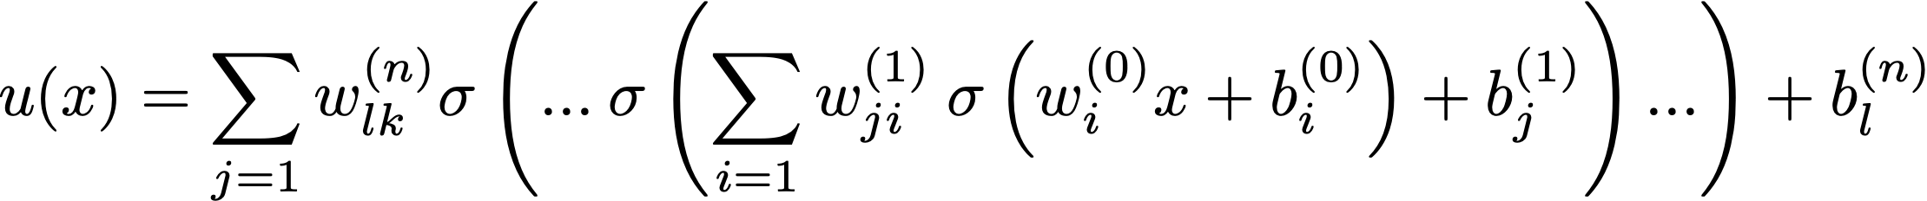
Neural network
Karniadakis et. al. (2021), Nat. Rev. Phys.
Fully-connected Neural network
Neuron
Input
Output
Universal function approximator
Hornik et. al. (1989), Neural Netw. 2
Notes:
It has been shown by Hornik that a neural network containing sufficient weights and biases can approximate any smooth functions. So neural network is a universal fn approximator.

Slide 13
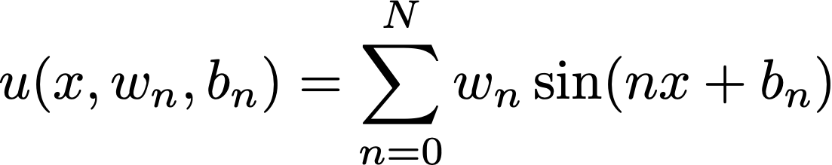





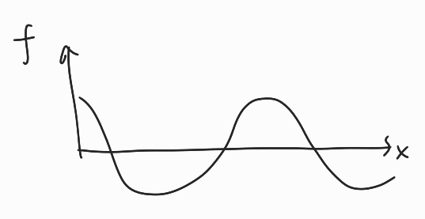
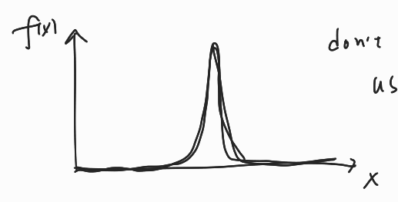

Neural network and Fourier series
Karniadakis et. al. (2021), Nat. Rev. Phys.
Fully-connected Neural network
Fourier series:
$$sin⁡(nx)$$
Neuron
Input
Output
Universal function approximator
Hornik et. al. (1989), Neural Netw. 2
Use sin() activation
If using sin() activation, need lots of neurons (frequencies)
Better to use tanh() activation
Notes:
In fact a single layer NN with activation function as sin, cos is mathematically equivalent to a fourier series. The weight connecting the input to the neurons represent the wave numbers and the weights connecting the neurons to the output is the amplitude of the sinusoidal functions.
So now we can ask what activation fn is appropriate.

Slide 14
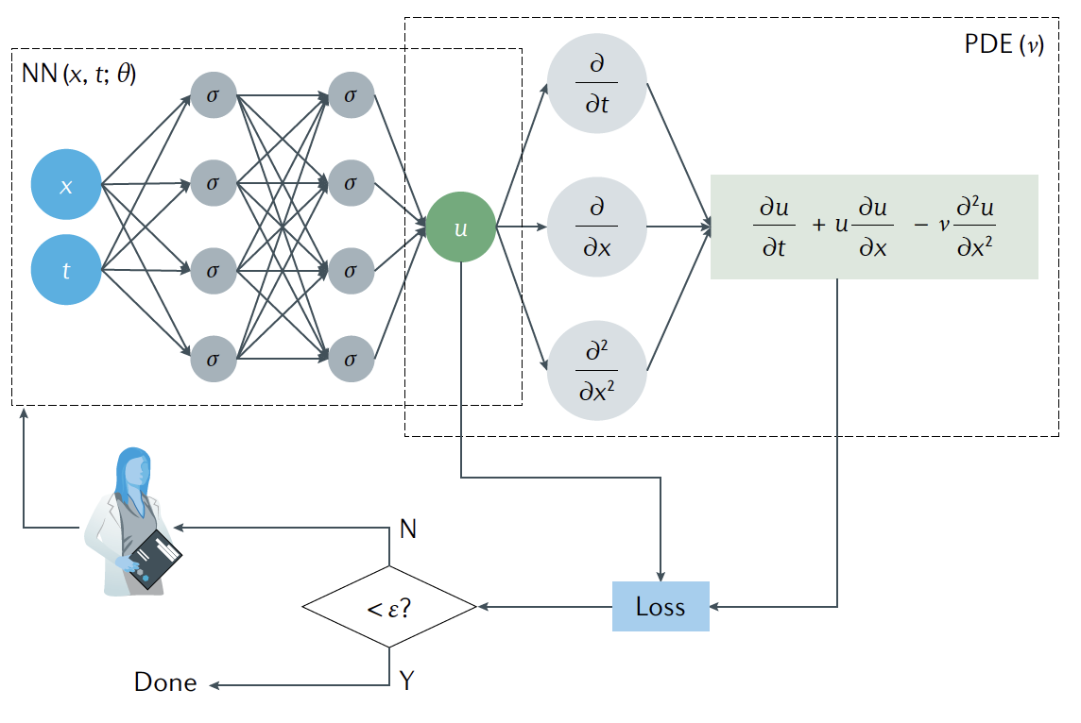
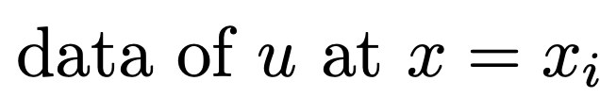
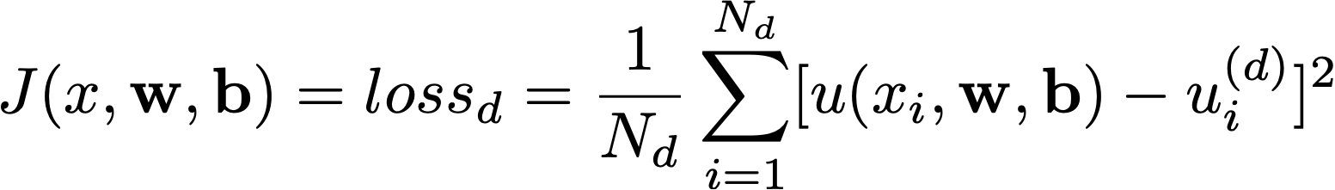



Neural network for curve fitting
Karniadakis et. al. (2021), Nat. Rev. Phys.
Fully-connected Neural network
Neuron
Input
Output
$$u$$
Data points
$$x$$
Updating variables:
Optimization
Cost function: mean squared error
Gradient descent
Notes:
NN can be used for curve fitting. The prediction of the nn is a continuous function of the input.
Throughout the training iterations, the NN will find the w,b that best minimizes the cost function, that quantifies the difference between the data points and the NN prediction. With the optimized w,b the NN prediction would pass through and interpolate between the data points.

Slide 15

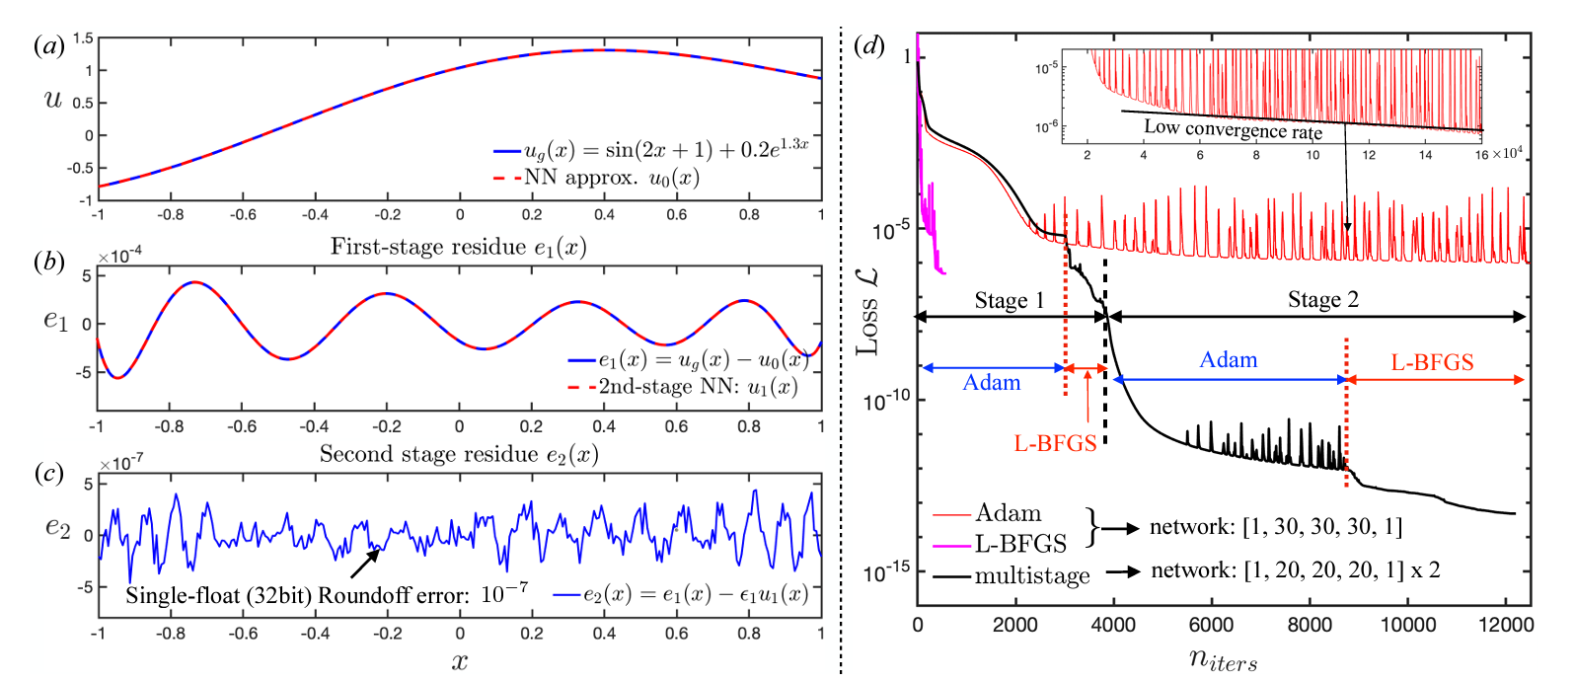
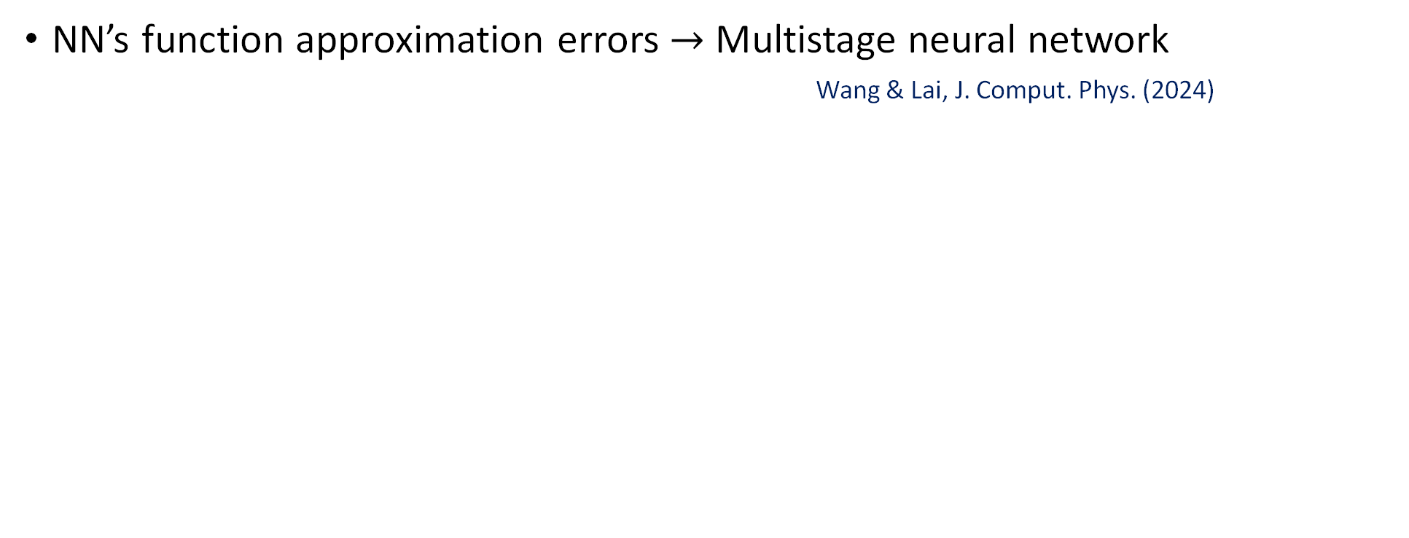

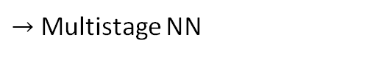
Expressiveness of neural networks
Yongji Wang
Postdoc
NN’s function approximation errors $→$ Multistage neural network
Wang & Lai, J. Comput. Phys. (2024)Approximating high-frequency functions $→$ Jagtap et al., JCP (2020)
Introduce a scaling variable in the activation function, which can be optimized
Determine the weights for different terms in the cost function
$→$Wang et al. SIAM J. Sci. Comput. (2021), Wang et al., JCP (2022), McClenny & Braga-Neto, SAPINN arXiv:2009.04544
Error bounds of the PINN solutions $→$Mishra & Molinaro, IMA J. Numer. Anal. (2023)
In addition to saying PDE residues are small, we know that the distance between the PINN approximated solution itself with the true solution, which is not available, would be small
NN as universal function approximators: Hornik et al (1990)
$→$Regular NN
$→$Multistage NN
Notes:
Here my postdoc Yongji uses vanilla NN to fit a 1d fn. The blue…the red…The loss fn quantifies the diff between ground truth and the NN…but the question is why not lower, if NN are truly universal fn approximators.
Here we propose the MSNN that uses a subsequent NN to effectively learn to correct for the errors from the 1st NN.
Msnn achieves much better precision with less total number of NN parameters and computational cost compared with a single NN.

Slide 16

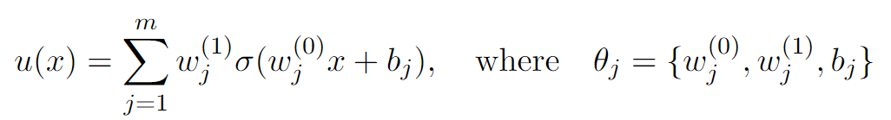

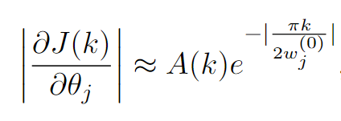
Spectral bias: A Fourier analysis of NN
Xu et al. (2022)
For a single-hidden-layer NN with input
The mean square loss measures the distance between the NN output $u(x)$ and ground truth $u_{g}(x)$
, where $\hat{u}(k)$ denotes the Fourier transform of $u(x)$
The loss at frequency k is
For tanh activation function, the gradient of loss at J(k) with respect to NN parameters $θ_{j}$ is
This gradient decay rapidly with frequency k!! This is a simple explanation of the spectral bias.
Notes:
Before explaining the algorithm I want to draw your attention to this simple explanation for the spectra bias,
The gradient of the loss function decays exponentially with higher frequencies. This is important as it shows that the gradient becomes small for large k, thus it would take extremely long # of iterations to learn high-frequency functions. This is a simple explanation of the origin of NN’s spectral bias.

Slide 17

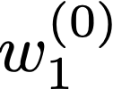
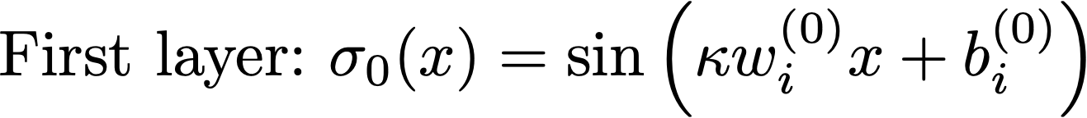

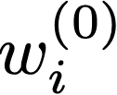


Capturing high-frequency functions
Yongji Wang
Postdoc
For multiscale problems, it is important to rescale the NN weights so that it actives the learning of high-frequency (large k) functions
We make $w_{j}^{(0)}∝k$
Our implementation:
Wang & Lai, J. Comput. Phys. (2024)
Notes:
To mitigate the problem, it is important to …..Note that in the exponential decay it is the factor k/w0, that determine the decay. If we increase the NN weights proportionally with the frequency k we want the NN to capture, we can keep the gradient large for large k. This reactivate the learning of high frequency functions
we have the scale factor kappa that is a multiplier in front of the weights connecting the input to the 1st hidden layer. This is similar and simpler than the fourier feature implementation.
Large kappa has the effect of rescaling the input x and makes it easier to learn high-frequency function.

Slide 18
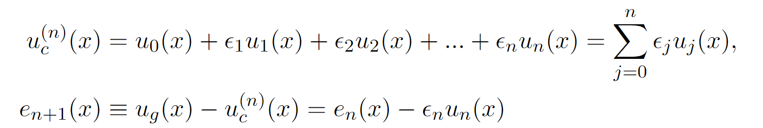

Main idea
Wang & Lai, J. Comput. Phys. (2024)
When NN training error is small, the learning becomes really slow.
MSNN includes a superposition of multi-stage NNs, with each stage using a new NN to fit the residue rescaled to O(1) from the previous NN.
where
NNs of different stages
Related work with similar flavors: Sequential residual learning: Krishnanunni & Bui-Thanh arXiv:2211.06860, Multi-level neural networks: Aldirany et al. (2024), Stacked networks: Howard et al. arXiv:2311.06483, Precision Machine Learning: Michaud et al. arXiv:2210.13447…etc
Notes:
So we talked about high freq fns, now we have another independent issue to overcome. When NN training error is small, the learning becomes really slow.
Here is the main idea of the MSNN. Inspired by perturbation theory, we write the NN approximated function as a superposition of the leading order approximation u0, and higher order error terms u1, u2..etc. epsilon 1 is a small constant and epsilon 2 is << epsilon. u0, u1 are NNs from different stages. So although the first NN u0 doesn’t perfectly fit the target function, we will use a subsequent NN u1 to learn and correct for the residue from the previous NN. Because u1, u2.. are O(1) magnitude functions it is easy for NN to capture each of the error terms instead of having one single NN capturing these small magnitude details.
Here is a list of related work with similar strategies…

Slide 19
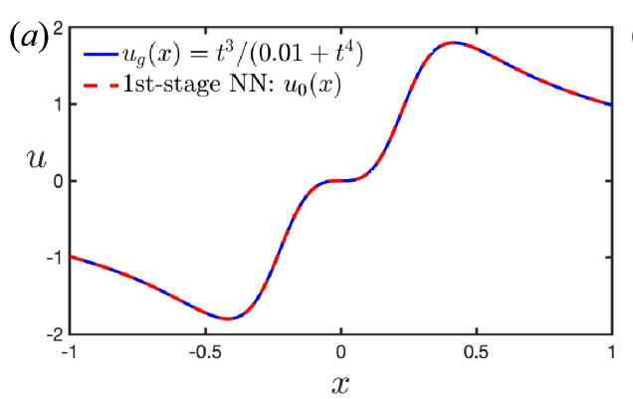
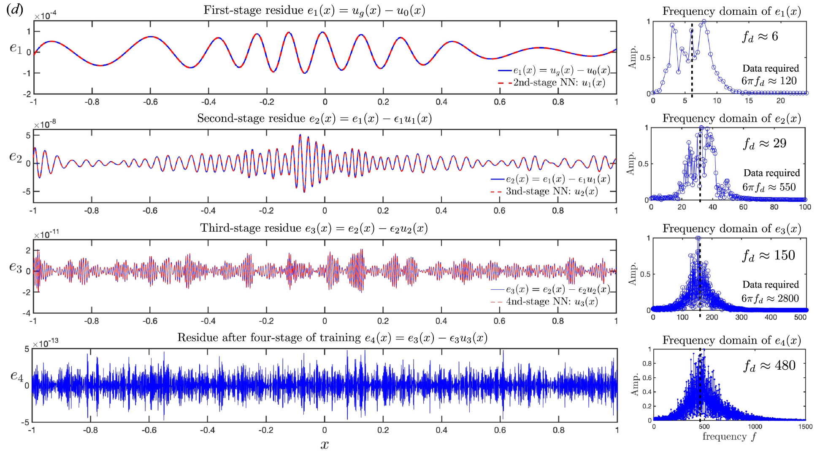
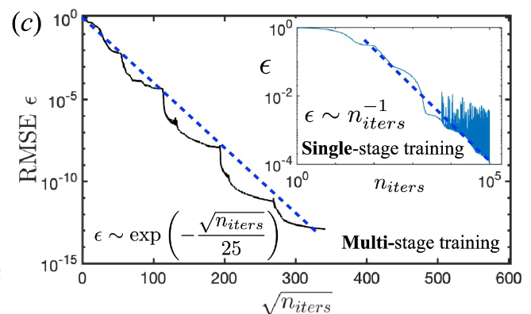




Multistage-NN (MSNN)
Wang & Lai, J. Comput. Phys. (2024)
$${10}^{−4}$$
$${10}^{−8}$$
$${10}^{−11}$$
$${10}^{−13}$$
Notes:
We show that the training error convergence is a lot faster for MSNN than a single NN.

Slide 20
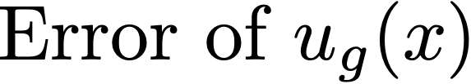

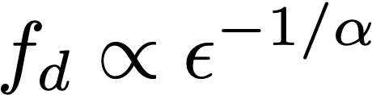

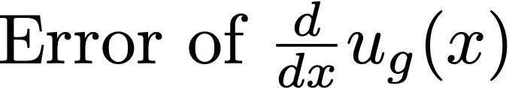
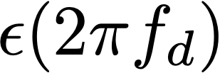
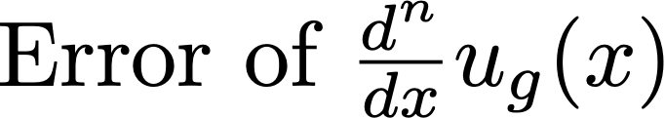
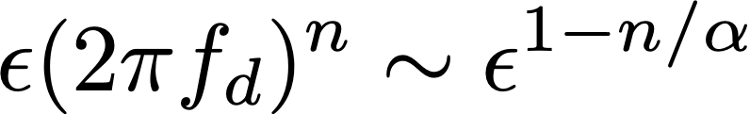
Scaling laws: Smaller errors, higher frequencies
1
6
Observed universal power-law:
where
Notes:
As we saw for higher stages NN the error is much smaller but the freq of the error is much higher. Here we plot the error throughout different stages, and their corresponding freq.

Slide 21
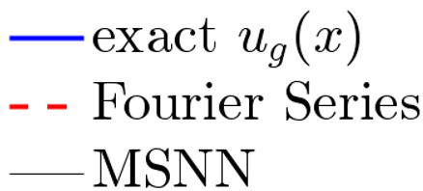
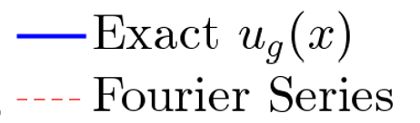
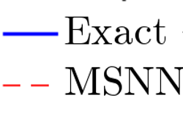
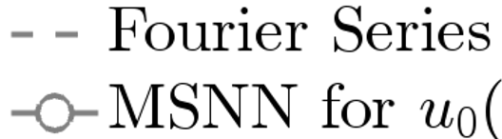




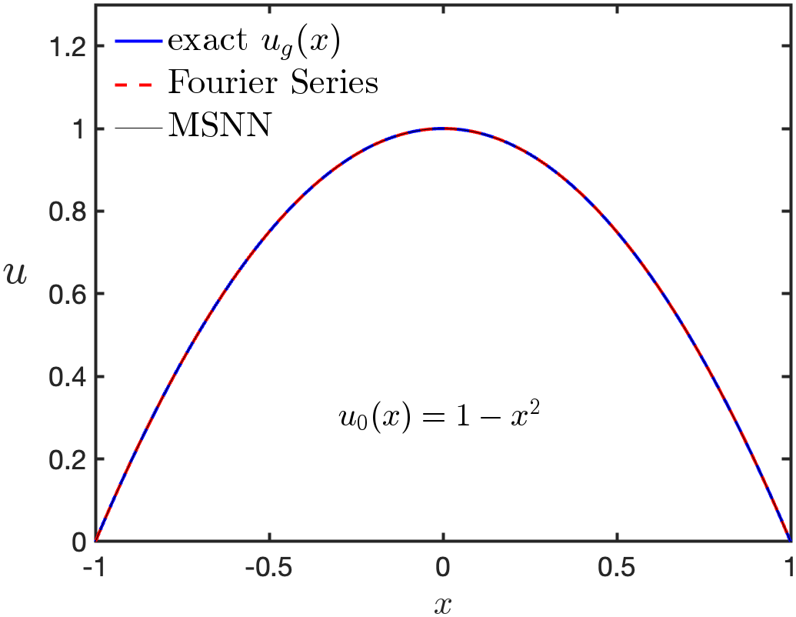
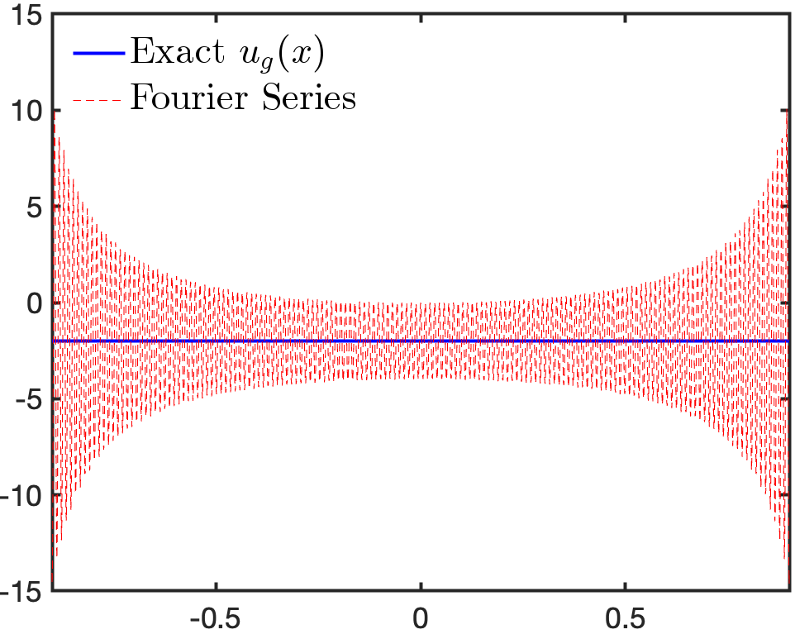
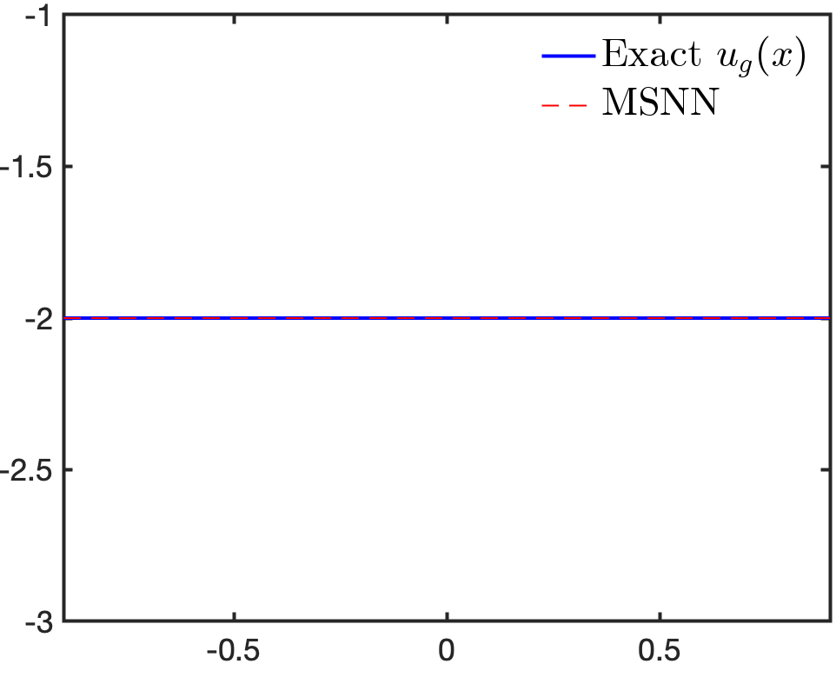
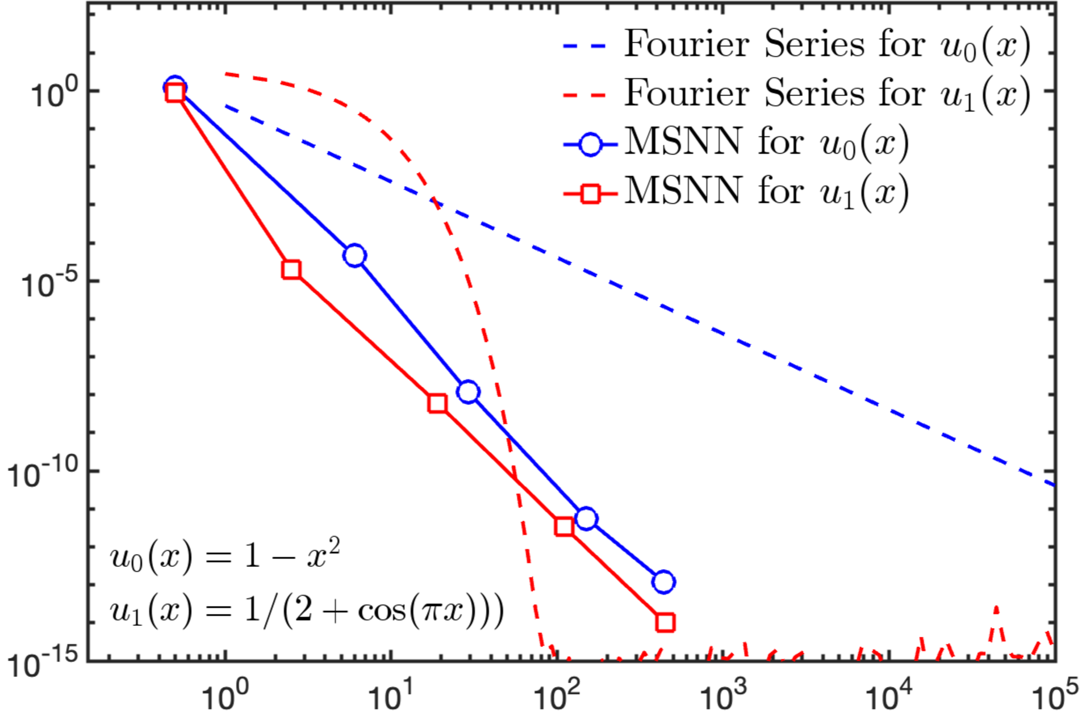




Multistage NN vs Fourier Series
Red: Periodic function
Blue: Non-periodic function
Non-periodic function
6
1
Periodic function
where

Slide 22
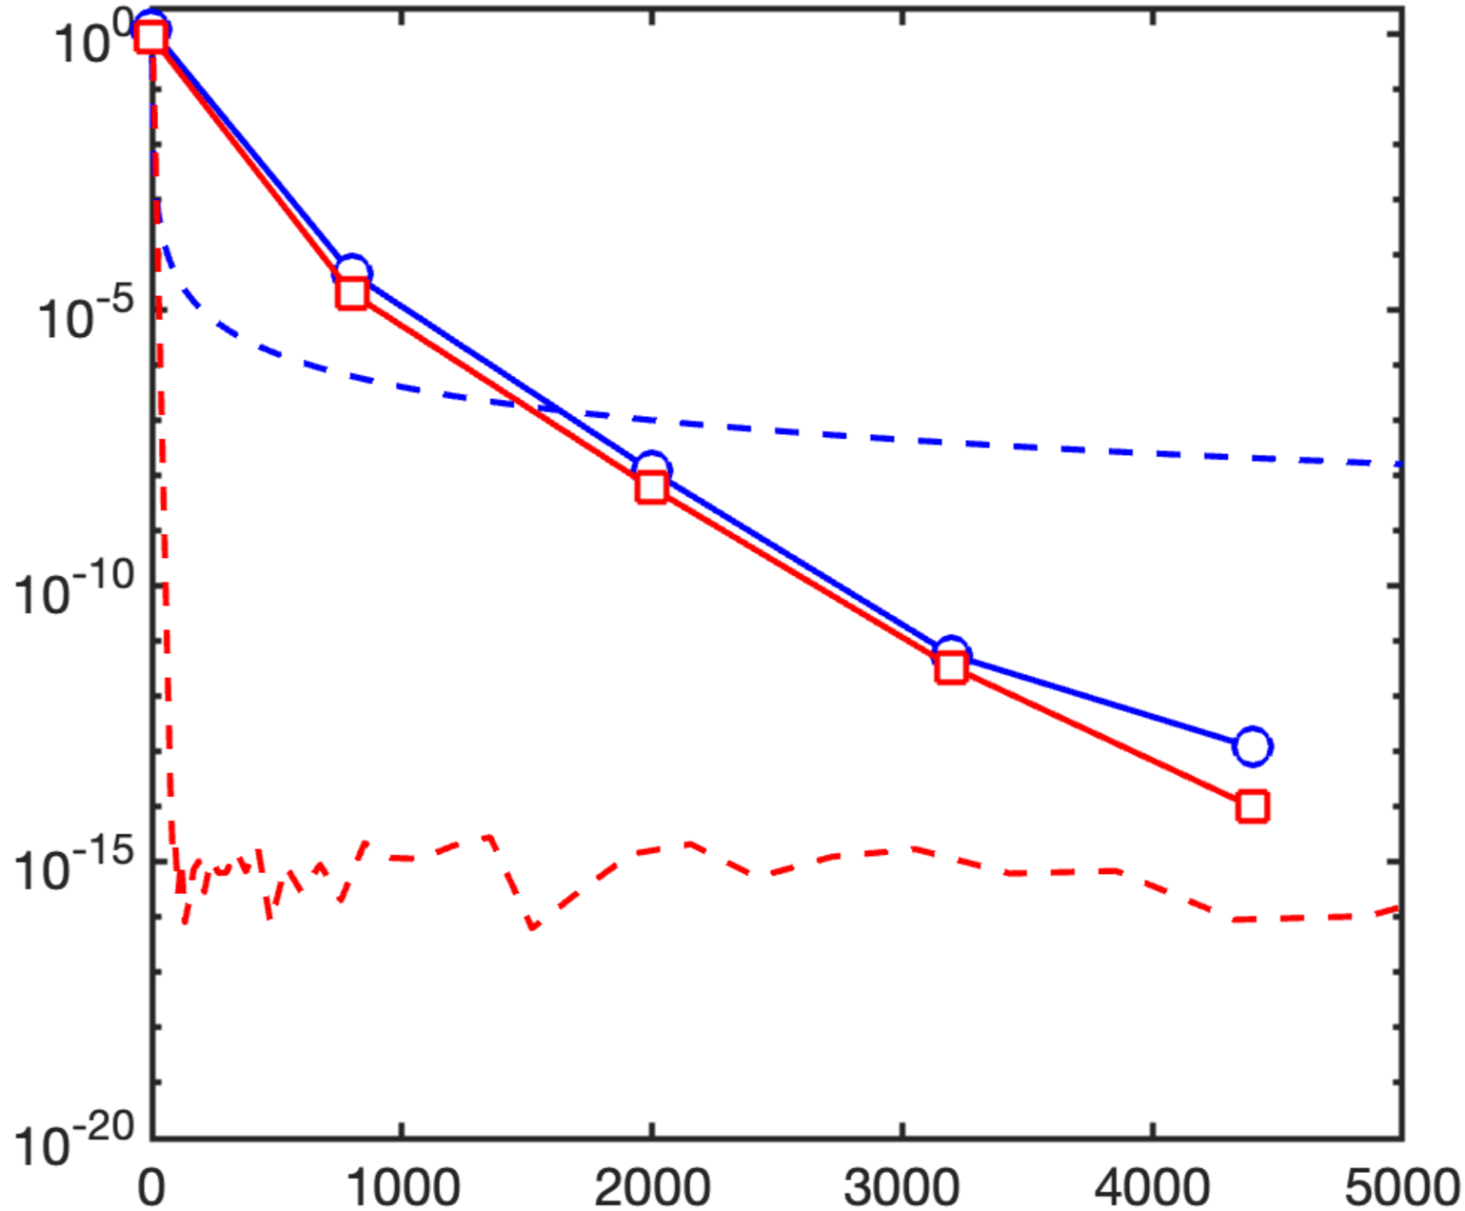
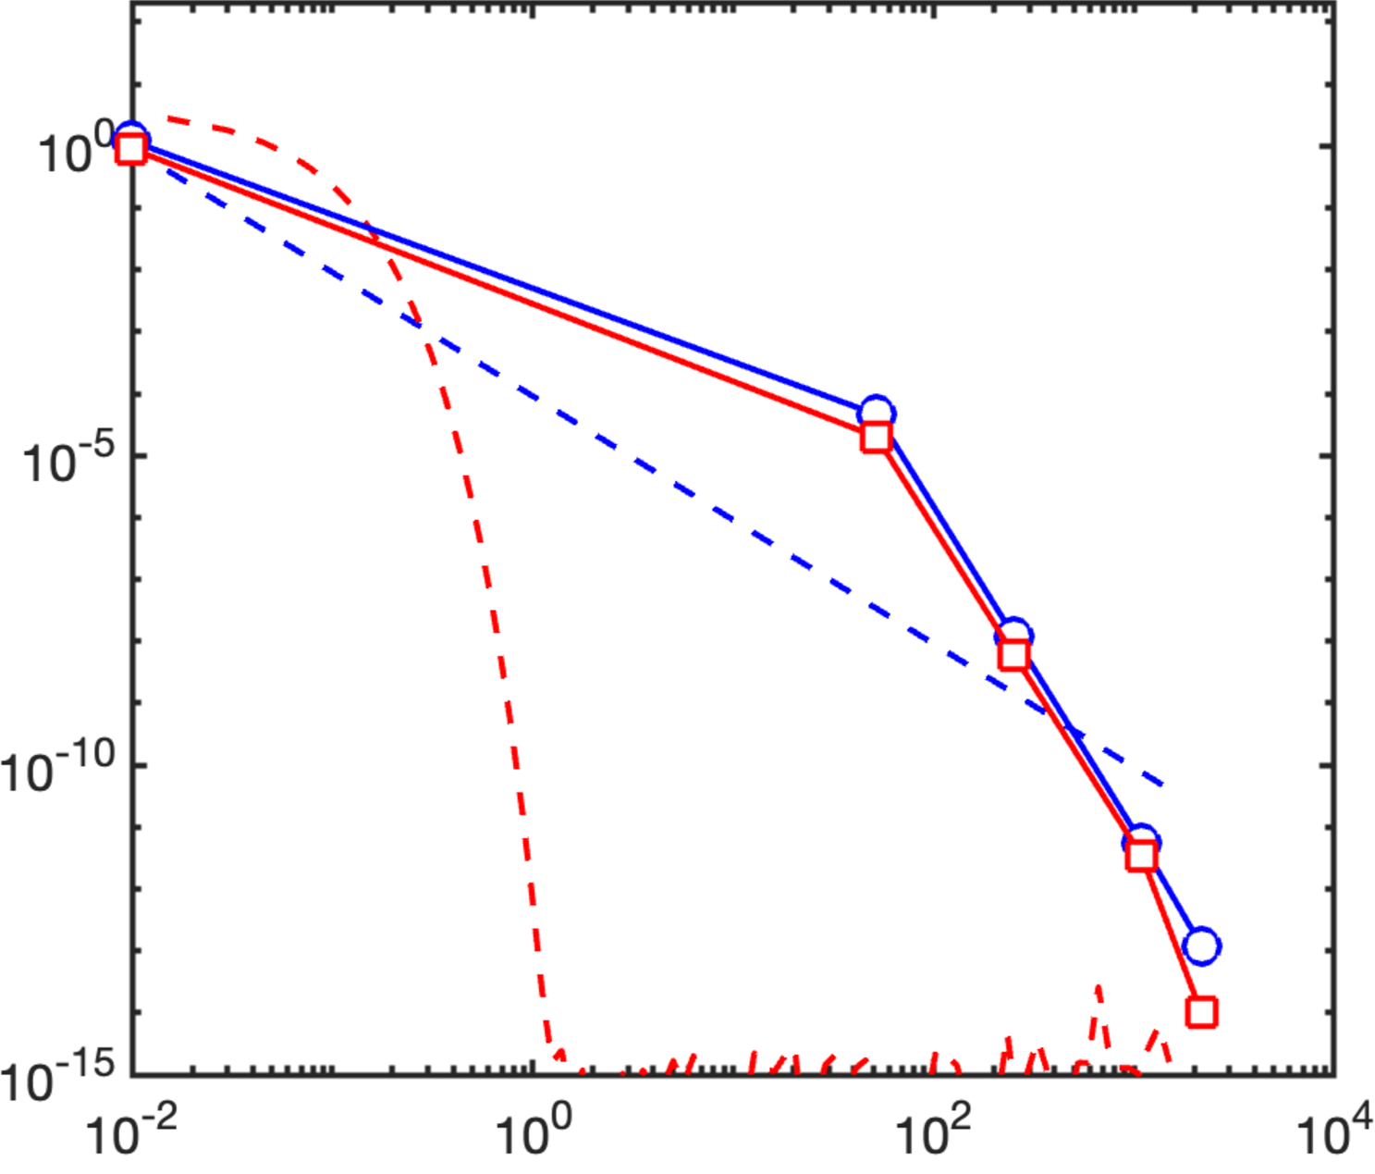

Multistage NN vs Fourier Series
Red: Periodic function
Blue: Non-periodic function
6
1

Slide 23

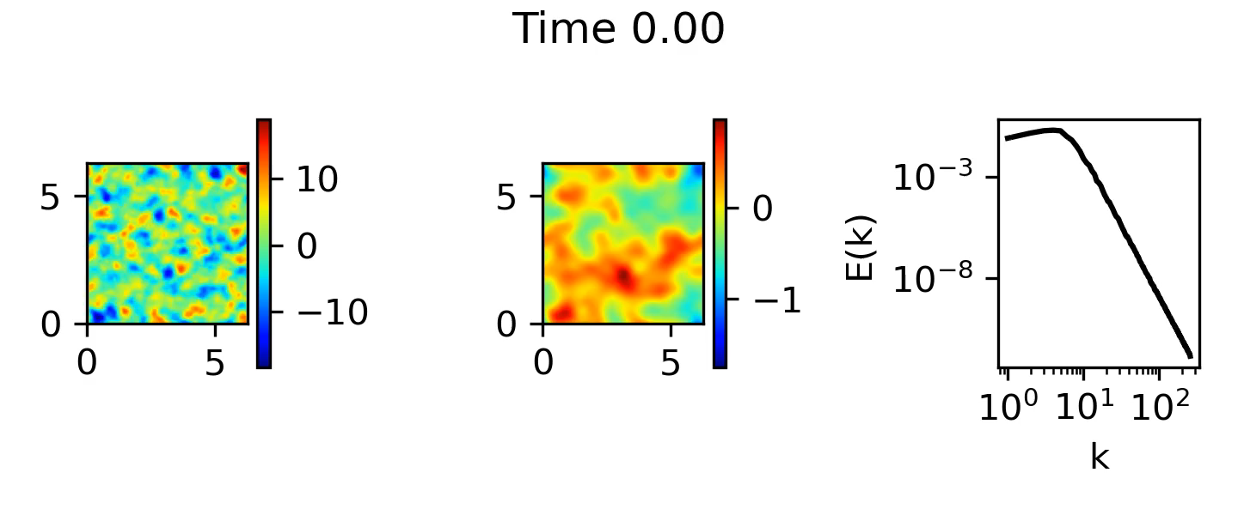
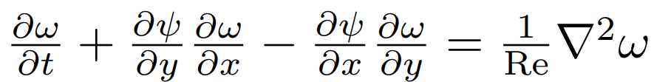

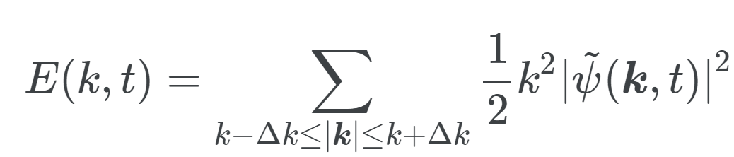


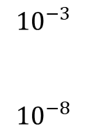



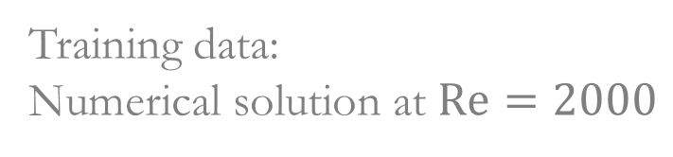
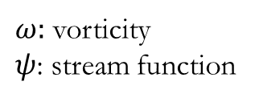

Can multistage-NN be used to tackle the spectral bias in multiscale problems?
Jakin Ng
Student
Example:
How precisely can a NN approximate a 2D fluid flow?
Training data:
Numerical solution at $Re=2000$
$$ω(x,y,t)$$
$$E(k)$$
2D incompressible Navier-Stokes eqn:
$${10}^{−3}$$
$${10}^{−8}$$
$ω:$ vorticity
$ψ$: stream function
$$y$$
$$x$$
${10}^{0}$ ${10}^{1}$ ${10}^{2}$
$$k$$
Energy spectrum:

Slide 24
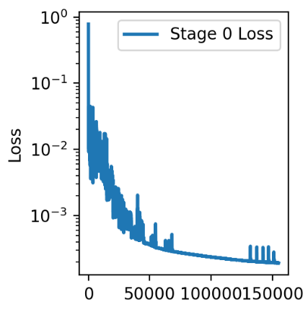
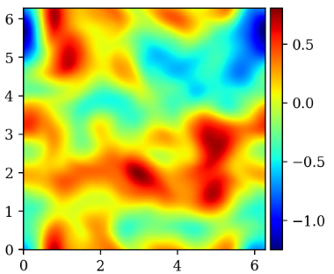
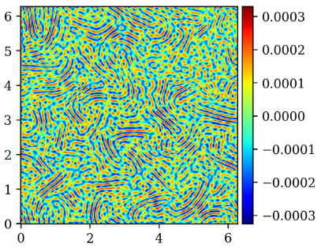
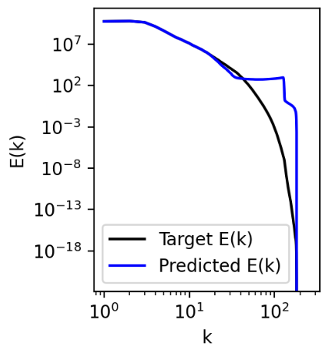













E.g. 2D incompressible Navier-Stokes
Loss convergence
Target $ψ(x,y)$
Error
$$y$$
$$y$$
$$x$$
$$x$$
Energy spectrum
Error in
Fourier domain
NN $ψ(x,y)$
$${10}^{−6}$$
Due to spectral bias
$$y$$
$$k_{y}$$
$$x$$
$$k_{x}$$
Notes:
NN input are x,y, output is phi

Slide 25










E.g. 2D incompressible Navier-Stokes
Loss convergence
Stage 0
Stage 1
Stage 0
Target $ψ(x,y)$
Error
Error
$${10}^{−7}$$
$$y$$
$$y$$
$$y$$
$$x$$
$$x$$
$$x$$
Energy spectrum
Error in
Fourier domain
Error in
Fourier domain
NN $ψ(x,y)$
$${10}^{−6}$$
$${10}^{−10}$$
$$y$$
$$k_{y}$$
$$k_{y}$$
$$x$$
$$k_{x}$$
$$k_{x}$$

Slide 26










E.g. 2D incompressible Navier-Stokes
Loss convergence
Stage 0
Stage 1 …. Stage 3
Machine precision
Target $ψ(x,y)$
Error
Error
$${10}^{−7}$$
Error
$${10}^{−16}$$
$$y$$
$$y$$
$$y$$
$$y$$
$$x$$
$$x$$
$$x$$
$$x$$
Energy spectrum
Error in
Fourier domain
Error in
Fourier domain
Error in
Fourier domain
NN $ψ(x,y)$
$${10}^{−6}$$
$${10}^{−10}$$
$${10}^{−19}$$
$$y$$
$$k_{y}$$
$$k_{y}$$
$$k_{y}$$
$$x$$
$$k_{x}$$
$$k_{x}$$
$$k_{x}$$
Notes:
machine precision

Slide 27


Multistage NN can tackle the spectral bias & accelerate loss convergence
Wang & Lai, J. Comput. Phys. (2024)
Ng, Wang & Lai, ICML workshop (2024), arXiv:2407.17213
Energy spectrum
Loss convergence
Regular NN
(spectral bias)
Regular NN
Loss
Multistage NN
(no spectral bias)
Multistage NN
(machine precision)
Navier-Stokes, Re = 2000
Wavenumber k
Iterations
Notes:
Comparing the MSNN with regular NN, we show that…
The red curve…
MSNN can achieve unprecedented accuracy, down to the machine precision of double-precision floating-point.

Slide 28

Multi-stage NN for regression problems
Final expression
where
Notes:
In summary, for regression problem, the training data for higher stage NN comes from the error from the previous stage. The errors of higher stage NN are usually high-freq fns. Although it is difficult for vanilla NN to capture high-freq data, we use a scaling factor kappa, that can be directly determined using the dominant frequency of the high frequency residues. This is exciting for us because using the MSNN, we can tackle the spectral bias and achieve unprecedented accuracy.
12min

Slide 29
We have shown that MSNN are good function approximators, can it be used to find PDE solutions numerically?
Wang & Lai, J. Comput. Phys. (2024)

Slide 30








Physics-informed neural networks
Karniadakis et. al. (2021), Nat. Rev. Phys.
Fully-connected Neural network
Neuron
Eqn:
Input
Output
Equation residue $f(x)$
Data loss:
Updating variables:
Eqn loss:
Optimization
Cost function: data + equation loss
Gradient descent
Notes:
Now suppose the output u as a function of input x is governed by some “equations”.
We substitute the NN prediction into the equations and calculate derivatives in the equation using automatic differentiation. The equation residue is zero when the NN prediction perfectly satisfies the equation. I want to point out that the NN output are explicit and continuous functions of the input so the derivatives of the output wrt input can be calculated explicitly.
In the cost fn, now we have two terms. By minimizing the cost fn, the NN not only fits the data but also satisfies the equation.

Slide 31














Multistage-PINN for simple ODE
Equation residue:
$f\left(u, x\right)$
$f_{1}≡f\left(u_{0}, x\right)$
$f_{2}≡f\left(u_{0}+ε_{1}u_{1}, x\right)$
Ansatz:
Equation residue of 1st stage NN $u_{0}$:
$$f_{1}$$
root mean square of
equation residue
Equation residue of 2nd stage NN $u_{1}$:
$$f_{2}$$
Stage 1
Stage 2
Stage 3

Slide 32
Outline
Machine-precision NN algorithm for tackling the spectral bias
Applications to finding PDE solutions numerically
Applications of finding singularities in fluids
With Tristan Buckmaster, Gonzalo Cao-Labora, Javier Gomez-Serran, Yongji Wang

Slide 33








Benchmark example: Burgers equation
Shock wave
$$λ$$
is the solution that blows up at $t=1$.
$$λ$$
is the self-similar variable.
$$λ$$
Original
coordinates
Self-similar
coordinates
u
Steady-state
self-similar solution
x
y
Notes:
Burgers’ equation can lead to shock formation, as illustrated by the animation below. The soln evolves with time. If we follow the red box
*we separate the soln to two parts, (1-t). U is the s.s. self-similar component that doesn’t depend time.

Slide 34



Benchmark example: Burgers equation
Shock wave
$$λ$$
is the solution that blows up at $t=1$.
$$λ$$
is the self-similar variable.
$$λ$$
$$λ$$
$$λ$$
The goal for NN:
1. Find the solution $U\left(y\right)$
2. Find the self-similar exponent $λ$
This is an inverse problem!
Notes:
*we separate the soln to two parts, (1-t) is what caused blow up with time. U is the component that doesn’t blow up with time, the so-called self similar soln.
This is a so-called inverse problem, because …

Slide 35













Multistage NN for Burgers
Equation residues:
$$f_{1}(y)$$
Solution
profile:
$$f_{1}$$
$$f_{3}(y)$$
$$f_{3}$$
Loss function:
Solution error:
Close to machine precision

Slide 36

Incompressible Euler equations
0
Major question:
Does there exist smooth, finite energy initial condition leading to a solution blowing up in finite time?
  DNS: Luo and Hou, PNAS (2014), Luo and Hou, MMS (2014)
  Proof: Chen and Hou, arXiv:2210.07191 (2022), arXiv:2305.05660 (2023)
Can we leverage neural networks’ expressiveness to find highly accurate numerical blow-up solution?
Notes:
This is the Euler eqn.
a big open question for the Euler equation that remains unsolved for a century is whether smooth, finite energy initial condition can blow up in finite time. In the past decade there has been several progress made by direct numerical simulations that suggest singularity formation for Euler eqn. However, near the time of singularity the time and space resolution needed to resolve the dynamics are extremely high, The smallest…. This poses a multiscale numerical challenge.
In the next few slides I will show how we tackle this problem with a PI MSNN

Slide 37






Incompressible asymmetric Euler…
Luo-Hou (2014):
Compelling numerical evidence for blow-up
Their simulation suggests an asymptotic self-similar scaling near blowup
The Luo-Hou scenario: assume asymmetricity with a cylindrical boundary
Imposing the self-similar ansatz for self-similar coordinates
$$λ$$
$$λ$$
Assuming $t→1,$
$s=−\log{(1−t)}→∞$ incompressible 3-D Euler equation becomes
Notes:
LuoHou performed compelling numerical simulations proposing a scenario for finite-time blowup near a cylindrical boundary. They simulated the time-dependent problem and observed a dramatic growth in the maximum of vorticity at this location, suggesting singularity formation at the boundary

Slide 38

















PINN (self-similar coordinate)
PINN: Raissi et. al. (2019), J Comp.Phys
Wang, Lai, Gómez-Serrano, Buckmaster, Physical Review Letters (2023)
6 hidden layer; 30 units per layer
Automatic
differentiation
Self-similar Euler equations
BC loss:
Updating variables:
+
Eqn loss:
Optimization
Notes:
We first reduce the dimensionality of the problem by working in the self-similar coordinate.
Similar to the ice inversion, here we use a piNN to approximate the 4 parameters we want to solve for as a function of 2 self similar input coordinate. Throughout the training iterations, the algo search for solutions that satisfies the self-similar Euler’s eqn. I want to emphasize that this is not a forward problem. Because we have some unknown parameters in the eqn. The search for the soln along with the unknown parameter is an inverse problem.

Slide 39








Adding structures to the NN-PDE solver
1. Symmetry constraints
2. Smoothness constraint
3. Map infinite to finite domain size
e.g.,
Change of coordinate:
e.g. Domain size
e.g., to impose odd symmetry
$$sinh⁡(z)$$
$$z$$
PINN is trained in the z coordinate

Slide 40























Find self-similar singularities to the Euler equation
Loss function
Inferred $λ=1.917$
Wang, Lai, Gómez-Serrano, Buckmaster, PRL (2023)
Smooth self-similar blow-up solution
Uniform and small equation residues everywhere
Notes:
I will skip a lot of numerical details here, which are detailed in the SI of our paper. But our nns numerically found, for the first time, a set of approximate smooth self-similar solutions that exhibit singularity to the Euler’s equation. This is one of the example where NN has found PDE solutions that had not been found with other classical methods. This quanta article did a great job explaining the background of this problem. Chales…This result is very exciting to us, because this is suggestive of a possible strategy to tackle the blow up problem for the navier stokes eqn.
3:30min

Slide 41


MSNN gives solution close to machine precision
Inferred $λ=1.920560013482733$
Chen and Hou: $λ=1.9205600$
With multistage NN, the error is further reduced.
Proof: Chen and Hou, arXiv:2210.07191 (2022), arXiv:2305.05660 (2023)
Loss function
Equation residue
1st stage
2nd stage
Notes:
I will skip a lot of numerical details here, which are detailed in the SI of our paper. But our nns numerically found, for the first time, a set of approximate smooth self-similar solutions that exhibit singularity to the Euler’s equation. This is one of the example where NN has found PDE solutions that had not been found with other classical methods. This quanta article did a great job explaining the background of this problem. Chales…This result is very exciting to us, because this is suggestive of a possible strategy to tackle the blow up problem for the navier stokes eqn.
3:30min

Slide 42





PINN can find unstable approximate solutions!
The self-similar CCF equation:
Solution profile
Equation residue
(want this to be 0)

Slide 43




An unstable CCF solution was found!
The self-similar CCF equation:
${Loss}_{s}=|∂_{z}f\left(z\right){\left.​\right|}^{2}→0$
${Loss}_{s}=|∂_{zzz}f\left(z\right){\left.​\right|}^{2}→0$
$$f$$
Unstable blow-up solutions are generally difficult to find numerically via classical time-stepping simulations.
Notes:
In both stable and unstable solutions the errors can be pushed down to 10^-9
Unstable solutions are generally incredibly difficult to find numerically via classical time-stepping simulations due to instabilities in the unstable solutions.
This is very exciting to us, because this is the first time an unstable self-similar blowup solution to the CCF equation is found numerically.

Slide 44
Multistage NN can enhance the expressiveness of NNs and yield highly accurate numerical solutions
What’s next?
Unstable blowup solutions
Systematic study of multistage NN for finding high-precision PDE solutions.
Understanding the origin of the scaling laws of multistage NN.
Why machine precision?
We can test hypothesis about the PDE solution’s structure. For discovering solutions that are not well-understood, if NN’s expressiveness is no longer a limiting factor, we can effectively test the “correct” constraints (e.g., smoothness, symmetry..etc) that can lead to the smallest PDE residue.

Slide 45
What have we learned?
Multistage neural networks can boost approximation accuracy, tackle the spectral bias and approach machine precision.
This is useful for representing multiscale functions accurately.
This is useful for numerically finding highly accurate PDE solutions for which Fourier series may not provide the optimal basis function
It can be used for searching singularities in fluids, or more broadly for finding solutions via imposing mathematical structures.
It found (numerically) unstable blow-up solutions that are otherwise difficult to find.
Require A TONS of mathematical knowledge to guide the NN find the right thing

Slide 46




Acknowledgement
Code available at: https://github.com/YaoGroup/MultistageNN
Yongji Wang
Jakin Ng
Gonzalo Cao-Labora
New York University
References:
Wang & Lai, “Multi-stage neural networks: Function approximator of machine precision”, J. Comput. Phys. (2024)
Ng, Wang & Lai, ICML workshop (2024), arXiv:2407.17213
Wang, Lai, Gómez-Serrano, Buckmaster,
Physical Review Letters (2023)
Postdoc
Student
Tristan Buckmaster
Javier G´omez-Serran
New York University
Brown University
Notes:
Thank my truly wonderful team. Yongji Wang is the core developer of the DL algorithms. None of the result would be possible without him. Jakin extended the MSNN to the navier stokes example. Our MSNN code is freely available on github for anyone interested. Charlie and Yuno are students who contributed substantially to the DL algorithms. Tristan and Javi provide insight into the cost functions for the singularity project, while Yongji and myself developed the nn algorithm.

Slide 47
Backup Slides

Slide 48


Stability analysis for Unstable CCF
The linearization of unstable solution has an unstable eigenvalue > 0
By solving the linearized equation via PINN for the second smooth solution, we do find another eigenfunction associated eigenvalue mu = 0.36525>0 , which confirms that the second smooth solution at lambda = 0.6057 is indeed an unstable solution
Notes:
define the linearization of the CCF equation around our approximate PINN solution
By solving the linearized equation via PINN for the second smooth solution, we do find another eigenfunction associated eigenvalue mu = 0.36525>0 , which confirms that the second smooth solution at lambda = 0:6057 is indeed an unstable solution

Slide 49



Slide 50






A simple linear ODE example
Equations
Exact solutions
Observation
Freq:
PDE residue
Solution error
Magn:
PDE residue:
Solution error: unknown
Notes:
The gray color shows info that would not be seen by the algorithm. I’m showing it here just to validate our result.
….
Again the panel in gray is not seen by the algorithm

Slide 51




1ST NN’s PDE residue gives the PDE for the 2nd NN
Equations
Ansatz
Observation
Freq:
Equation for the 2nd stage NN
How to estimate this?
Magn:
: PDE residue
PDE residue:
Solution error: unknown
Notes:
We know that to design a MSNN we need to specify the order of magnitude of the epsilon1, which is the magnitude of the error of the first-stage NN. How to estimate this magnitude of epsilon1?
By plugging the solution ansatz into the original PDE, we obtain this new PDE, where the RHS is precisely the PDE residue from the original eqn. So 1ST NN’s PDE residue gives the PDE for the 2nd NN that solves for the higher order term u1.
Moreover, the magnitude of the dominant term in the LHS, in this case the first derivative term, can be estimated as the magnitude of u1 over the x lengthscale of u1, which is related to its dominant frequency. By balancing these two dominant terms we can estimate that the magnitude of the solution error epsilon1, based on the magnitude of the PDE residue and the frequency of the PDE residue.

Slide 52



1ST NN’s PDE residue gives the PDE for the 2nd NN
Equations
Ansatz
Observation
Freq:
Equation for the 2nd stage NN
How to estimate this?
Magn:
: PDE residue
What about nonlinear equations?
2nd-stage PDE:
Here I only mention the intuitions, see 3.1.2 of Wang and Lai (2024) for formal derivations.
Becomes a linear equation
Notes:
That’s how we estimate epsilon 1, again all of these procedures can be automated.
What about PDEs with higher order derivatives? Instead of 1/x you can estimate 1/x^n
What about nonlinear equations?
Because 𝜖1≪1, all the nonlinear terms of 𝑢1 fall into the high-order 𝑂(𝜖1^2) term, and can generally be disregarded. This suggests that despite the nonlinearity of original equations, the governing equations for higher-stage networks essentially become linear equations. Therefore Similar strategy mentioned earlier would apply.

Slide 53




Optimal range of $κ$
Our implementation:
Optimal
range
Notes:
The networks start overfitting the data when kappa is too large
kappa = 2\pi f_d / \sqrt{Var}

Slide 54

Back to Incompressible asymmetric Euler…
The goal for NN:
1. Find the solutions
$U\left(y_{1}, y_{2}\right), Ω\left(y_{1}, y_{2}\right), Ψ\left(y_{1}, y_{2}\right), Φ(y_{1}, y_{2}$)
2. Find the self-similar exponent $λ$
Notes:
Need to impose additional constraints to guarantee uniqueness of the solution

Slide 55





Slide 56




Approaching infinite domain (domain size $≈{10}^{12})$
Change of coordinate: PINN is trained in the z coordinate; domain size
$$sinh⁡(z)$$
$$z$$

Slide 57
Symmetry is imposed as a hard constraint

Slide 58


