Slide 1
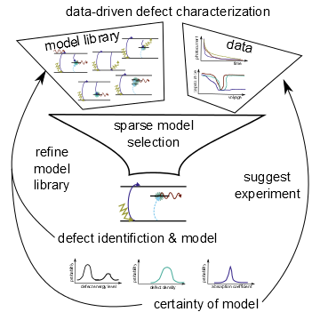





Data-Driven Model Discovery Meets Mechanistic Modeling for Biological Systems
Niall M. Mangan
Assistant Prof.
Eng. Sci. & Applied Math
Northwestern University

Slide 2
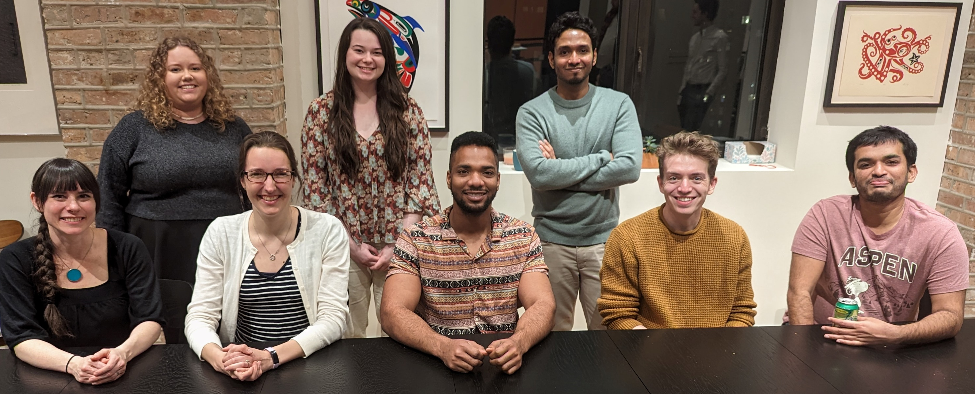
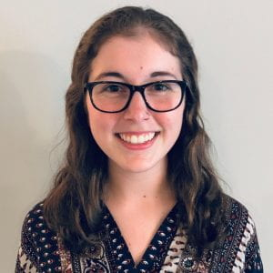





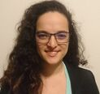



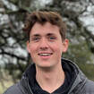



Christina Catlett
Dr. Manu Jayadharan
Maria Warns
Katie Dreyer
NU Center for Optimization and Statistical Learning
Dr. Cody FitzGerald
Dr. Jithin George
Dr. Katelyn Leisman
Dr. Andre Archer
Andrew Engedal
(MSU)
Jessica Lin (Berkeley)
Finn Hagarty
Dr. Helena
Ribera Ponsa
Dr. Sasha
Shirman
Julie Nguyen
niallmangan.com

Slide 3
Mechanistic Modeling
Data-driven prediction
Notes:
Heuristic generation of ~10-100 models with fitting and evaluation
Equation-free modeling
Auto-regressive, moving average models
Neural-networks
Clustering analysis

Slide 4
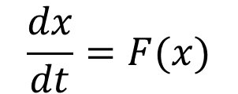
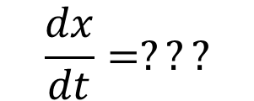
Mechanistic Modeling
Data-driven prediction
known
mechanistic equations
unknown
$$\frac{dx}{dt}=F(x)$$
$$\frac{dx}{dt}=???$$

Slide 5
Mechanistic Modeling
Data-driven prediction
known
mechanistic equations
$$\frac{dx}{dt}=F(x)$$
Information from data

Slide 6
Mechanistic Modeling
Data-driven prediction
known
mechanistic equations
$$\frac{dx}{dt}=F(x)$$
Information from data
Qualitative analysis of behavior
Multi-model fitting and comparison
Sparse model identification/regression
Machine learning
Quantitative analysis for single model
Genetic and greedy searches in model space

Slide 7
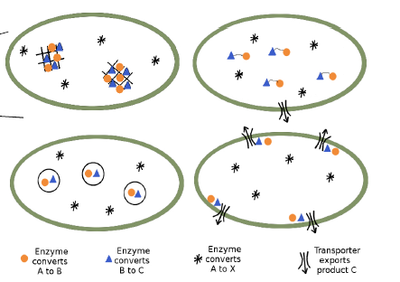
Mechanistic Modeling
Data-driven prediction
known
mechanistic equations
$$\frac{dx}{dt}=F(x)$$
Information from data
How and why do bacteria organize metabolism in time and space?
Multi-model fitting and comparison
Sparse model identification/regression
Machine learning
Genetic and greedy searches in model space

Slide 8
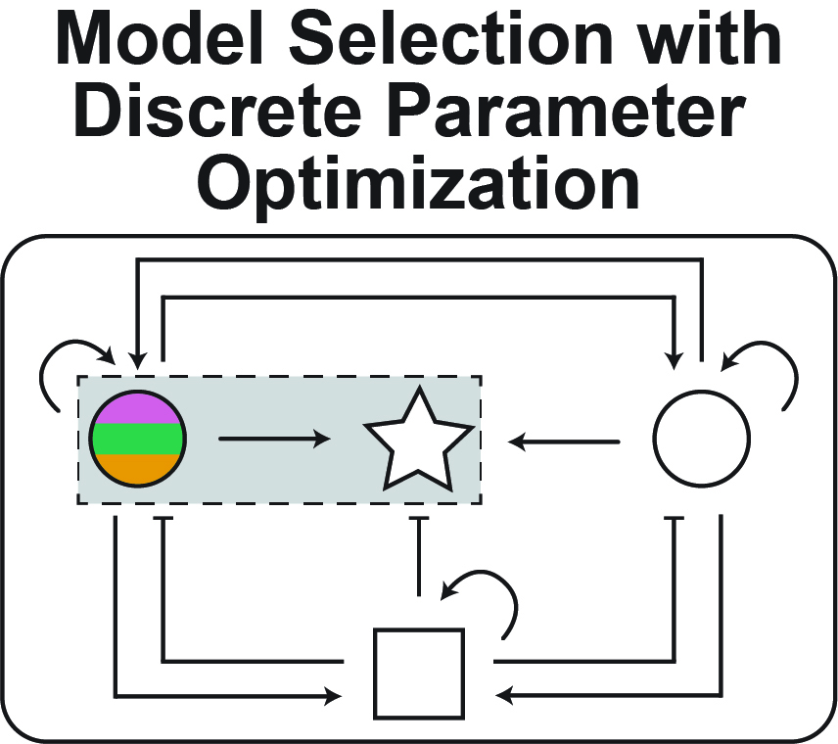


Mechanistic Modeling
Data-driven prediction
known
mechanistic equations
$$\frac{dx}{dt}=F(x)$$
Information from data
How and why do bacteria organize metabolism in time and space?
Multi-model fitting and comparison
Sparse model identification/regression
Machine learning
Can we design genetic programs for mammalian cells to process dynamic signals?

Slide 9
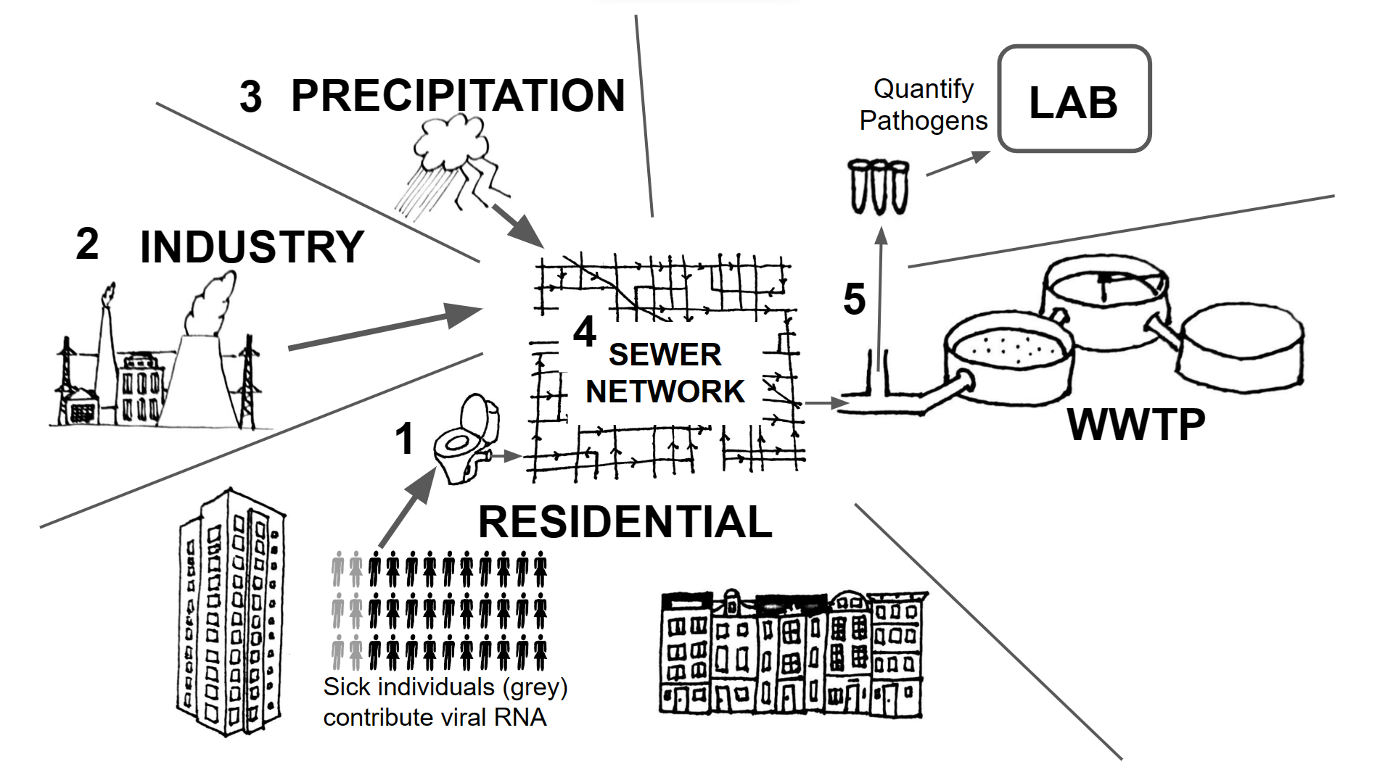


Mechanistic Modeling
Data-driven prediction
known
mechanistic equations
$$\frac{dx}{dt}=F(x)$$
Information from data
How and why do bacteria organize metabolism in time and space?
Can wastewater detection of SARS-CoV-2 predict hospitalizations?
Sparse model identification/regression
Machine learning
Can we design genetic programs for mammalian cells to process dynamic signals?

Slide 10
Mechanistic Modeling
Data-driven prediction
known
mechanistic equations
$$\frac{dx}{dt}=F(x)$$
Information from data
How and why do bacteria organize metabolism in time and space?
Can wastewater detection of SARS-CoV-2 predict hospitalizations?
Sparse model identification/regression
Machine learning
Can we design genetic programs for mammalian cells to process dynamic signals?

Slide 11
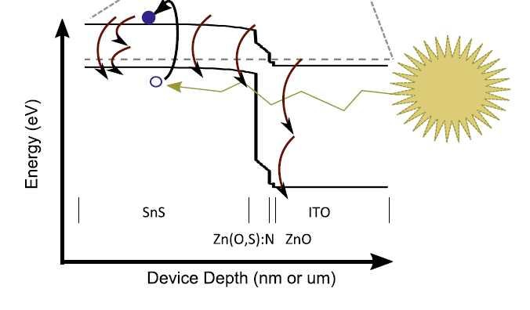
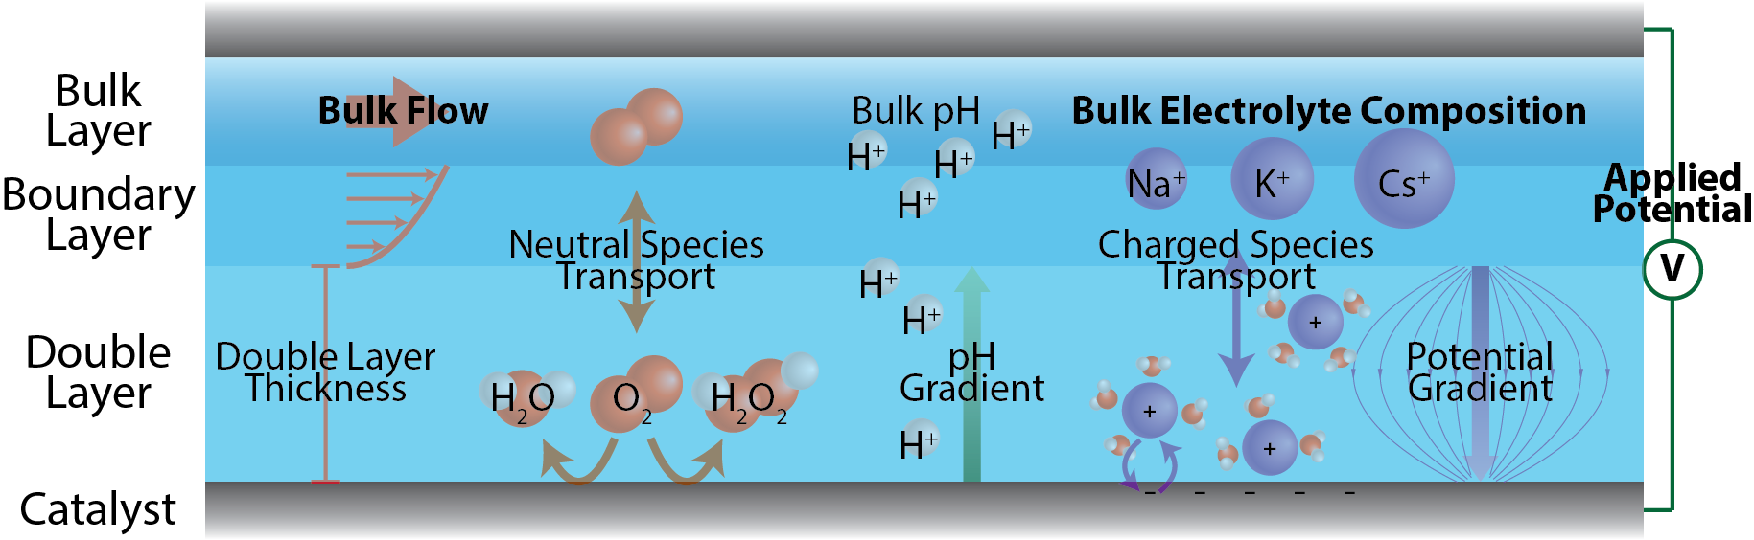
Mangan Group: sustainable chemistry and materials
How do transport, nano-environment structure, and chemical reaction mechanism interrelate?
Can we identify dominant loss mechanisms in solar cells from electrical measurements?
niallmangan.com

Slide 12
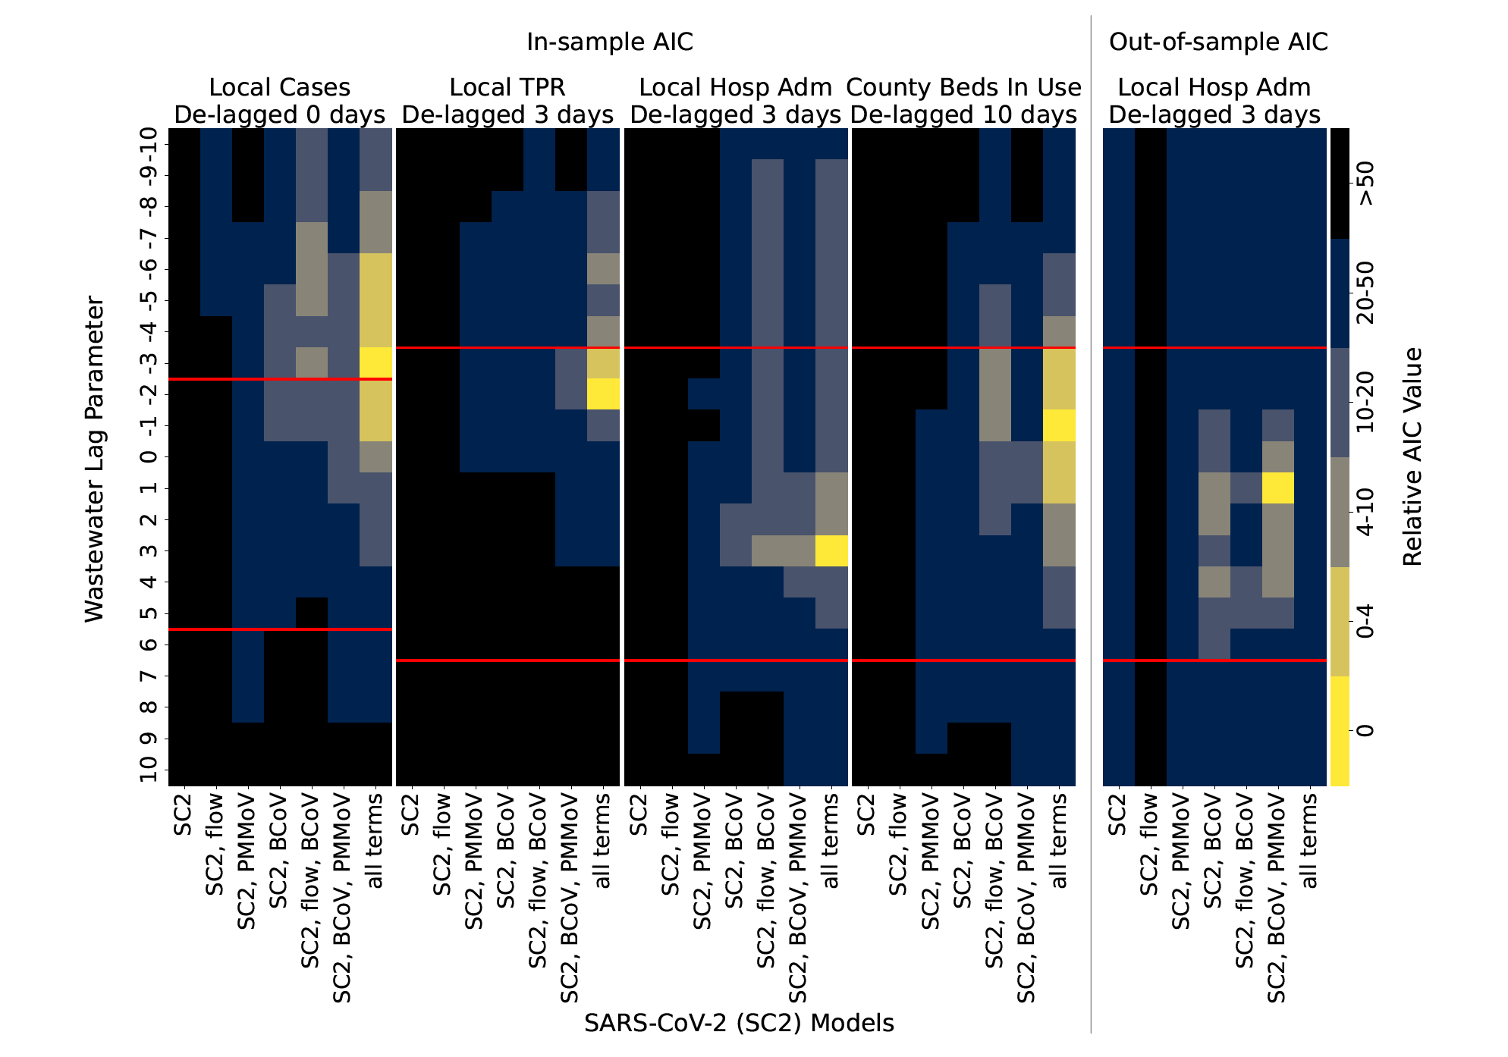
Models to relate wastewater to hospitalizations
Waste Water Treatment Plant
K. P. Leisman et al. Water Research, 252, 121178 (2024).

Slide 13
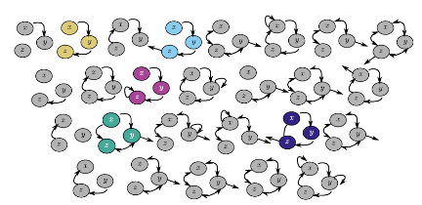

Identifying Models from Data:
Sparse-model selection
Hidden state-variables and chaotic systems
Dynamics of hibernation
  Model Identification

Slide 14
Challenge of building a model: testing models is expensive
Would be nice to have all possible models for:
connectivity of network
dynamical interactions on network

Slide 15
Challenge of building a model: testing models is expensive
Would be nice to have all possible models for:
connectivity of network
dynamical interactions on network
$\frac{dx}{dt}=ξ_{x0}+ξ_{x1}x+ξ_{x2}y+ξ_{x3}z+ξ_{x4}xy+ξ_{x5}xz+ξ_{x6}yz+ξ_{x7}x_{}^{2}$+ $ξ_{x8}y_{}^{2}+ …$
$\frac{dy}{dt}=ξ_{y0}+ξ_{y1}x+ξ_{y2}y+ξ_{y3}z+ξ_{y4}xy+ξ_{y5}xz+ξ_{y6}yz+ξ_{y7}x_{}^{2}$+ $ξ_{y8}y_{}^{2}+ …$
$\frac{dz}{dt}=ξ_{z0}+ξ_{z1}x+ξ_{z2}y+ξ_{z3}z+ξ_{z4}xy+ξ_{z5}xz+ξ_{z6}yz+ξ_{z7}x_{}^{2}$+ $ξ_{z8}y_{}^{2}+ …$

Slide 16






Challenge of building a model: testing models is expensive
Would be nice to have all possible models for:
connectivity of network
dynamical interactions on network
$\frac{dx}{dt}=ξ_{x0}+ξ_{x1}x+ξ_{x2}y+ξ_{x3}z+ξ_{x4}xy+ξ_{x5}xz+ξ_{x6}yz+ξ_{x7}x_{}^{2}$+ $ξ_{x8}y_{}^{2}+ …$
$\frac{dy}{dt}=ξ_{y0}+ξ_{y1}x+ξ_{y2}y+ξ_{y3}z+ξ_{y4}xy+ξ_{y5}xz+ξ_{y6}yz+ξ_{y7}x_{}^{2}$+ $ξ_{y8}y_{}^{2}+ …$
$\frac{dz}{dt}=ξ_{z0}+ξ_{z1}x+ξ_{z2}y+ξ_{z3}z+ξ_{z4}xy+ξ_{z5}xz+ξ_{z6}yz+ξ_{z7}x_{}^{2}$+ $ξ_{z8}y_{}^{2}+ …$

Slide 17




Challenge of building a model: testing models is expensive
Would be nice to have all possible models for:
connectivity of network
dynamical interactions on network
$\frac{dx}{dt}=ξ_{x0}+ξ_{x1}x+ξ_{x2}y+ξ_{x3}z+ξ_{x4}xy+ξ_{x5}xz+ξ_{x6}yz+ξ_{x7}x_{}^{2}$+ $ξ_{x8}y_{}^{2}+ …$
$\frac{dy}{dt}=ξ_{y0}+ξ_{y1}x+ξ_{y2}y+ξ_{y3}z+ξ_{y4}xy+ξ_{y5}xz+ξ_{y6}yz+ξ_{y7}x_{}^{2}$+ $ξ_{y8}y_{}^{2}+ …$
$\frac{dz}{dt}=ξ_{z0}+ξ_{z1}x+ξ_{z2}y+ξ_{z3}z+ξ_{z4}xy+ξ_{z5}xz+ξ_{z6}yz+ξ_{z7}x_{}^{2}$+ $ξ_{z8}y_{}^{2}+ …$

Slide 18
Challenge of building a model: testing models is expensive
Would be nice to have all possible models for:
connectivity of network
dynamical interactions on network
If we tried enumerating all possible mass-action kinetic models:
If we wrote out every possible model for
3 populations
2nd order polynomials
….that would be ~10⁹ models…

Slide 19
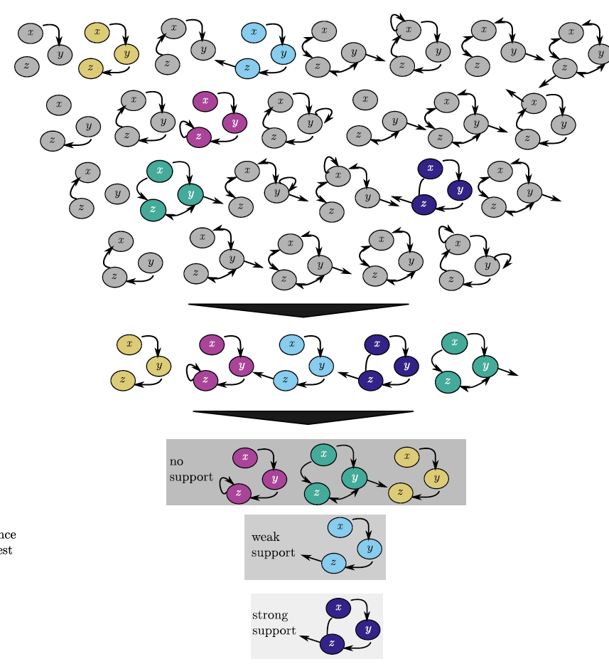
Using data to identify models directly!
  Model Identification

Slide 20
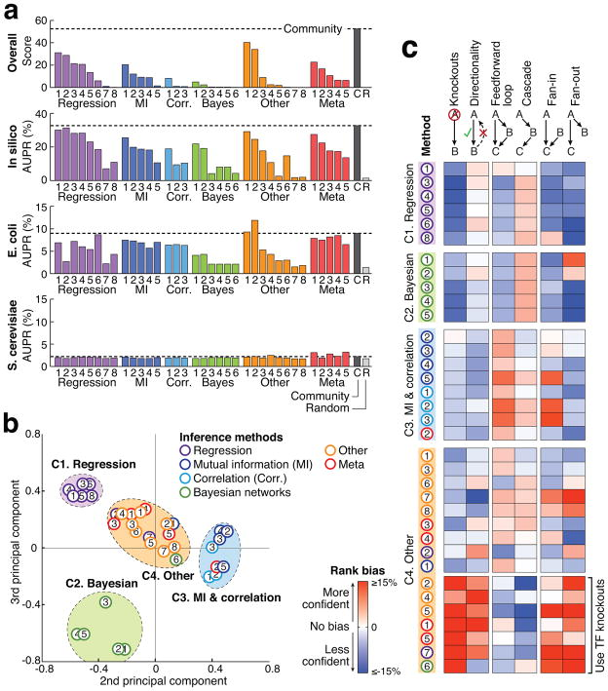
Methods for (large) biological networks:
Dream Challenge: Infer biological networks with
1000s of components
Different methods:
Linear/nonlinear
Binary/functional
Work to varying degrees
w/ perturbations is always better
Dream Challenge: D. Marbach, et. al. “Wisdom of crowds for robust gene network inference,” Nat Methods, vol. 9, no. 8, pp. 796–804, 2012.
Notes:
Noah Simon

Slide 21
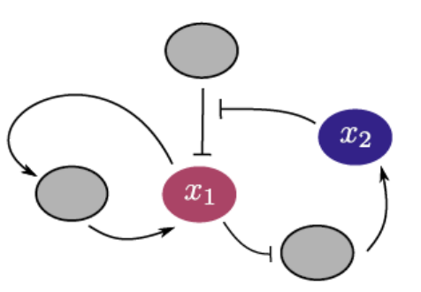

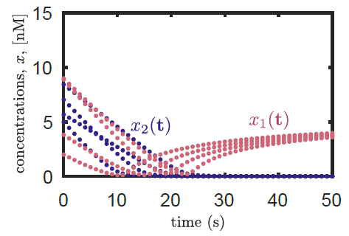
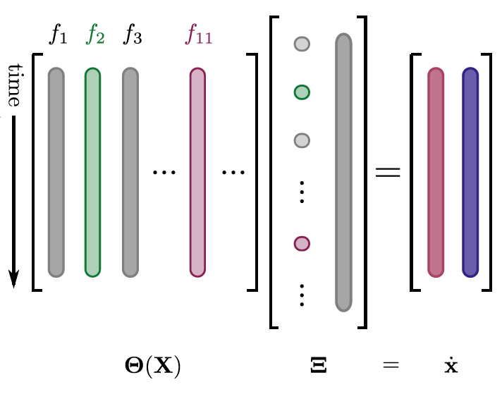
Sparse Identification of Nonlinear Dynamics (SINDy)
1) Generate data from system
2) Build a nonlinear library of candidate
functions and formulate regression to
select terms
S. L. Brunton, J. L. Proctor, and J. N. Kutz, Proc. Natl. Acad. Sci., 2016.

Slide 22


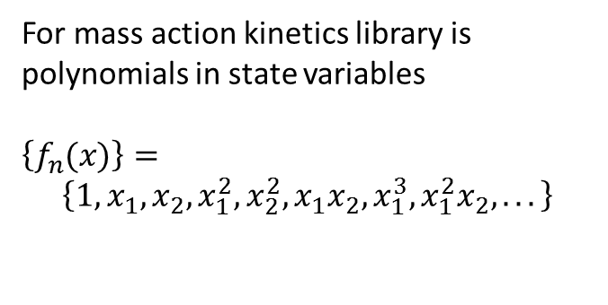
Sparse Identification of Nonlinear Dynamics (SINDy)
1) Generate data from system
2) Build a nonlinear library of candidate
functions and formulate regression to
select terms
For mass action kinetics library is polynomials in state variables
$$\left\{f_{n}(x)\right\}=$$
$$\left\{1, x_{1},x_{2},x_{1}^{2},x_{2}^{2},x_{1}x_{2}, x_{1}^{3},x_{1}^{2}x_{2},...\right\}$$
$$1 { x}_{1} x_{2}$$
$$x_{1}^{2}x_{2}$$
S. L. Brunton, J. L. Proctor, and J. N. Kutz, Proc. Natl. Acad. Sci., 2016.

Slide 23
Sparse Identification of Nonlinear Dynamics (SINDy)
1) Generate data from system
2) Build a nonlinear library of candidate
functions and formulate regression to
select terms
$$1 { x}_{1} x_{2}$$
$$x_{1}^{2}x_{2}$$
S. L. Brunton, J. L. Proctor, and J. N. Kutz, Proc. Natl. Acad. Sci., 2016.

Slide 24

Sparse Identification of Nonlinear Dynamics (SINDy)
2) Build a nonlinear library of candidate
functions and formulate regression to
select terms
3) Determine sparse coefficients
and evaluate identified model
1) Generate data from system
Alternate between
  Least Squares
  Hard Thresholding
$$1 { x}_{1} x_{2}$$
$$x_{1}^{2}x_{2}$$
S. L. Brunton, J. L. Proctor, and J. N. Kutz, Proc. Natl. Acad. Sci., 2016.

Slide 25
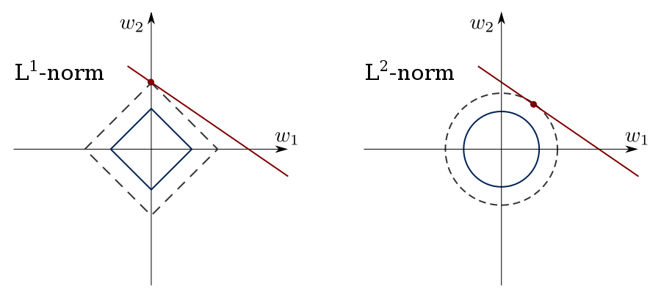
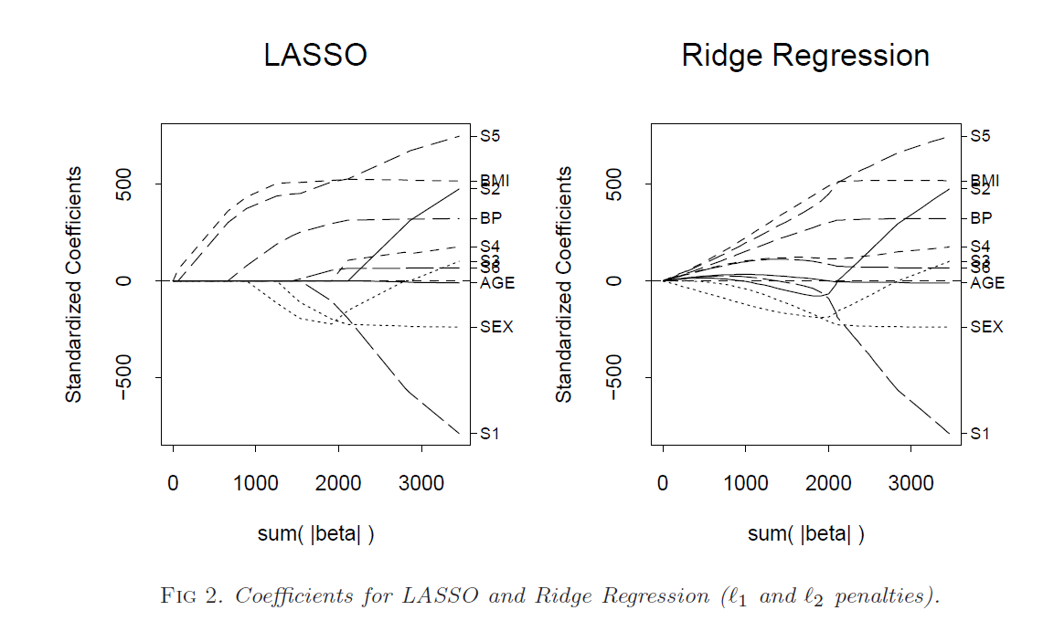

Sparse selection of variables, terms, features
Use sparse regression to solve for
LASSO
Ridge
Elastic Net
$$\hat{ξ}=\min_{ξ}{({\left\|y−Xξ\right\|}^{2}+λ_{1}{\left\|ξ\right\|}^{2}+λ_{2}{\left\|ξ\right\|}_{1} })$$
Has been applied to many, many systems for variable selection!
T. Hesterberg, N. H. Choi, L. Meier, and C. Fraley, “Least angle and ℓ 1 penalized regression: A review *,” Stat. Surv., vol. 2, pp. 61–93, 2008.

Slide 26
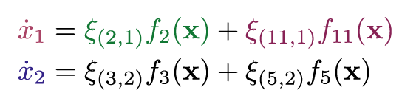
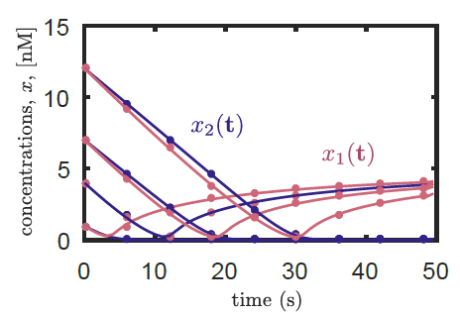


Sparse Identification of Nonlinear Dynamics (SINDy)
1) Generate data from system
2) Build a nonlinear library of candidate
functions and formulate regression to
select terms
3) Determine sparse coefficients
and evaluate identified model
$${ x}_{1}$$
$$x_{1}^{2}x_{2}$$
$$1 { x}_{1} x_{2}$$
$$x_{1}^{2}x_{2}$$
S. L. Brunton, J. L. Proctor, and J. N. Kutz, Proc. Natl. Acad. Sci., 2016.

Slide 27
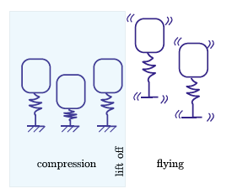
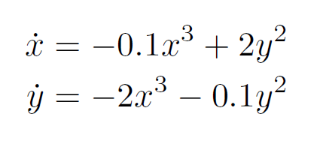
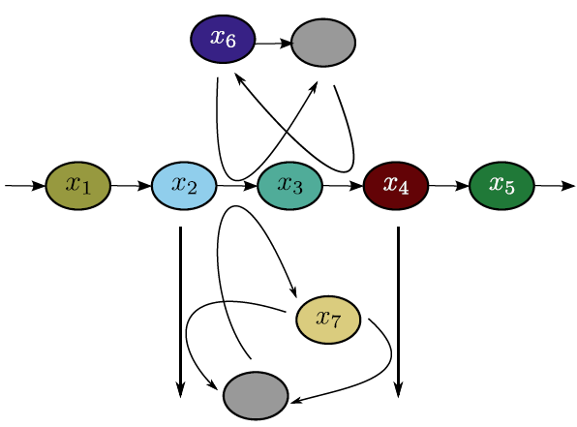
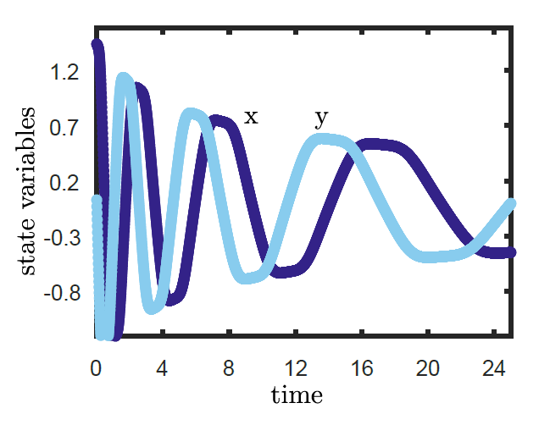
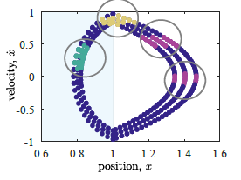
Methods when all dynamics are measured
Combine with information theory
Mass-action kinetics with multiple time-scales
Model changes during measurement
Solve using sparse linear algebra techniques, where most terms are zero.
Papers & code linked at niallmangan.com
Work done with Nathan Kutz, Josh Proctor, Steve Brunton and Travis Askham while at U. Washington, Seattle.

Slide 28


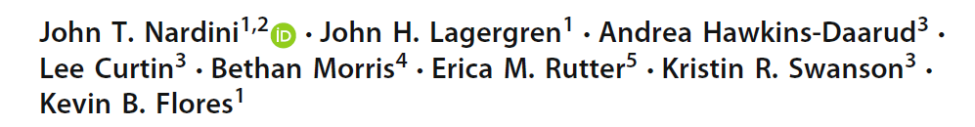
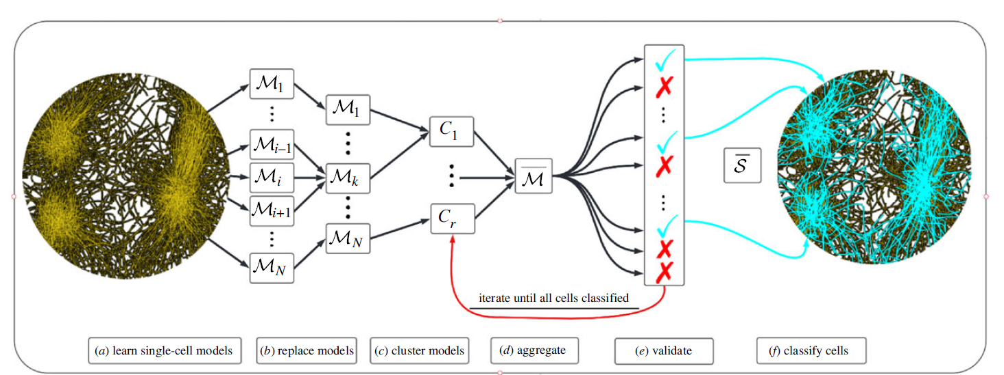
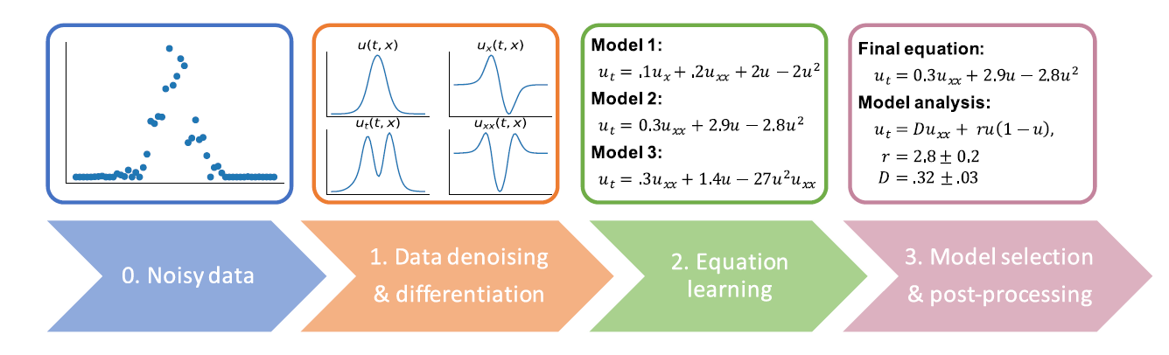
Methods for biological systems

Slide 29
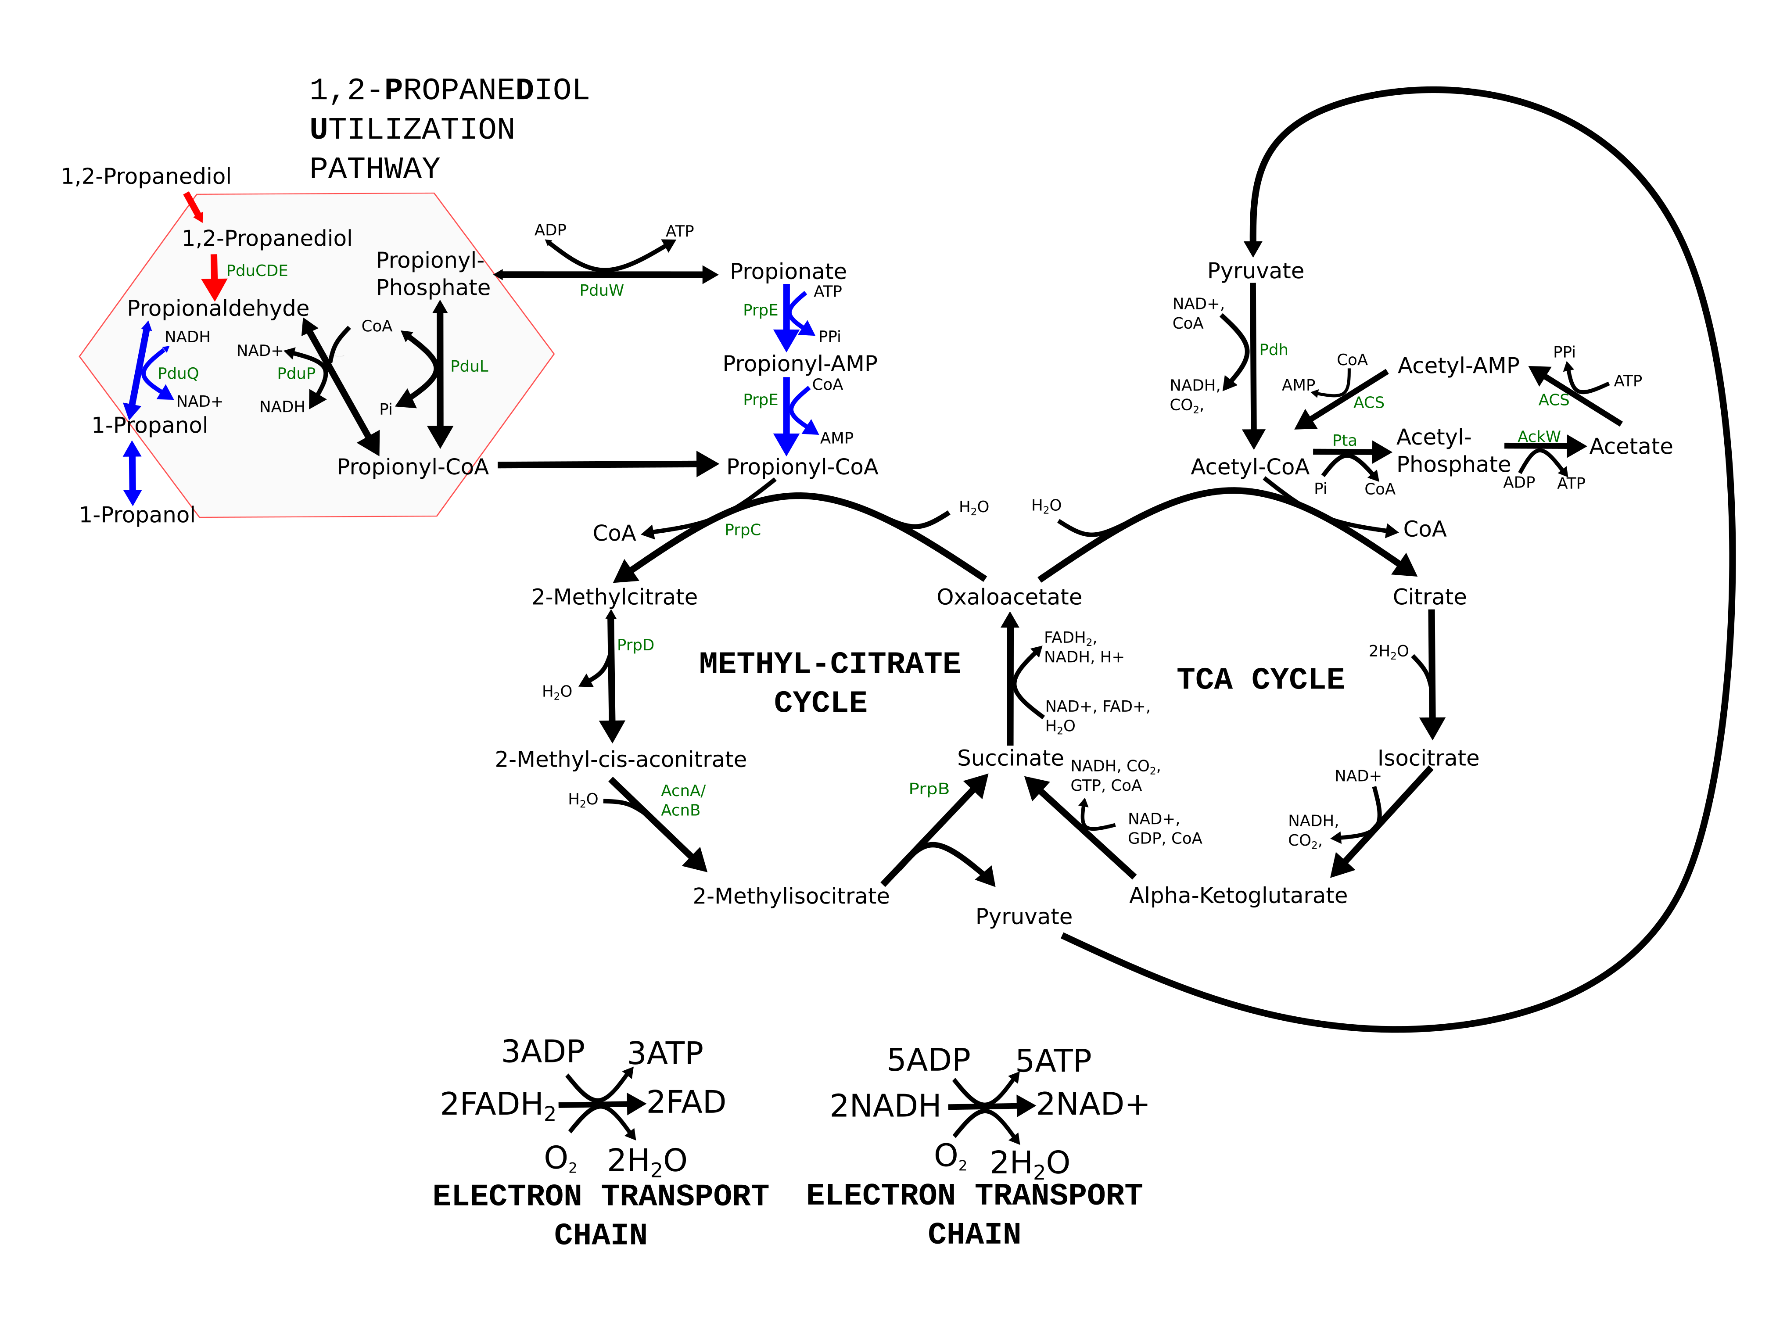
Problem 2: we often can’t measure everything.

Slide 30
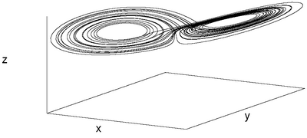
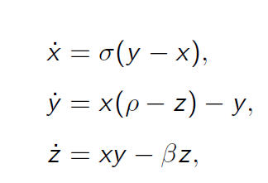
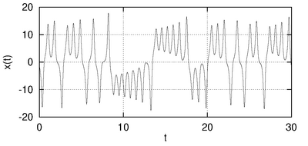
Challenge: Unmeasured or hidden variables.
Why should we expect to be able to recover dynamics of variables we don’t measure?
Taken’s embedding theorem (1981)

Slide 31
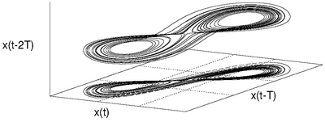
Challenge: Unmeasured or hidden variables.
Why should we expect to be able to recover dynamics of variables we don’t measure?
Taken’s embedding theorem (1981)
Can reconstruct the system using only x!

Slide 32
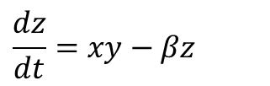
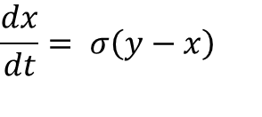
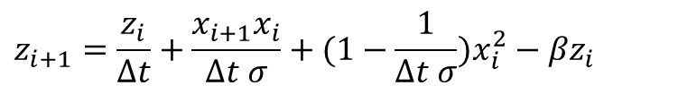
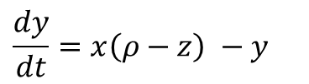
Challenge: Unmeasured or hidden variables.
Approach 1: Delay-coordinates
Linear optimization over
  Parameters
Could also express as 3rd order ODE
Approach 2: coupled-systems
Nonlinear optimization over
  Parameters and unmeasured variables (t)
More linear in state variables
$x_{i+2}=−{x_{i}z}_{i}+\left(\frac{σ−1}{ σ∆t}\right)x_{i+1}+x_{i}(1+ρ+\frac{σ−1}{ σ∆t}−\frac{1}{{∆t}^{2} σ}$)
$$z_{i+1}=\frac{z_{i}}{∆t}+\frac{x_{i+1}x_{i}}{∆t σ}+(1−\frac{1}{∆t σ})x_{i}^{2}−βz_{i}$$
$$\frac{dx}{dt}= σ\left(y−x\right)$$
$$\frac{dz}{dt}=xy−βz$$
Unmeasured y(t)
$$\frac{dy}{dt}=x\left(ρ−z\right) −y$$

Slide 33
Challenge: Unmeasured or hidden variables.
Approach 1: Delay-coordinates
Linear optimization over
  Parameters
Could also express as 3rd order ODE
Approach 2: coupled-systems
Nonlinear optimization over
  Parameters and unmeasured variables (t)
More linear in state variables
$x_{i+2}=−{x_{i}z}_{i}+\left(\frac{σ−1}{ σ∆t}\right)x_{i+1}+x_{i}(1+ρ+\frac{σ−1}{ σ∆t}−\frac{1}{{∆t}^{2} σ}$)
$$z_{i+1}=\frac{z_{i}}{∆t}+\frac{x_{i+1}x_{i}}{∆t σ}+(1−\frac{1}{∆t σ})x_{i}^{2}−βz_{i}$$
$$\frac{dx}{dt}= σ\left(y−x\right)$$
$$\frac{dz}{dt}=xy−βz$$
Unmeasured y(t)
$$\frac{dy}{dt}=x\left(ρ−z\right) −y$$

Slide 34
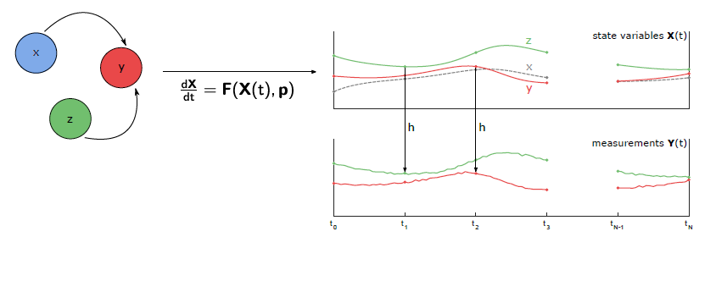
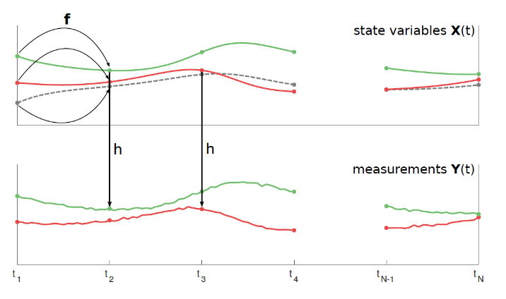
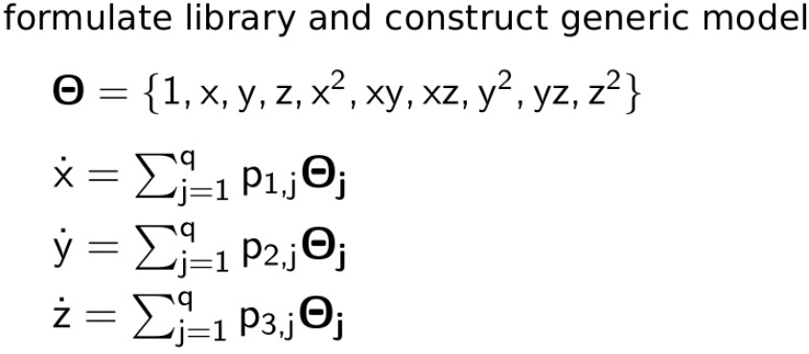
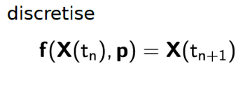
Model selection with hidden variables.
Assumes we know dimension of system
Dr. Helena
Ribera Ponsa
Dr. Sasha
Shirman
Julie Nguyen

Slide 35
Model selection with hidden variables.
Assumes we know dimension of system
Need to simultaneously estimate:
Model structure (which p are 0 or nonzero)
parameters {p}
the entire trajectory of unmeasured variable x
Dr. Helena
Ribera Ponsa
Dr. Sasha
Shirman
Julie Nguyen

Slide 36
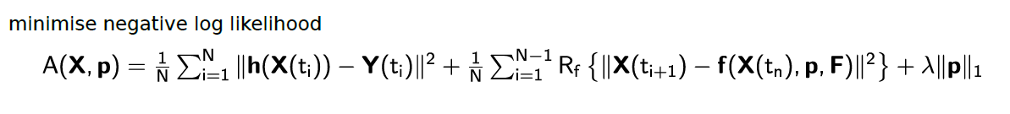
Model selection with hidden variables.
i
H. Ribera, S. Shirman, A. V. Nguyen, N. M. Mangan Chaos 32, 063101 (2022)

Slide 37
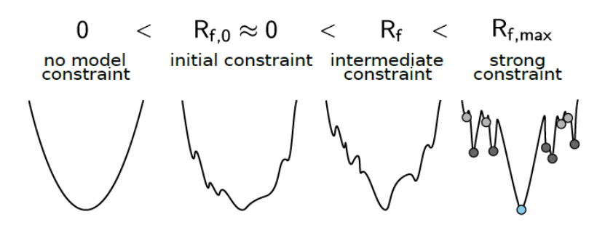
Model selection with hidden variables.
i
Sparsity
Measurement Error
Model Error
Sparsity
H. Ribera, S. Shirman, A. V. Nguyen, N. M. Mangan Chaos 32, 063101 (2022)

Slide 38
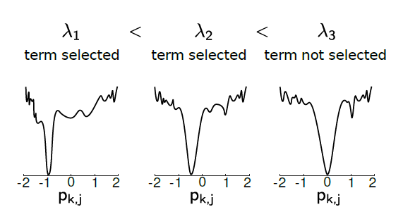
Model selection with hidden variables.
i
Sparsity
Measurement Error
Model Error
Sparsity
H. Ribera, S. Shirman, A. V. Nguyen, N. M. Mangan Chaos 32, 063101 (2022)

Slide 39
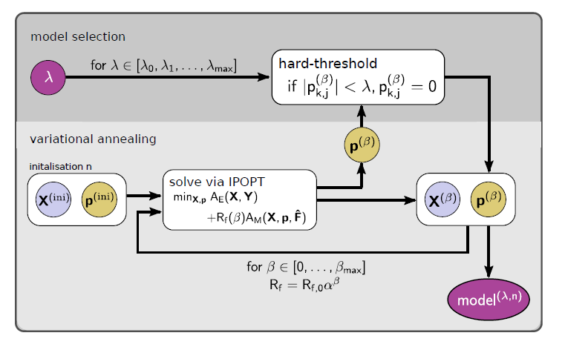
Model selection with hidden variables.
i
Sparsity
Measurement Error
Model Error
Sparsity
H. Ribera, S. Shirman, A. V. Nguyen, N. M. Mangan Chaos 32, 063101 (2022)

Slide 40
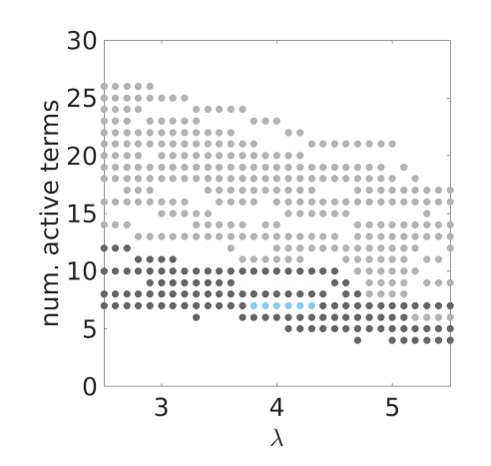
Model selection with hidden variables.
i
Sparsity
Measurement Error
Model Error
Sparsity
H. Ribera, S. Shirman, A. V. Nguyen, N. M. Mangan Chaos 32, 063101 (2022)

Slide 41

Test on experimental data!
Blakely et al. A simple Lorenz circuit and its radio frequency implementation". Chaos 17.2 (2007), p. 023112.

Slide 42


Test on experimental data!
H. Ribera, S. Shirman, A. V. Nguyen, N. M. Mangan Chaos 32, 063101 (2022)

Slide 43



Test on experimental data! Victory*!
Cross-validation on out of sample data:
H. Ribera, S. Shirman, A. V. Nguyen, N. M. Mangan Chaos 32, 063101 (2022)

Slide 44

Models with ‘extra’ terms have strong support
Cross-validation
Cross-validation w/ AIC shows significant difference in models
Hypothesis of additional terms needs experimental validation
Many questions remain about optimal manifold sampling
H. Ribera, S. Shirman, A. V. Nguyen, N. M. Mangan Chaos 32, 063101 (2022)

Slide 45

Robustness to noise
Cumulative distribution for seeds
20 noise seeds
100 parameter & y(t) initializations
~1%, 5%, 10% noise
For 1% all instances found model
For 5% only one failed
For 10% 11/20 instances failed
Recovery is highly bi-modal
H. Ribera, S. Shirman, A. V. Nguyen, N. M. Mangan Chaos 32, 063101 (2022)

Slide 46


Nonlinear functions of parameters
Colpitts Oscillator
Varying Model Libraries
Requires 2 iterations of DAHSI
Applications:
Neuronal systems?
Energy barriers?
H. Ribera, S. Shirman, A. V. Nguyen, N. M. Mangan Chaos 32, 063101 (2022)

Slide 47





Other work on sparse-selection for hidden variables

Slide 48
Identifying Models from Data:
Sparse-model selection
Hidden state-variables and chaotic systems
Dynamics of hibernation
  Model Identification

Slide 49



Metabolic regulation in hibernating artic ground squirrel
Dr. Cody FitzGerald
Andrew
Engedal

Slide 50
How many dimensions does the system have?
Dr. Cody FitzGerald
Andrew
Engedal

Slide 51

How many dimensions does the system have?
– time delay embedding

Slide 52
How many dimensions does the system have?
– time delay embedding
2D and 3D embeddings
are compact

Slide 53





What models do we find?
m1
$$\dot{x}=k_{1}\left(x−y\right)x(1−x)$$
$$\dot{y}=k_{2}\left(x+y\right)(x−y)$$
m2
$$\dot{x}=k_{1}\left(x+y\right)x(1−x)$$
$$\dot{y}={−k}_{2}\left(x+y\right)(x−y)$$
m3
m5
$\dot{x}=k_{1}x+k_{2}x^{2}−k_{3}x^{3}+$ $k_{4}xy−k_{5}x^{2}y$
$\dot{x}=k_{1}x+k_{2}x^{2}−k_{3}x^{3}+$ $k_{4}xy−k_{5}x^{2}y$
$$\dot{y}=k_{6}x+k_{7}y−k_{8}x^{2}+{k_{9}y}^{2}+k_{10}xy$$
$$\dot{y}=k_{6}x+k_{7}y−k_{8}x^{2}+{k_{9}y}^{2}+k_{10}xy$$
m4
…m??
$\dot{x}={−k}_{1}x+k_{2}x^{3}−k_{3}y^{3}−$ $k_{4}xy−k_{5}x^{2}y − k_{6}xy^{2}$
$\dot{x}=k_{1}x+k_{2}x^{2}−k_{3}x^{3}−$ $k_{4}xy−k_{6}x^{2}y$
$$\dot{y}= {−k}_{7}x−k_{8}y−k_{8}x^{3}+{k_{9}y}^{2}+k_{10}xy$$
$$\dot{y}= k_{7}y−{k_{9}y}^{2}+k_{10}xy$$

Slide 54






What models do we find?
m1
m2
$$\dot{x}=k_{1}\left(x−y\right)x(1−x)$$
$$\dot{x}=k_{1}\left(x+y\right)x(1−x)$$
$$\dot{y}=k_{2}\left(x+y\right)(x−y)$$
$$\dot{y}={−k}_{2}\left(x+y\right)(x−y)$$
x – temperature
y – hidden state
y flipped
Scaled States
Scaled States
Measurement index
Measurement index

Slide 55

What models do we find?
m1
m3
$$\dot{x}=k_{1}\left(x−y\right)x(1−x)$$
$\dot{x}=k_{1}x+k_{2}x^{2}−k_{3}x^{3}+$ $k_{4}xy−k_{5}x^{2}y$
$$\dot{y}=k_{2}\left(x+y\right)(x−y)$$
$$\dot{y}=k_{6}x+k_{7}y−k_{8}x^{2}+{k_{9}y}^{2}+k_{10}xy$$
x – temperature
y – hidden state
y scaled and translated
Scaled States
Scaled States
Measurement index
Measurement index

Slide 56


What models do we find?
m1
$$\dot{x}=k_{1}\left(x−y\right)x(1−x)$$
$\dot{x}=k_{1}x+k_{2}x^{2}−k_{3}x^{3}−$ $k_{4}xy−k_{6}x^{2}y$
$$\dot{y}=k_{2}\left(x+y\right)(x−y)$$
$$\dot{y}= k_{7}y−{k_{9}y}^{2}+k_{10}xy$$
x – temperature
y – hidden state
Other??
Scaled States
Scaled States
Measurement index
Measurement index

Slide 57



Mechanistic examination of model 1
Scaled States
Hidden state y
Time
Scaled Temperature

Slide 58
Metabolic regulation in hibernating artic ground squirrel
Sparsely selected model consistent with existing “depleted metabolite” hypothesis
First use of algorithm on data with no agreed upon model
Need to improve robust selection of small parameters
Scaled States
Hidden state y
Time
Scaled Temperature

Slide 59



Challenges in applying to other ODE systems
Chaotic
system
Recovery drops to 3%
Need alternative optimization method
Need to design experimental sampling?
Cost functions are “flat” in many dimensions
Sampling of dynamics requires design
Metabolic
system
cell permeability
compartment permeability

Slide 60
Identifying Models from Data:
Sparse-model selection
Hidden state-variables and chaotic systems
Dynamics of hibernation
Thank you!
  Model Identification

Slide 61
Christina Catlett
Dr. Manu Jayadharan
Maria Warns
Katie Dreyer
NU Center for Optimization and Statistical Learning
Dr. Cody FitzGerald
Dr. Jithin George
Dr. Katelyn Leisman
Dr. Andre Archer
Andrew Engedal
(MSU)
Jessica Lin (Berkeley)
Finn Hagarty
Dr. Helena
Ribera Ponsa
Dr. Sasha
Shirman
Julie Nguyen
niallmangan.com

Slide 62





Modeling the pyrenoid-based CO₂-concentrating mechanism provides insights into its operating principles and a roadmap for its engineering into crops
Princeton collaborators:
Norm. CO₂
fixation flux
Thylakoid membranes
0
0.5
1
10⁻²
Passive HCO₃⁻ uptake
Rubisco
HCO₃⁻
BST
CAH3
Chenyi Fei
Alexandra Wilson
Rubisco
CO₂
10⁻⁴
Matrix
Rubisco
HCO₃⁻
LCIA
Pyrenoid
Rubisco
Rubisco
LCIA-mediated permeability (m/s)
CO₂
half-maximal flux
LCIB
CO₂
10⁻⁶
Rubisco
Thylakoid
lumen
No
CCM
Stroma
pH=6
pH=8
pH=7
10⁰
10²
10⁴
10⁶
LCIB rate (1/s)
Prof. Ned Wingreen
Prof. Martin Jonikas
Carbonic anhydrases
HCO₃⁻ transporters
Fei*, Wilson*, et al., Nature Plants 2022
.

Slide 63





Walking into the complex plane to ‘order’ better time integrators
Jithin George
Samuel Jung
5th order accuracy in 5 RK steps!
Larger stability regions for complex-valued systems.
J. George, S. Jung, N.M. Mangan arXiv:2110.04402 [math.NA]

Slide 64






GAMES: A dynamic model development workflow for rigorous characterization of synthetic genetic systems
Kate Dray
Dr. Joe Muldoon
Prof. Neda Bagheri (UW)
Prof. Josh Leonard
K Dray et al. ACS Synth. Biol. 2022, 11, 2, 1009–1029

Slide 65








Changes in body shape implicate cuticle stretch in C. elegans development
Joy Nyaanga
Christina Goss
Dr. Sasha Shirman
Hour 1
Hour 21
Hour 31
Dr. Gaotian
Zhang
Prof. Erik
Andersen
Hour 43
Hour 51
Hour 68
Nyaanga et al. Cells and Development 2022

Slide 66
Thank you!
  Model Identification

