Slide 1
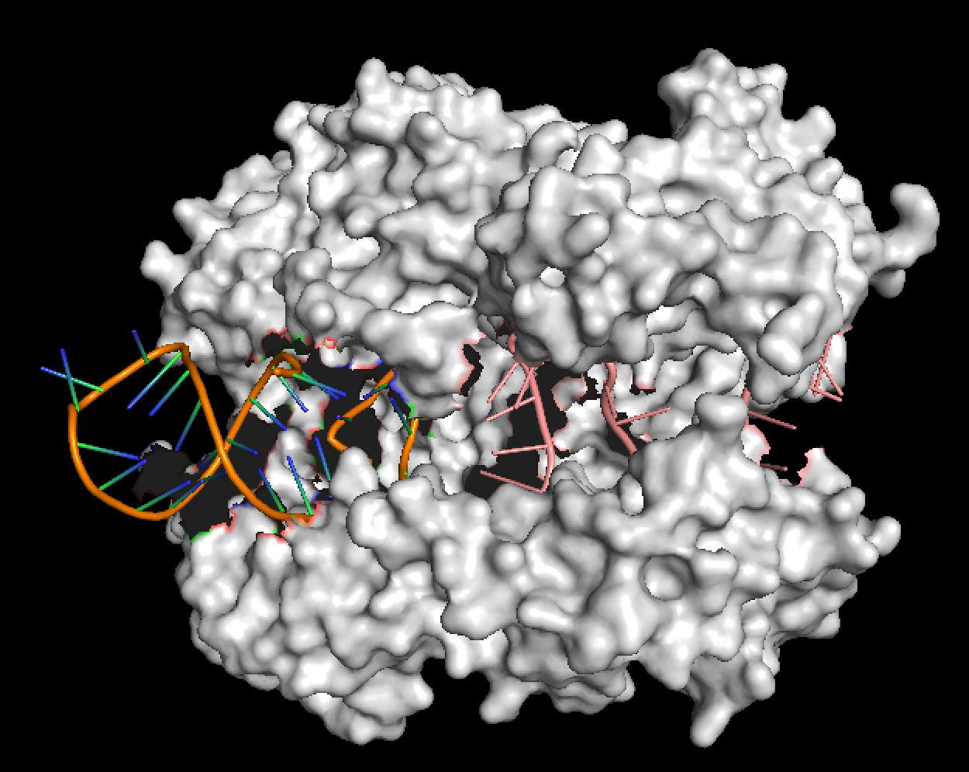
Manipulating mammalian transcription for the interrogation of complex diseases
Silvana Konermann
Founder, Executive Director and Core Faculty, Arc Institute
Assistant Professor, Biochemistry Department, Stanford University

Slide 2
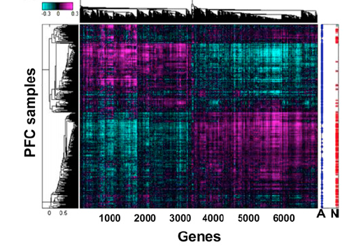
Genetics and gene expression signatures of Alzheimer’s Disease
Transcriptional profiling
GWAS
ApoE4
Limited to postmortem samples
>4000 genes differentially expressed
>90%: non-coding variants
Linked to gene expression by eQTLs
Need for (1) targeted transcriptional perturbations and (2) human brain model systems to identify transcripts and isoforms driving disease risk and progression
Lambert et al., Nature Genetics 2013, Zhang et al. Cell. 2013
Notes:
In neurological diseases including neurodegeneration transcriptional networks are found to be perturbed, leading to large scale transcriptional changes
In this example, analyzing transcriptional differences between healthy and alzeimer’s disease brain, thousands of genes are differentially expressed in the prefrontal cortex
As NGS technologies develop, power of these studies increase but challenge to indetify key drivers of disease development remains to
Goal of graduate work: delelop such tools that can be appliad at the necessary scale (ideally genome wide) to help

Slide 3
Overview
Targeting transcription at the level of DNA at genome scale
Direct targeting of RNA to modulate knock-down and splicing
Building human brain model systems to interrogate LOAD and other complex neurological diseases
Building Arc Institute as a new structural model to enable the study of complex diseases more broadly

Slide 4
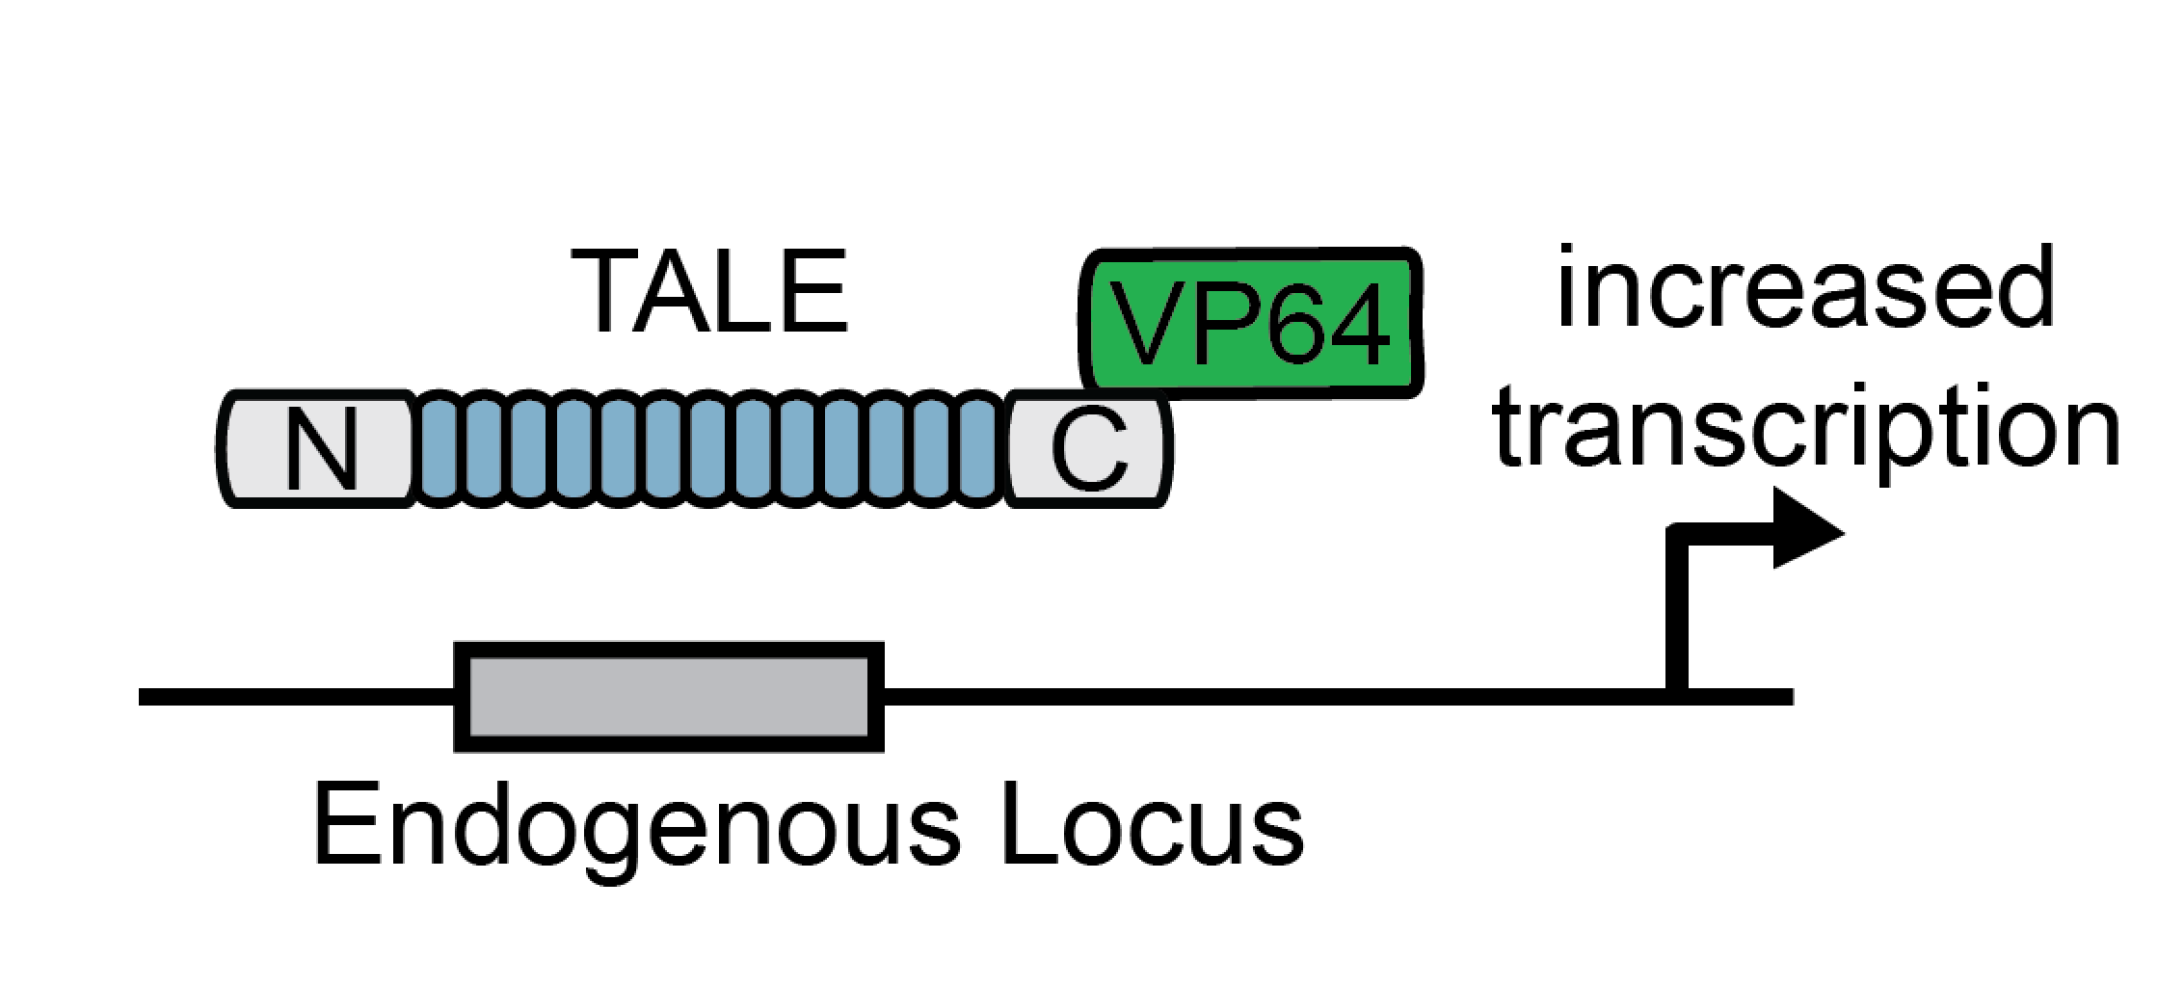
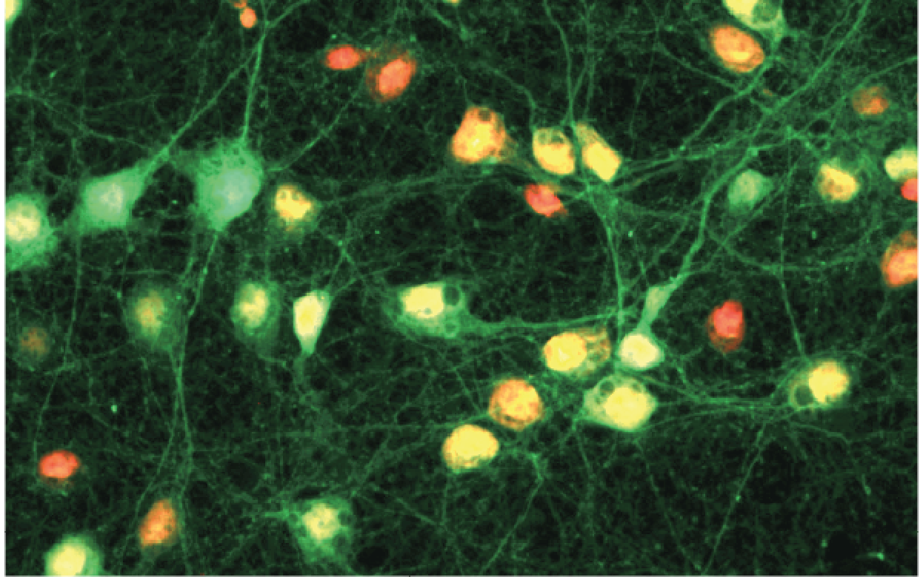
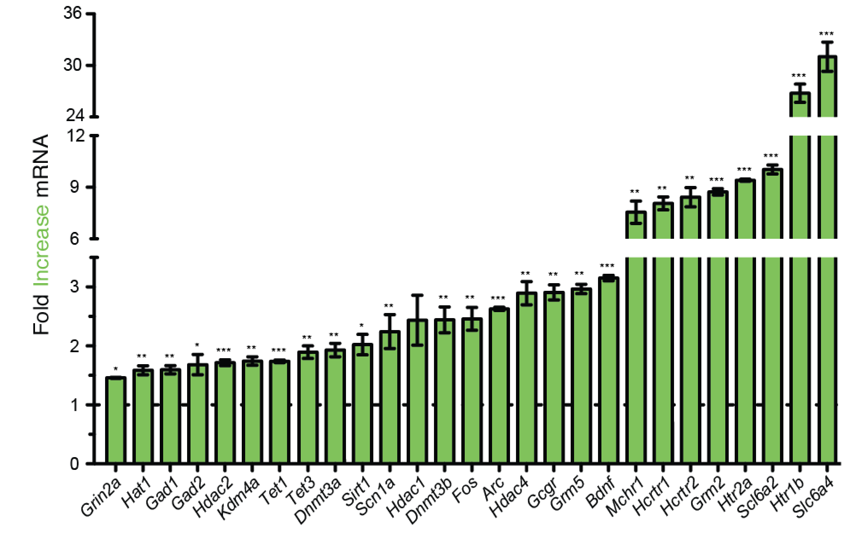
Transcriptional control 1.0: reprogrammable transcription factors in neurons using TALE-TFs
Protein-encoded targeting limits throughput: challenge for investigating complex multigenic neurological diseases
Konermann et al., Nature. 2013

Slide 5
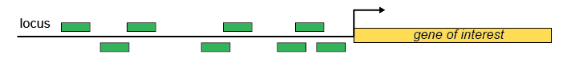

Towards transcriptional control on a network level
Single gene level: robust activator with lower screening efforts
Network level: multiplexed activation of genes / genome-wide screens
Requirements: easy retargeting, robust activation, reliability
Notes:
Working towards a system that allows for the interrogation of multiple genes through transcriptional control

Slide 6
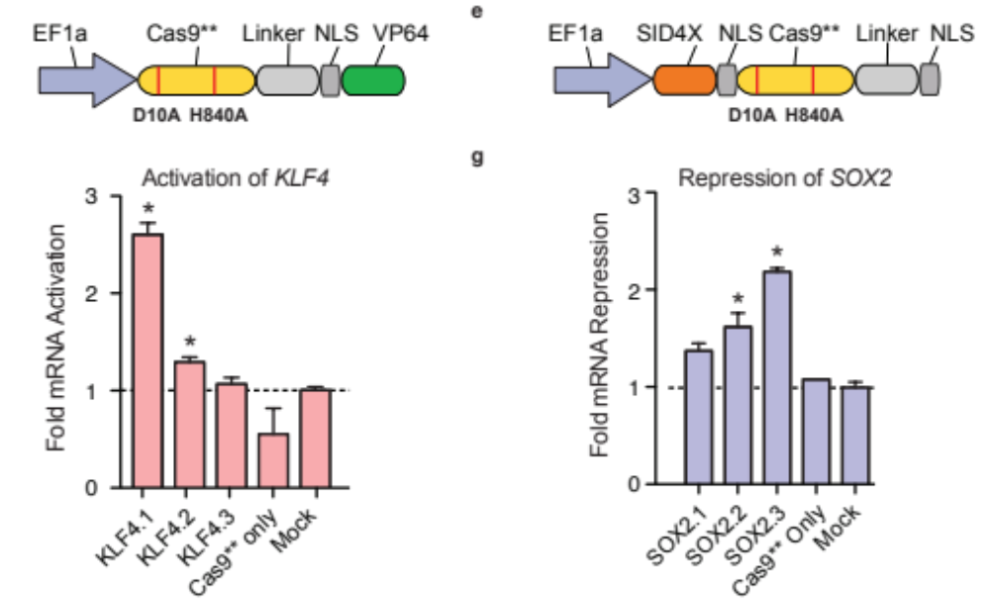
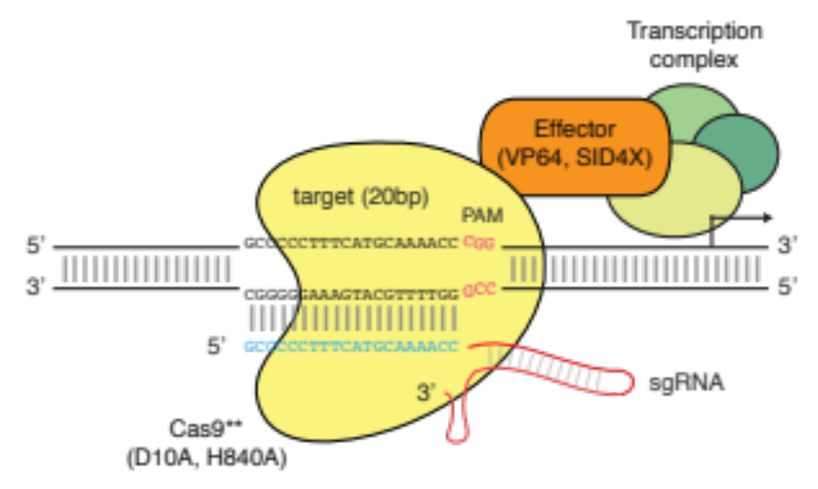
First generation Cas9-based transcriptional effectors
easy retargeting
robust activation, reliability
Gilbert, L. A. et al., Cell 2013, Konermann et al., Nature 2013,
Maeder, M. L. et al. Nature Methods 2013, Perez-Pinera, P. et al., Nature Methods 2013, Mali, P, et al., NBT, 2013

Slide 7
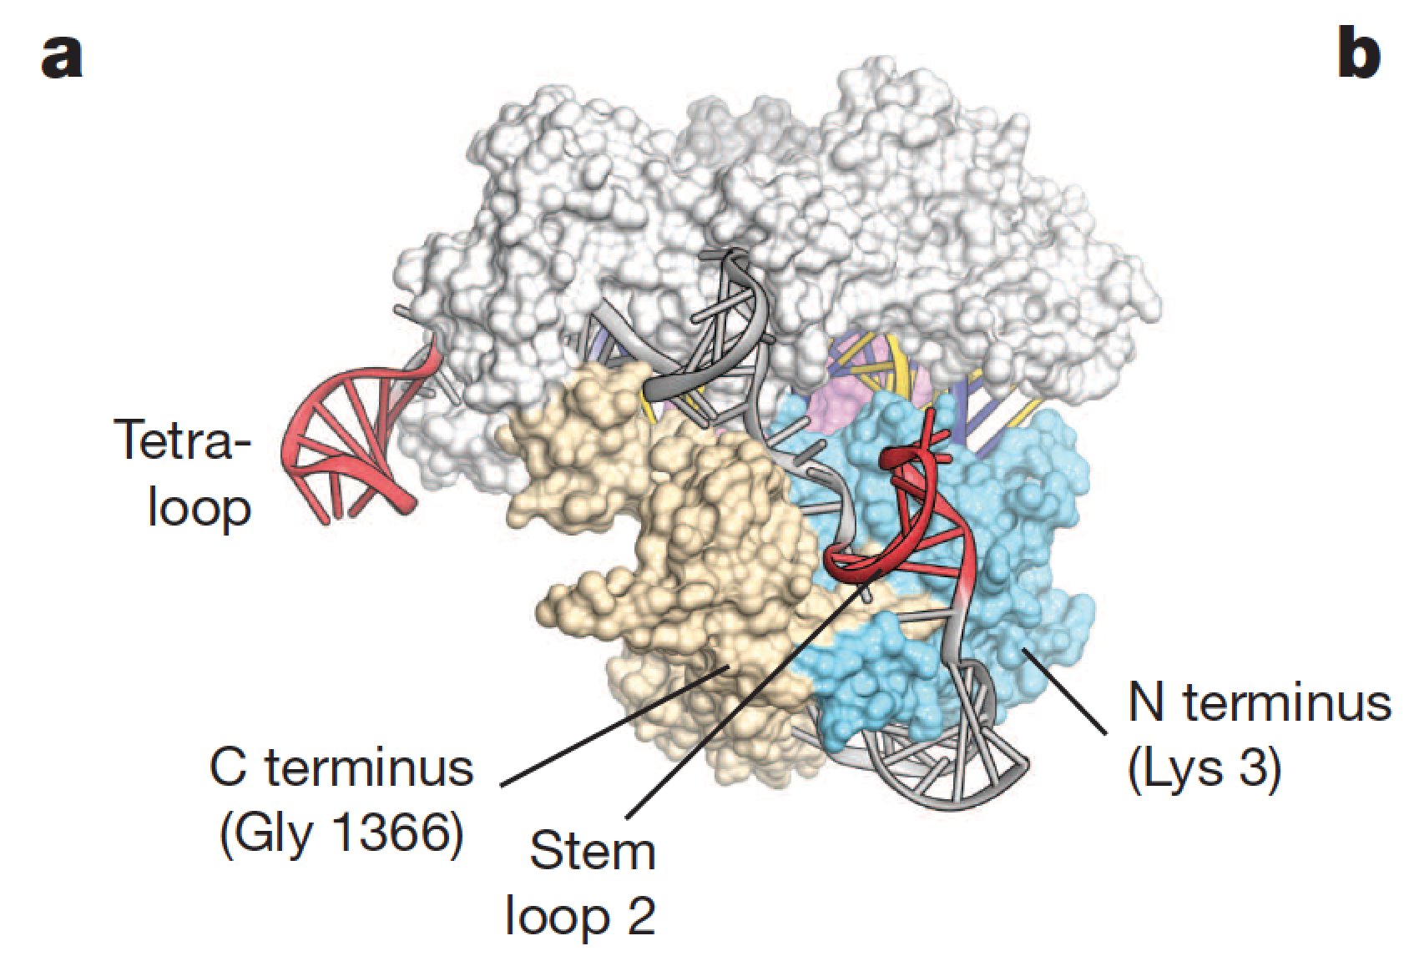
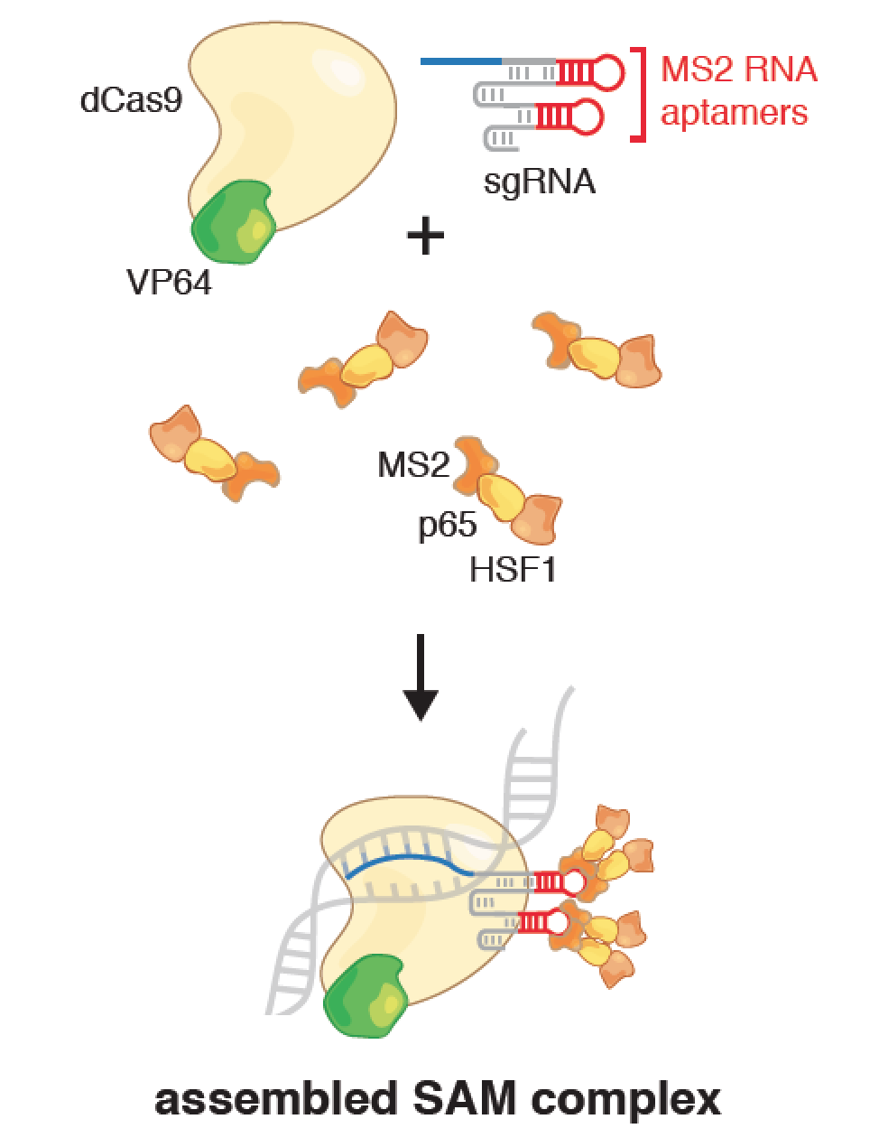
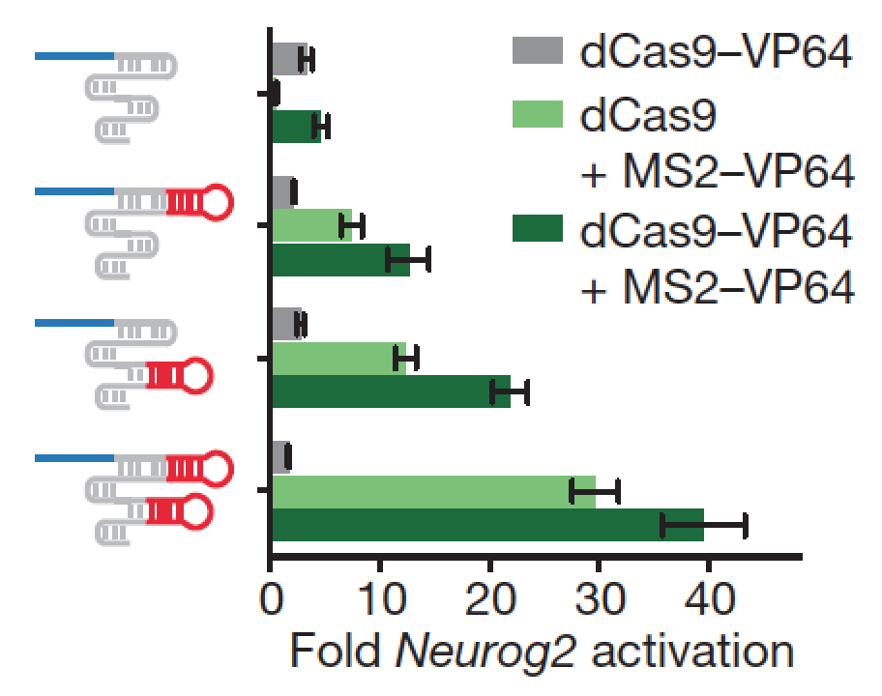
Engineering of a Cas9 Synergistic Activation Mediator (SAM)
Synergistic pairing of activation domains + recruitment to exposed RNA loops: robust and high efficiency activation (~100x improvement)
Konermann et al., Nature 2015

Slide 8
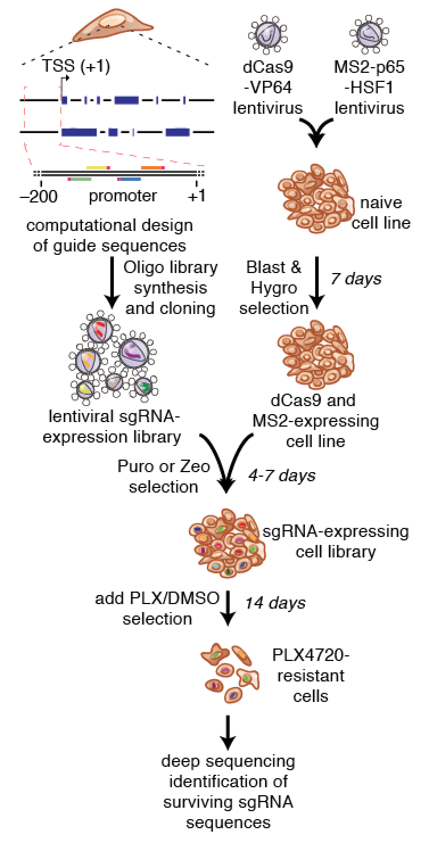
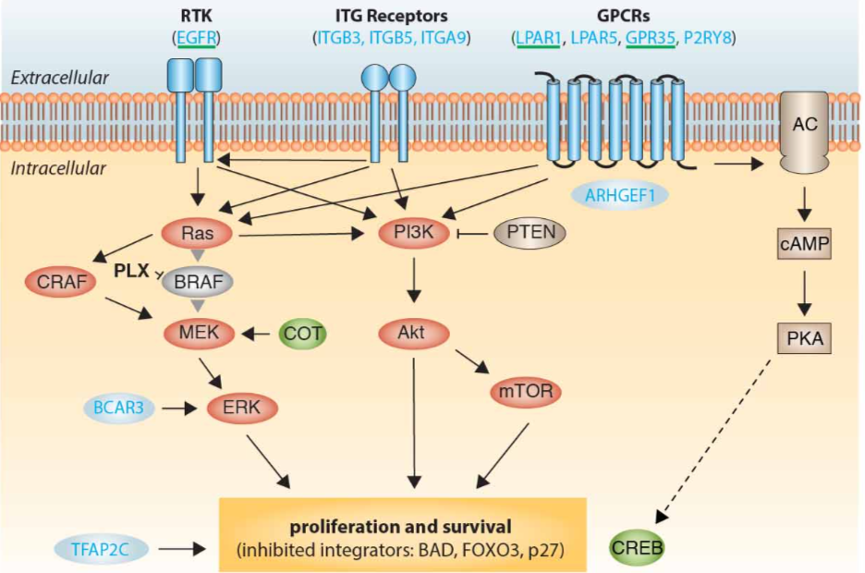
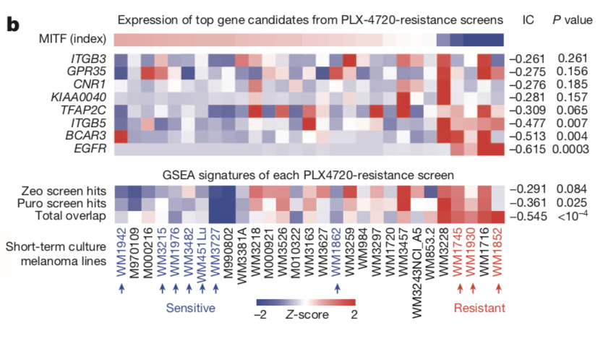
Dissecting disease mechanisms at genome scale
Screen hits cluster in 3 major pathways
of PLX4720 melanoma drug resistance
Hit signature expression is significantly associated with resistance in patient short-term cultures
Konermann et al., Nature 2015
Notes:
Highlighting the utility of this approach in dissecting transcritptional mechanisms in disease

Slide 9
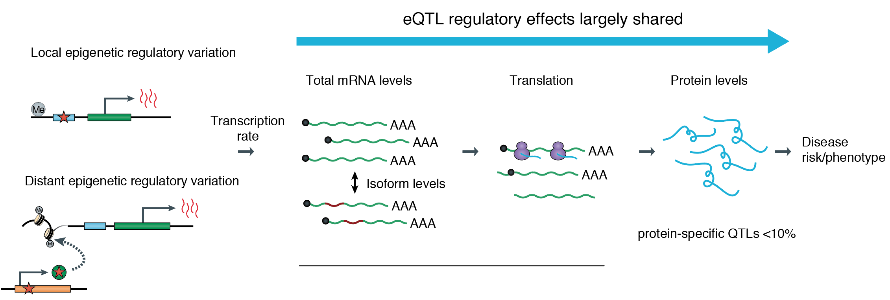
Moving beyond DNA: toward direct targeting of RNA
How do we perturb these processes directly?
Adapted from Albert et al. Nature Reviews Genetics 2015; Li et al. Science 2016
Notes:
towards the end of my PhD and in my postdoctoral work I became interested in moving beyond transcriptional control at the DNA level to target RNA directly.
Direct RNA targeting has a few unique advantages, including the ability to target individual isoforms and isoform ratios as well as targeting for example non-coding RNAs independentily of their DNA promoter or enhancer.

Slide 10
Overview
Targeting transcription at the level of DNA at genome scale
Direct targeting of RNA to modulate knock-down and splicing
Building human brain model systems to interrogate LOAD and other complex neurological diseases
Building Arc Institute as a new structural model to enable the study of complex diseases more broadly

Slide 11
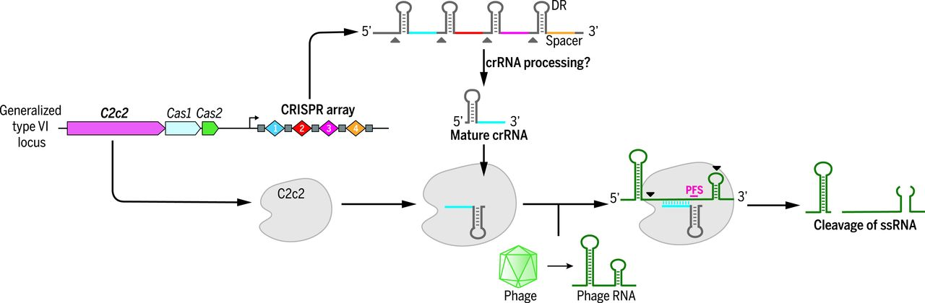
Direct control of transcripts: RNA targeting CRISPR systems (Cas13)
Abudayyeh*, Gootenberg*, Konermann* et al., Science, 2016

Slide 12
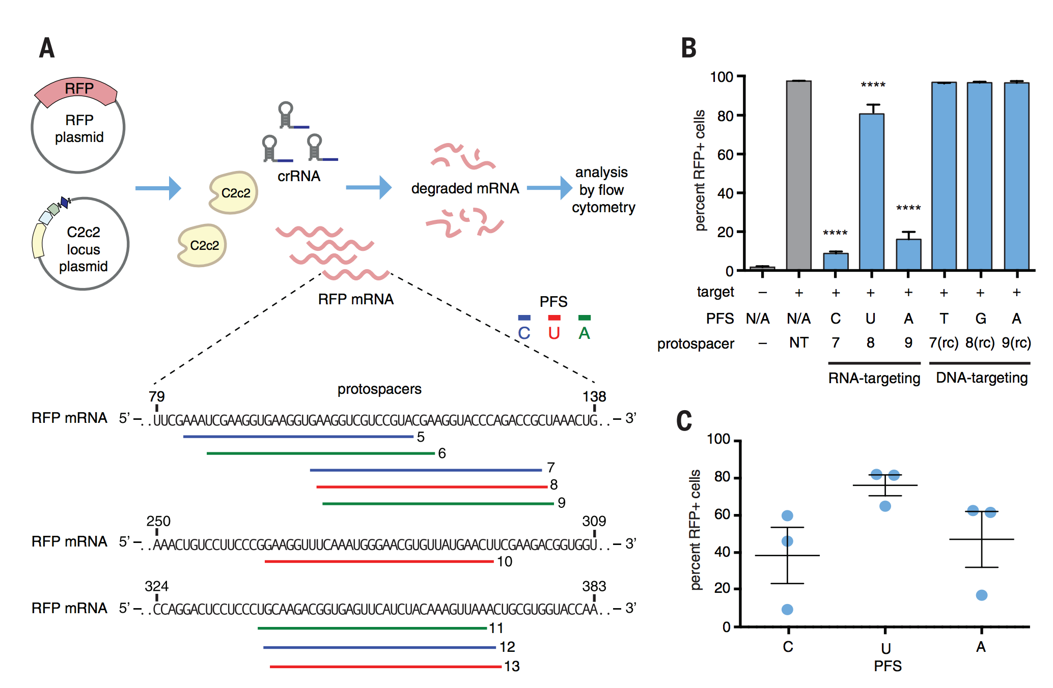
LshC2c2 is a programmable RNA nuclease in prokaryotes
Abudayyeh*, Gootenberg*, Konermann* et al., Science, 2016

Slide 13
LshC2c2 is a single-effector reprogrammable RNase in vitro
Despite HEPN-domain dependent RNA cleavage activity in vitro, LshC2c2 does not exhibit significant RNA knockdown in human cells
Abudayyeh*, Gootenberg*, Konermann* et al., Science, 2016

Slide 14
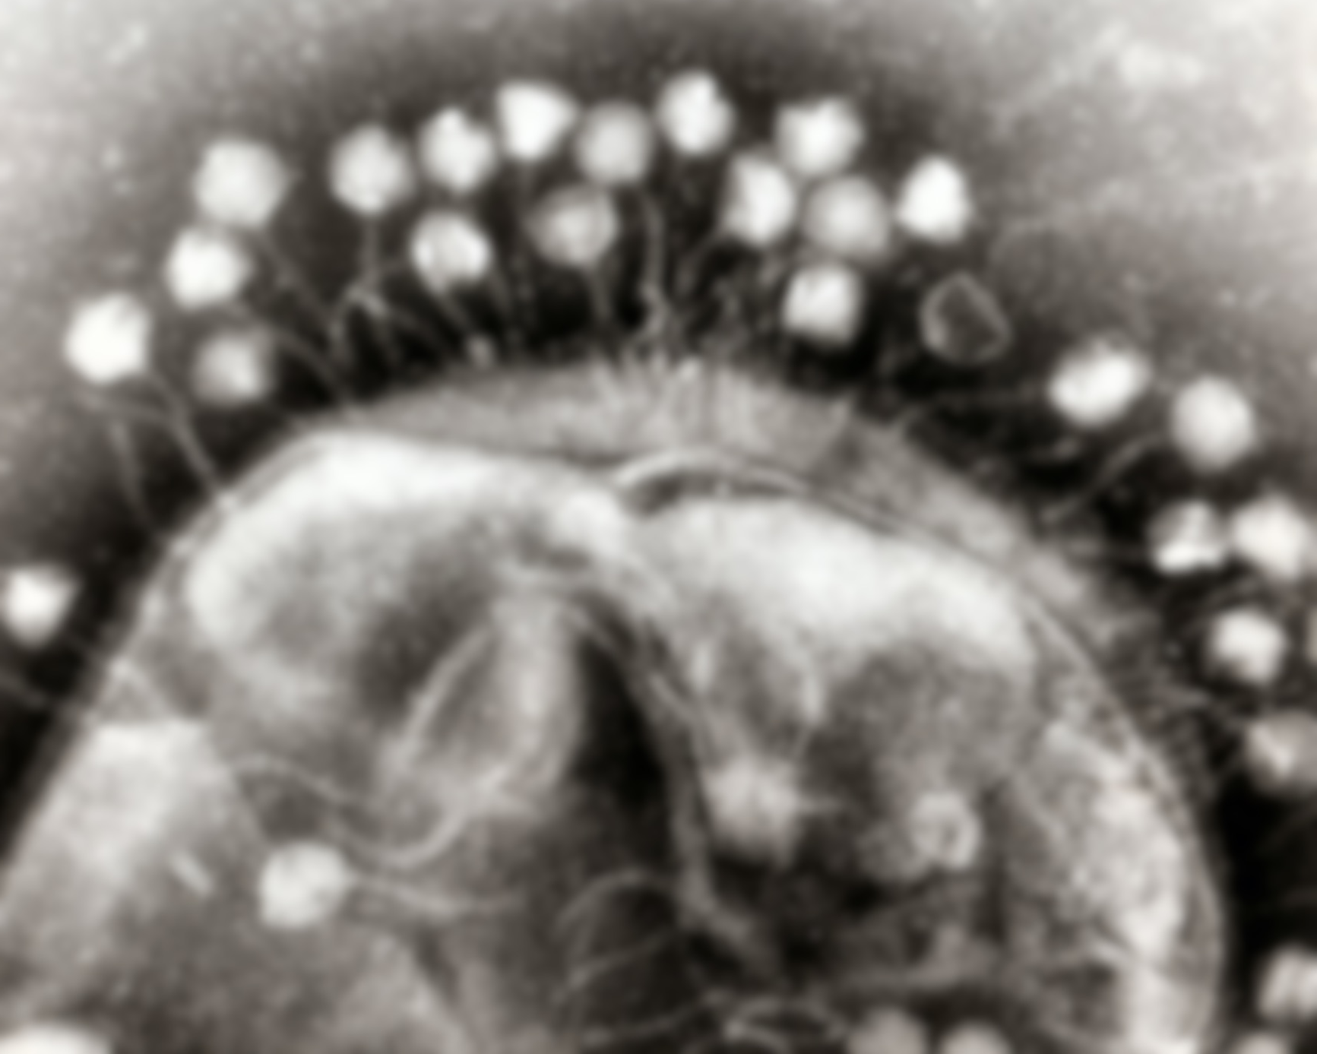
Back to the source: search for RNA-targeting CRISPRs
Key features
High activity
(2) Consistency
(3) Specificity
(4) Lack of toxicity
Delivery (small size)
Notes:
to develop a tool for RNA targeting in mammalian cells...lloking for an enzyme famility that fulfilled a few key criteria

Slide 15
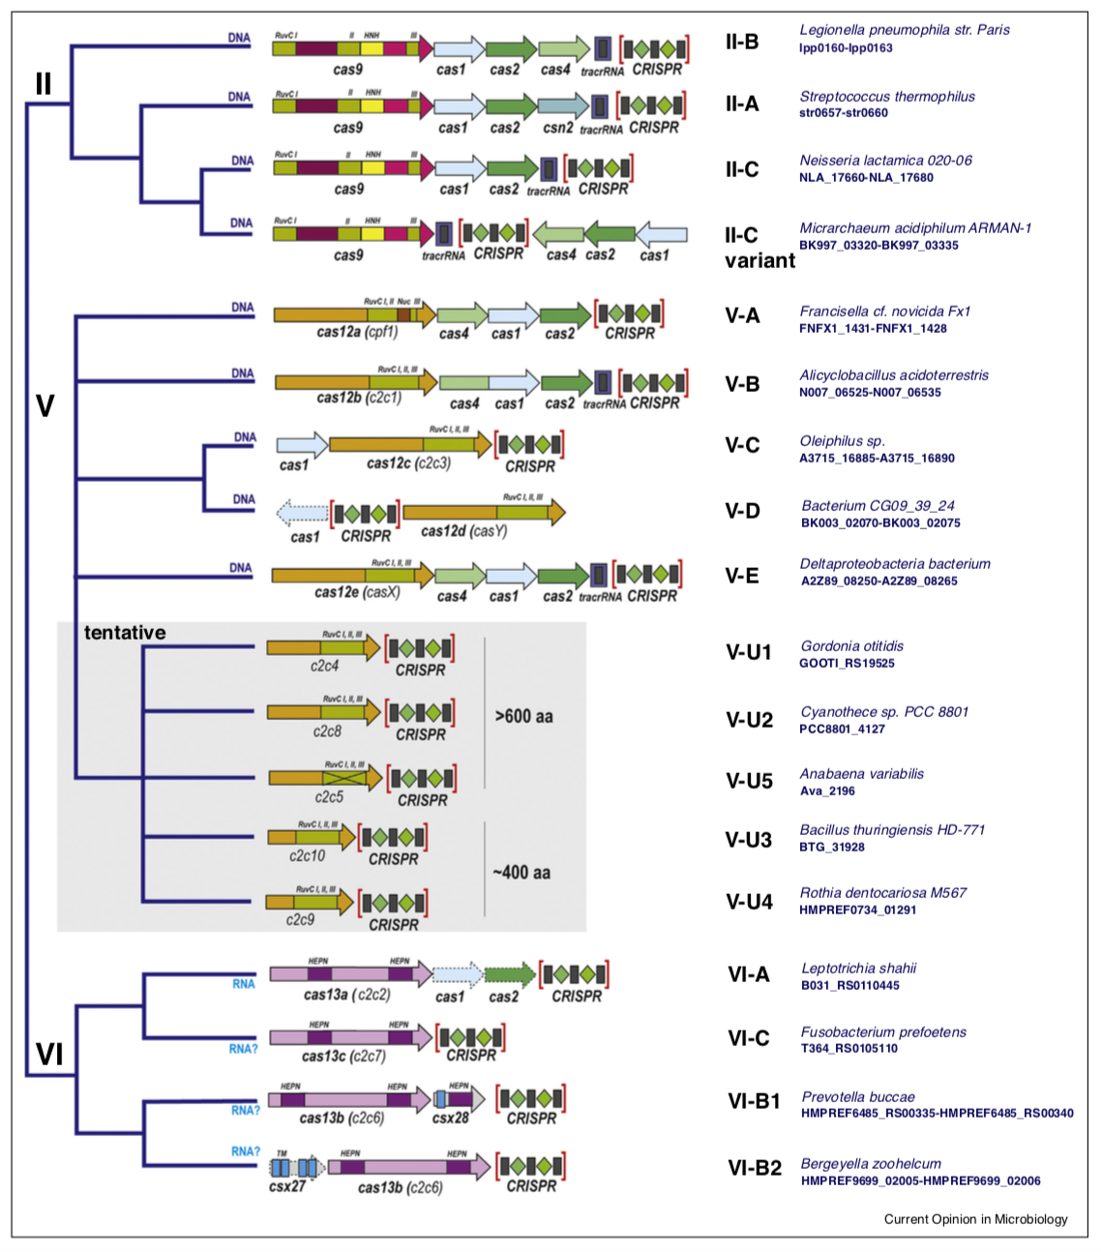
Discovery of a new CRISPR family: Cas13d
Class 2
Computational search focused on CRISPR array as minimal feature for discovery

Slide 16
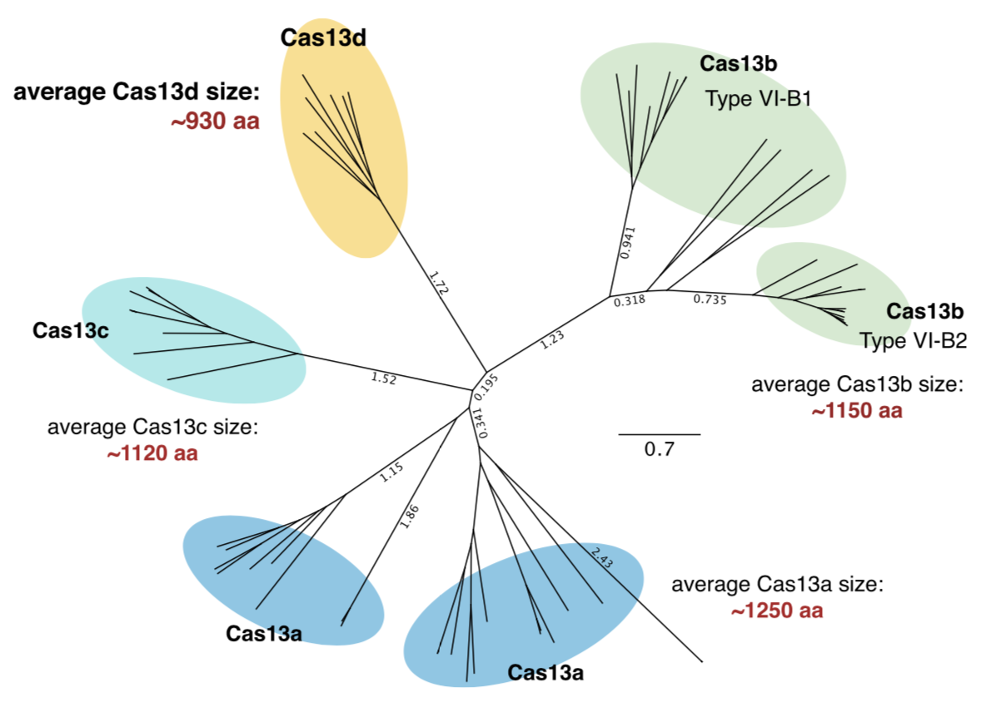
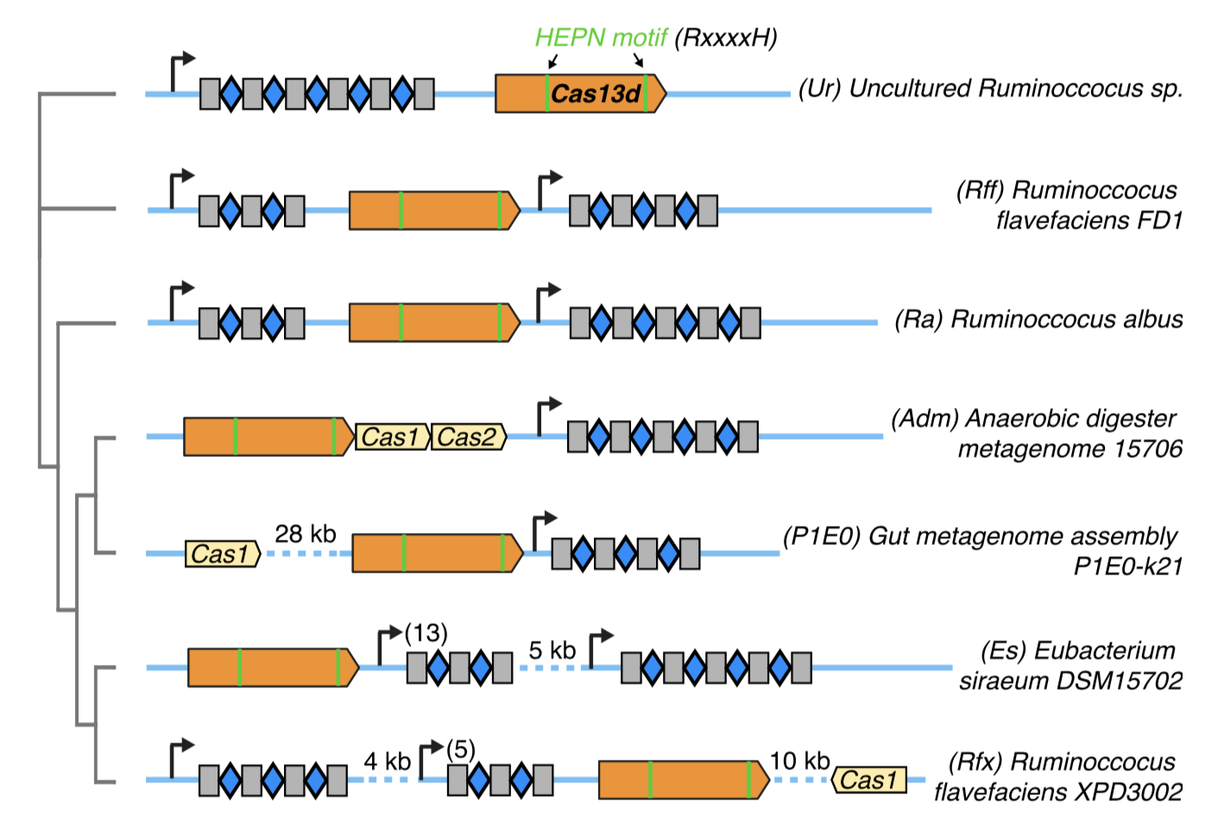
Discovery of a new CRISPR family: Cas13d
Presence of HEPN domains indicates potential for RNA targeting (Activity)
Unusually small size (Delivery)
Konermann et al., Cell, 2018
Notes:
Presence of HEPN domains indicates potential for RNA targeting

Slide 17
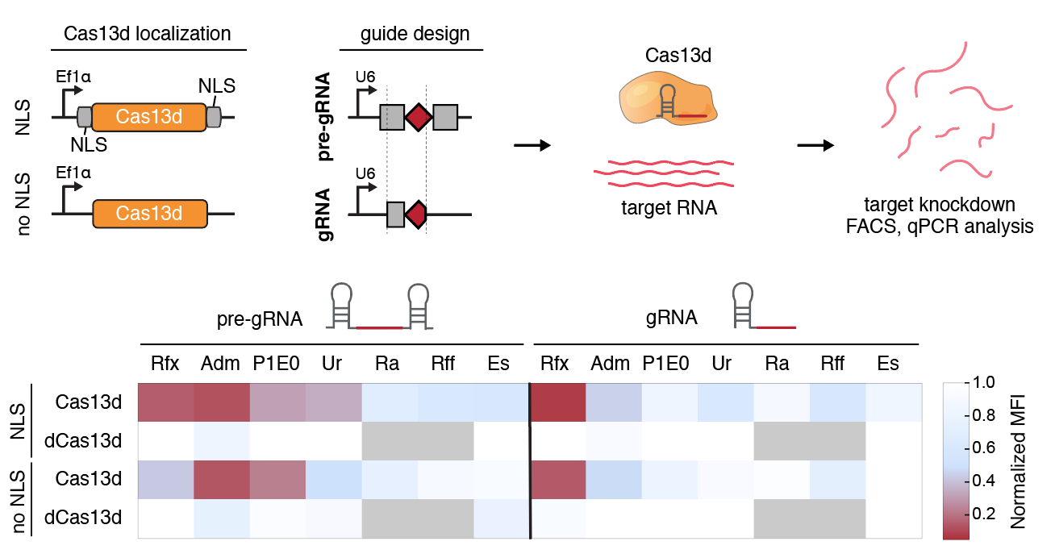
Cell-based activity screen to identify active Cas13d orthologs
Most active construct:
Cas13d-NLS from Ruminococcus flavefaciens strain XPD3002 (CasRx)
Konermann et al., Cell, 2018
Notes:
Next, we wanted to move Cas13d into human cells. The first step is to figure out which family member is the most active in human cells. Just like different Cas9s have different genome editing activity, we wanted to see which Cas13d, which originate from different bacteria or metagenomic samples, would have the most robust activity.

Slide 18
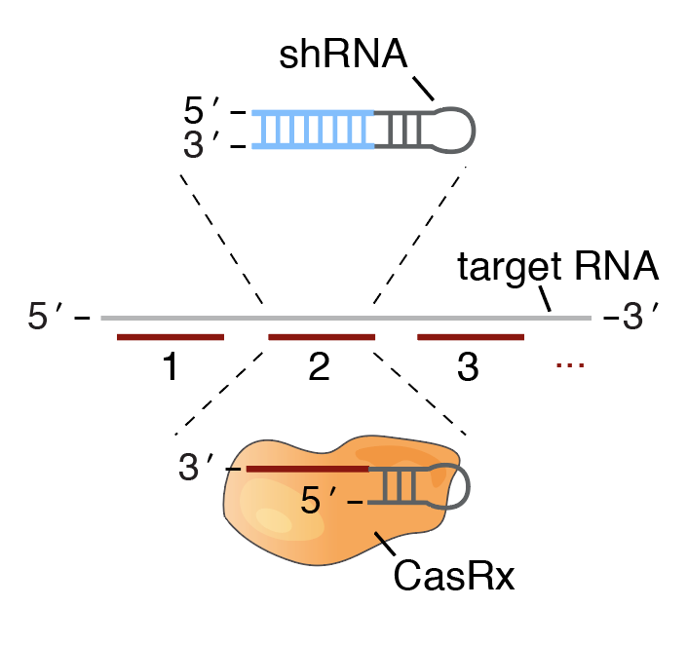
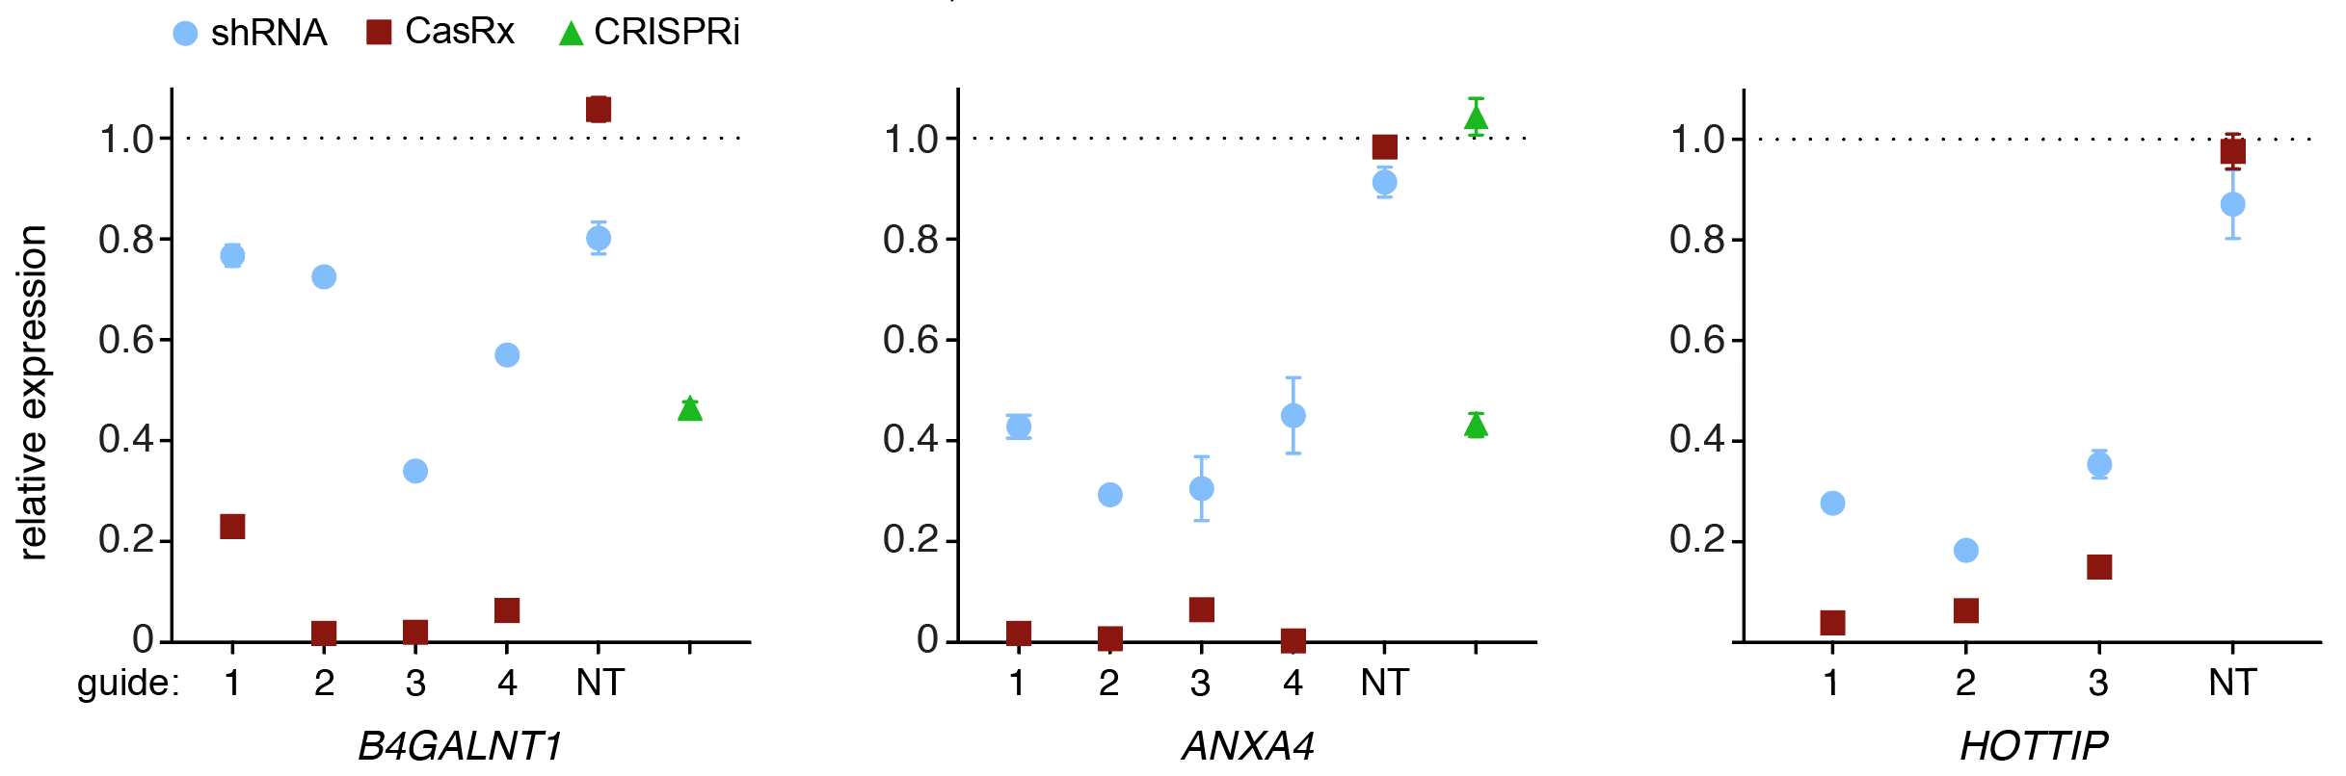
CasRx efficiency relative to RNAi and CRISPRi
Konermann et al., Cell, 2018
Notes:
We did a direct head to head on 2 coding and 1 noncoding transcript at 11 distinct positions. We were happy to see CasRx outperformed RNAi and CRISPRi in every case. So we’ve checked some of the boxes. A big remaining question is if this type of RNA knockdown is specific.

Slide 19
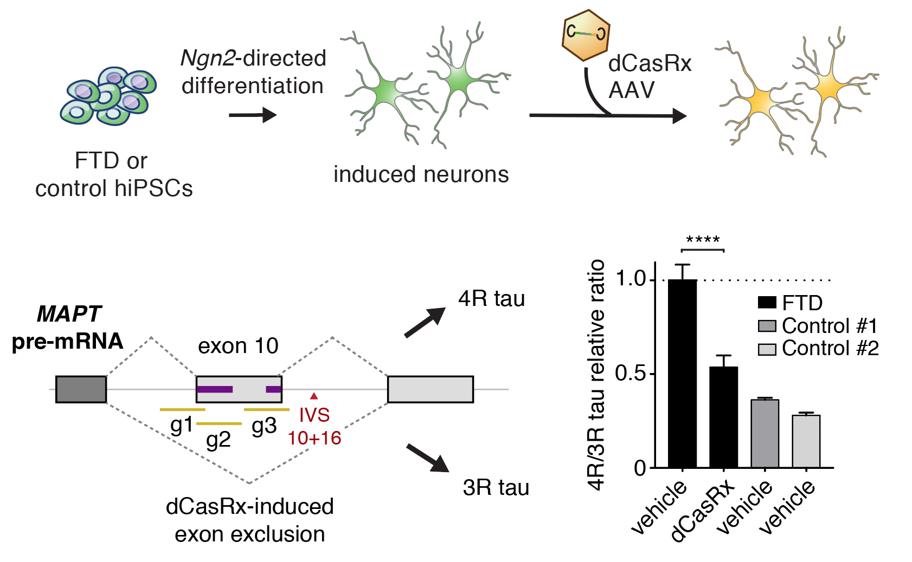
Targeting of dysregulated tau isoform ratios in frontotemporal
dementia
Modular RNA-binding domain, can be delivered by AAV
Konermann et al., Cell, 2018
Notes:
As I mentioned earlier, one of the major interests of our lab is neurodegeneration. Multiple types of dementia are caused by defects in Tau, and Frontotemporal Dementia can be caused by diverse point mutations in MAPT, the gene encoding for tau. Tau exists as two major isoforms in human neurons, 4R and 3R, which are distinguished by the presence or absence of tau exon 10 and thus contain 4 or 3 microtubule binding domains. The balance of these two isoforms is generally perturbed in FTDP-17 as well as other tauopathies, driving the progression of neurodegeneration. Some forms of FTD are caused by mutations in the intron following MAPT exon 10 which disrupt an intronic splice silencer and elevate the expression of 4R tau, thereby inducing pathological changes.

Slide 20
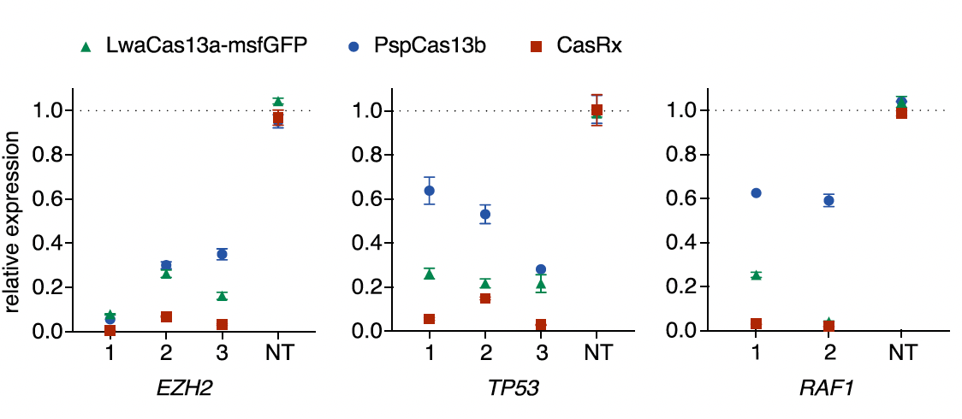
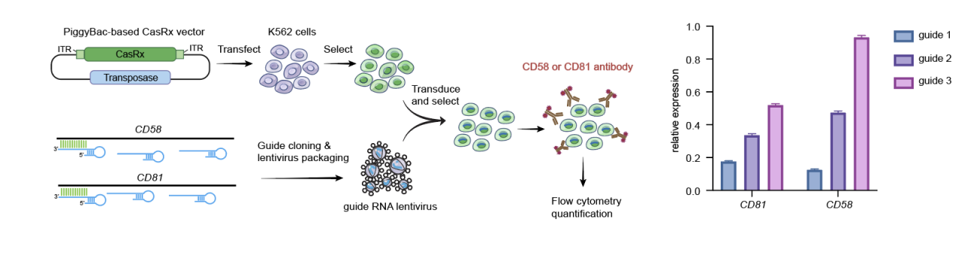
Solving Efficiency and Consistency
Cas13d is the smallest Cas13 subtype
CasRx is the most efficient RNA-targeting enzyme based on available internal and external comparisons
When evaluating endogenous protein KD following stable expression in K562s, knockdown across guides is not consistent
Konermann et al., Cell (2018), Wessels et al., Nat Biotech (2020, Wei et al, BioRxiv, 2022 )

Slide 21
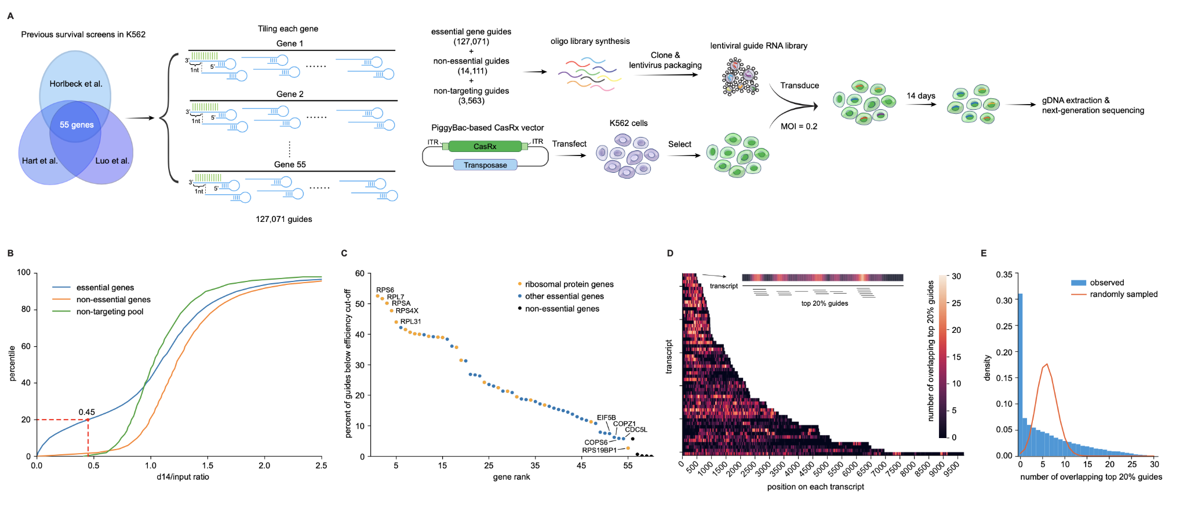
  Phenotypic screening on essential transcripts for high-throughput evaluation of predictors of guide efficiency
What are the determinants of guide efficiency?

Slide 22
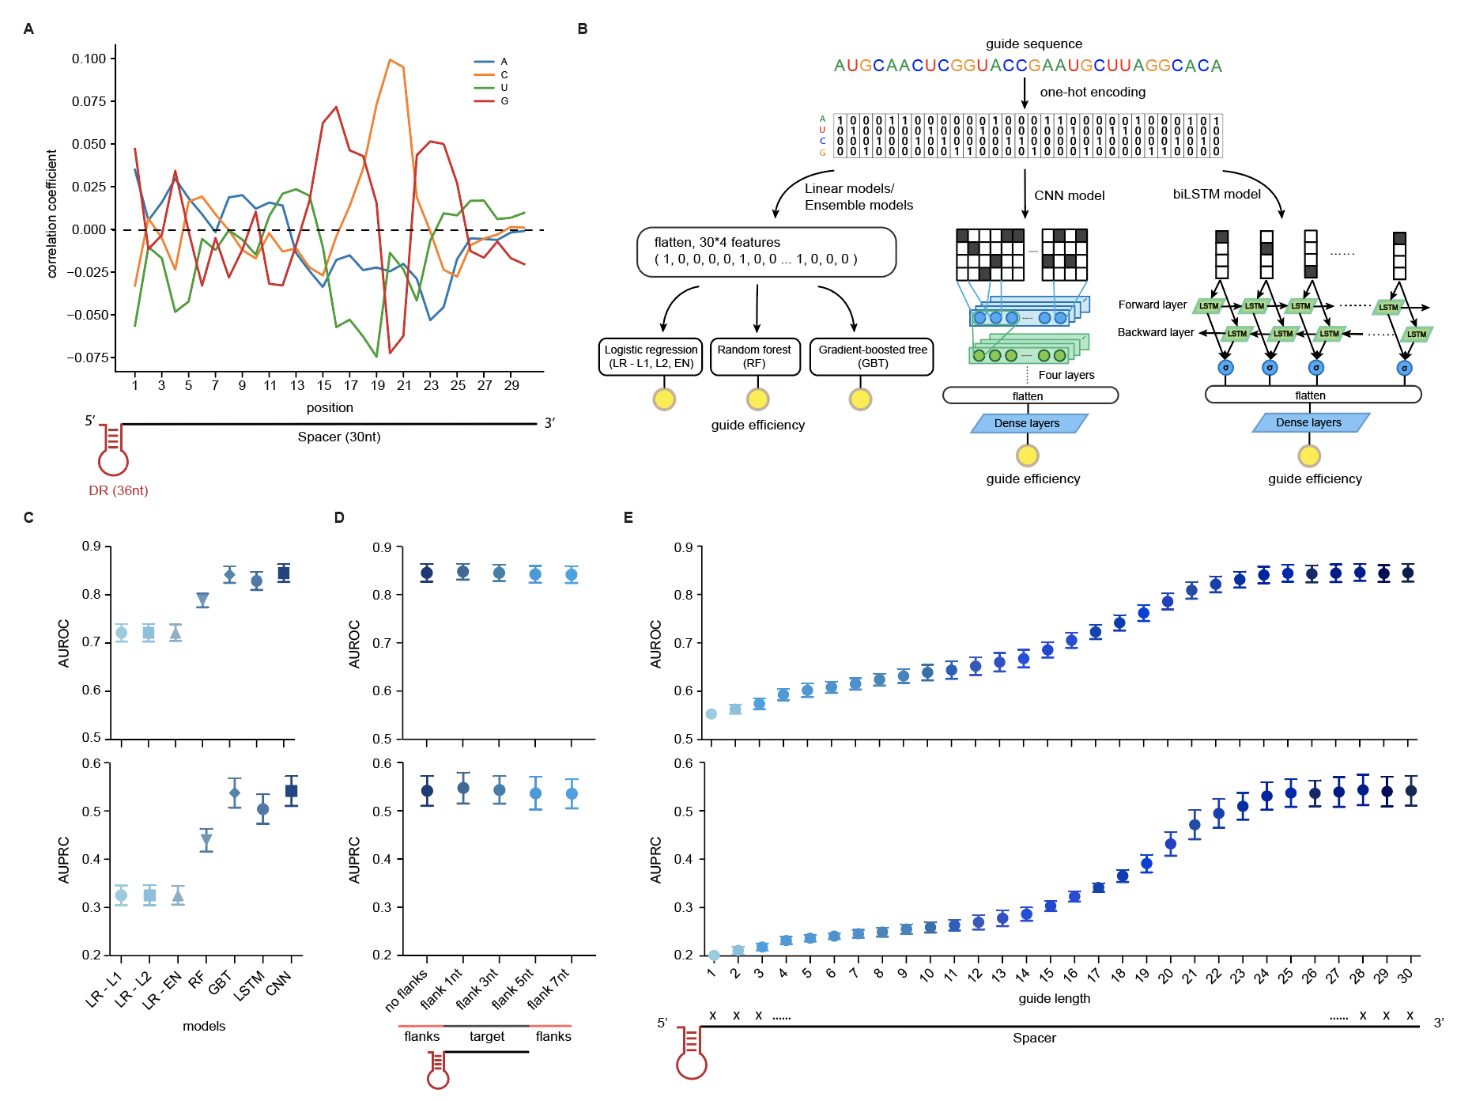
Prediction of CasRx activity based on guide RNA sequence alone
Systematic comparison of linear, ensemble and deep learning models
No manual sequence feature selection

Slide 23
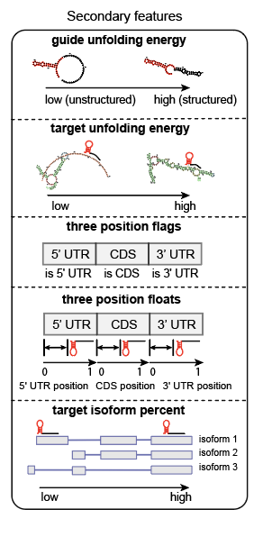
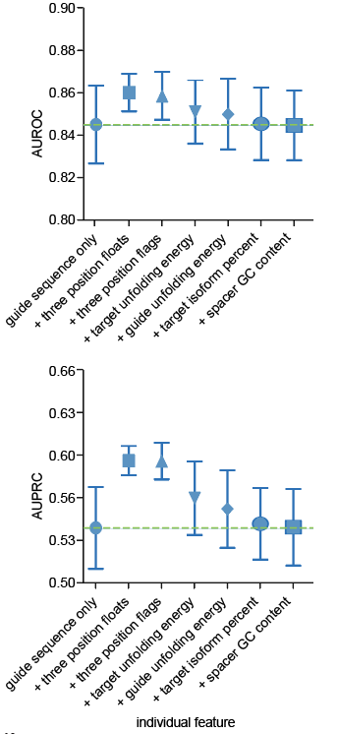
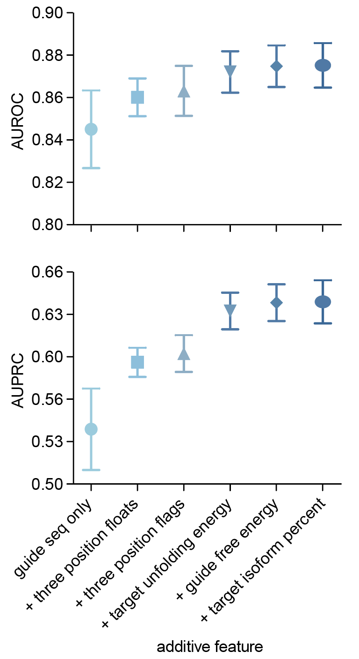
Systematic evaluation and addition of secondary predictive features
CDS targeting is the most impactful secondary feature
RNA secondary structure prediction via lineafold provides marginal improvements in prediction accuracy

Slide 24
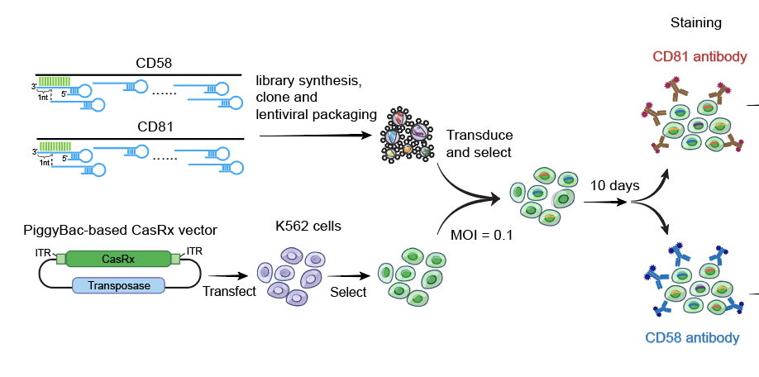
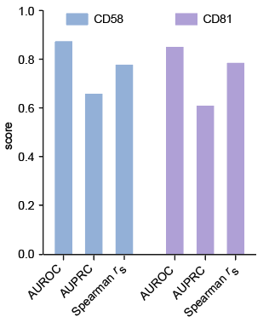
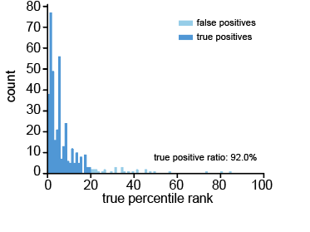
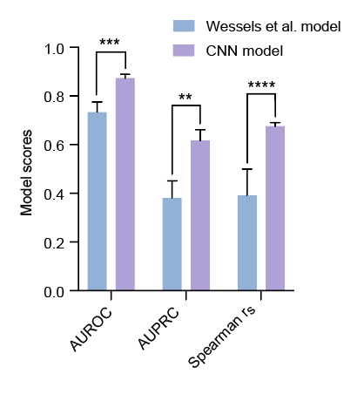
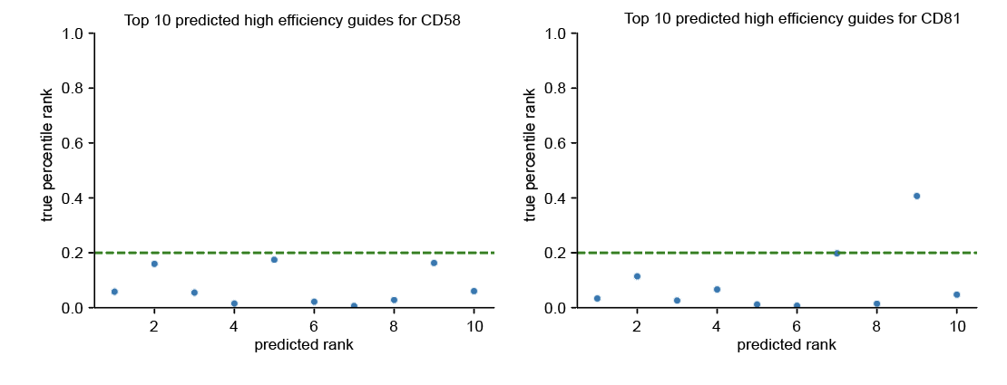
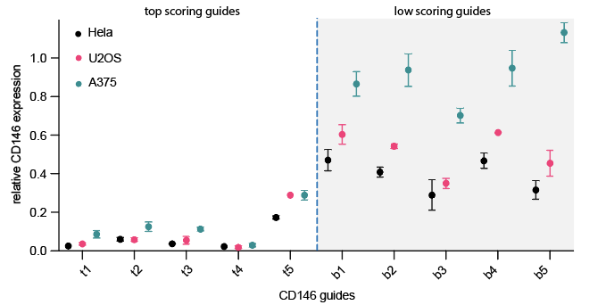
Model performance across readouts and cell types
90% true positive ratio of effective guides (top 20%) when used to select the most efficient guides / transcript
Consistent performance across 5 cell types
Improved performance compared to non-deep learning based prior model based on a smaller dataset

Slide 25
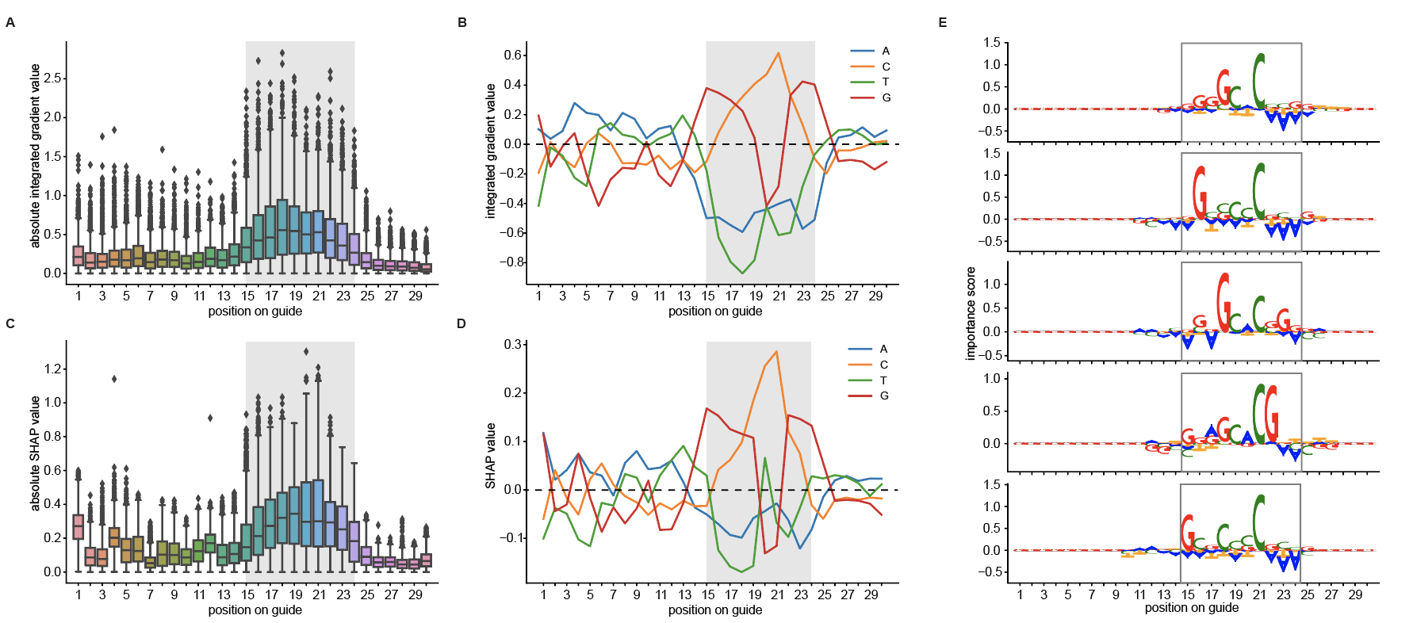
Discovery of a core CasRx sequence motif using DL model interpretation approaches
Adaptation of Tf-Modisco algorithm for deep learning model interpretation

Slide 26
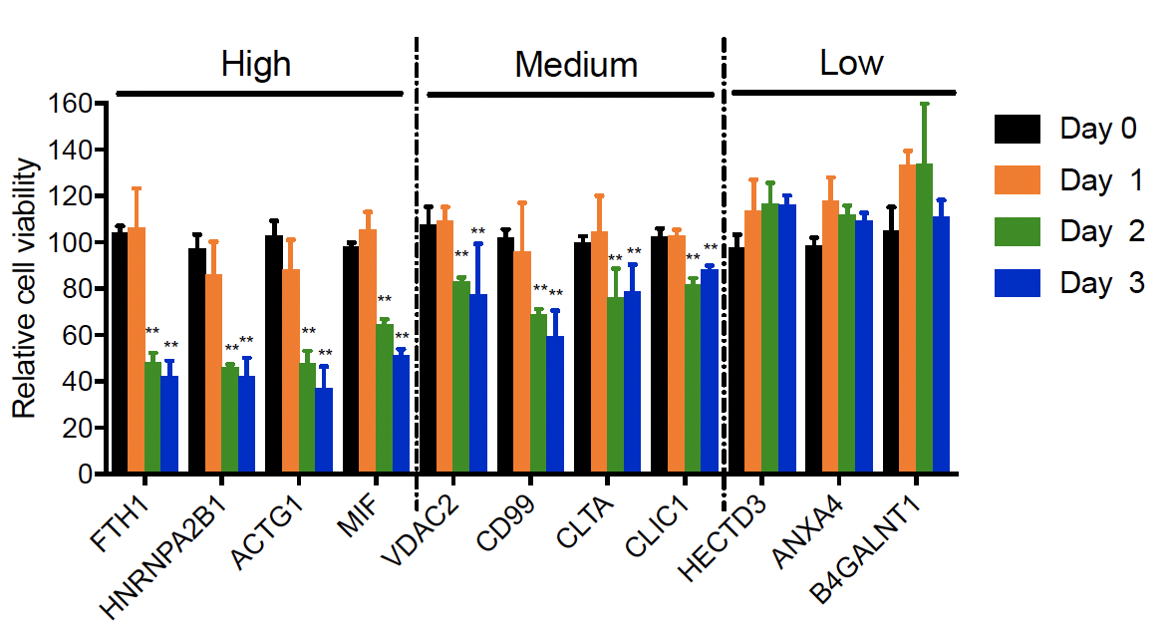
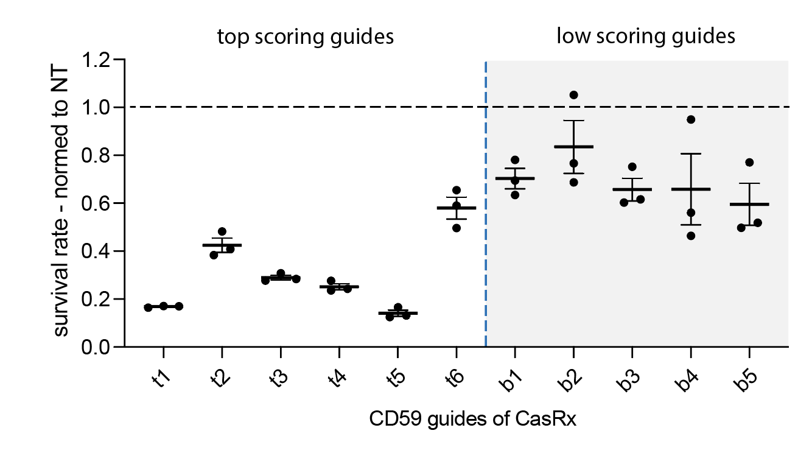
2. Solving context-dependent Cas13 cellular toxicity and collateral RNA cleavage
Cas13 targeting mediated cellular toxicity is dependent on target abundance
Cas13 mediated cellular toxicity is dependent on guide efficacy
Cas13 mediated cellular toxicity is cell-type dependent
  Shi et al. 2021, BioRxiv ; Ai et al. 2022, BioRxiv, Wei et al, 2022, BioRxiv

Slide 27
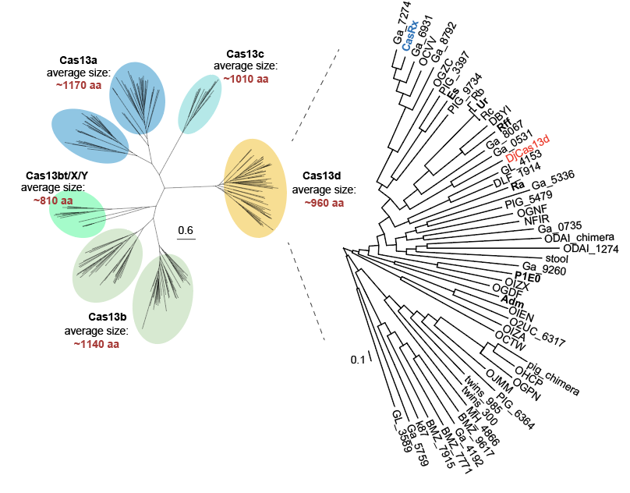
Mining metagenomic sequence contigs for novel ortholog discovery
  Discovery of 46 novel Cas13d orthologs (from 7 prior known ones)
  Wei et al, 2022, BioRxiv

Slide 28
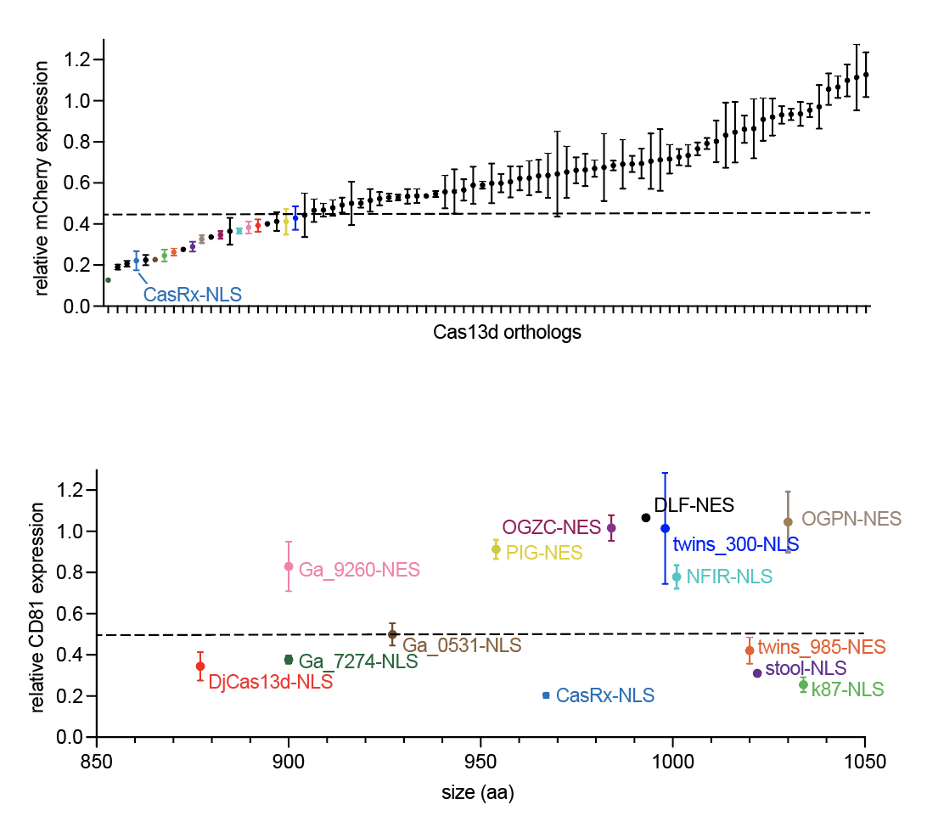
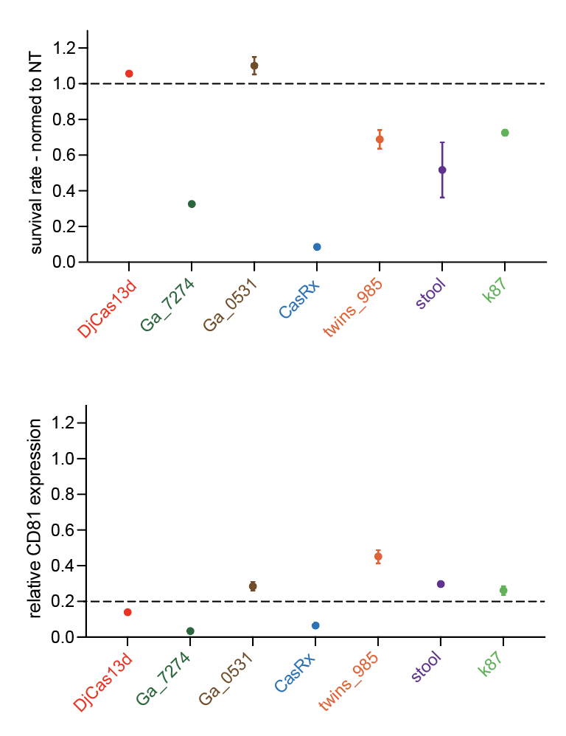
Are there naturally occurring Cas13 orthologs with reduced cellular toxicity?
  Efficiency test
  Cytotoxicity in hESC (H1)

Slide 29
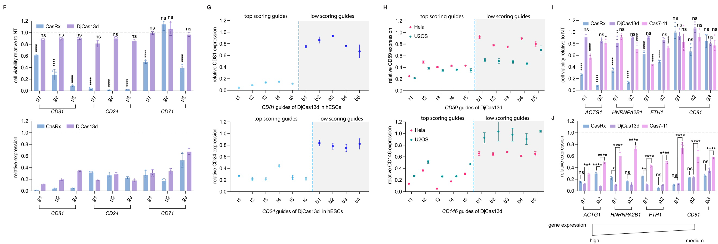
2. Solving context-dependent Cas13 cellular toxicity and collateral RNA cleavage
  Wei et al, 2022, BioRxiv

Slide 30
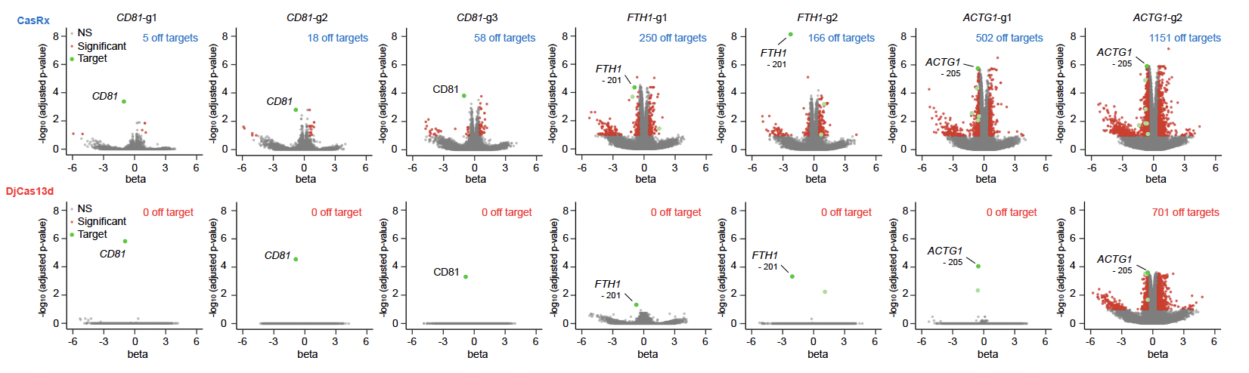
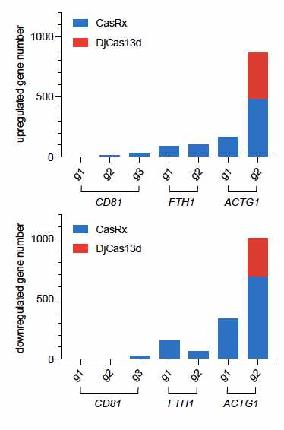
2. Solving context-dependent Cas13 cellular toxicity and collateral RNA cleavage
  Wei et al, 2022, BioRxiv

Slide 31
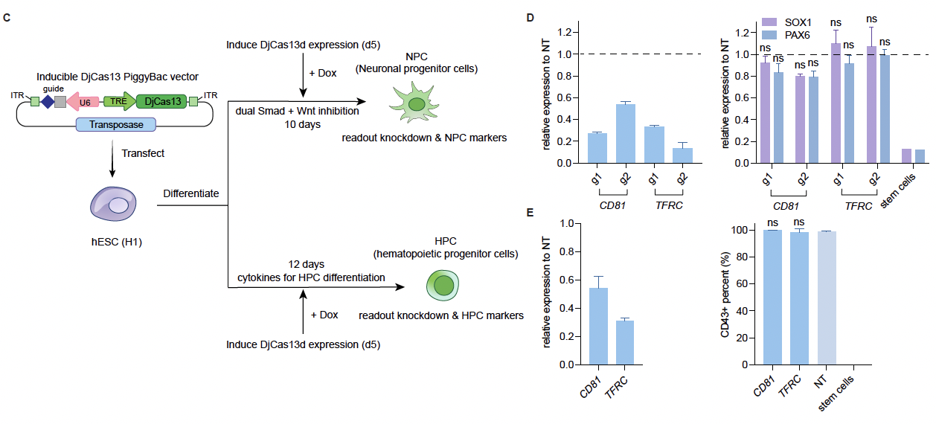
2. Solving context-dependent Cas13 cellular toxicity and collateral RNA cleavage
Cas13 targeting mediated cellular toxicity is dependent on target abundance
Cas13 mediated cellular toxicity is dependent on guide efficacy
Cas13 mediated cellular toxicity is cell-type dependent
  Wei et al, 2022, BioRxiv

Slide 32
Summary – Comprehensive solution to efficient RNA targeting
  Large scale dataset of more than 100,000 CasRx guides forms the basis of a highly robust CNN model. – Efficiency, consistency
  Model performance is preserved across genes, cell types, screen readout modalities, and different Cas13d orthologs. - Consistency
  DjCas13d, a novel Cas13d ortholog, is a low cellular toxicity, high specificity and compact enzyme for efficient RNA targeting in sensitive cells – Specificity, low toxicity, size
  Freely available at rnatargeting.org
  Shi et al. 2021, BioRxiv ; Ai et al. 2022, BioRxiv, Wei et al, 2022, BioRxiv

Slide 33
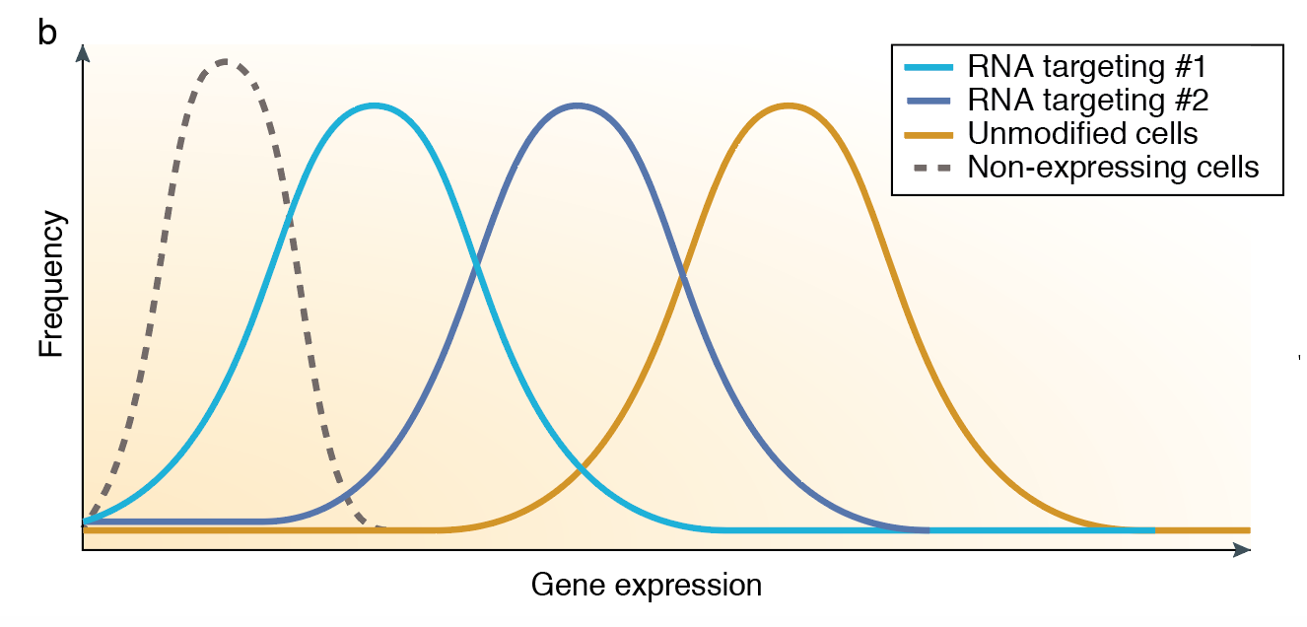
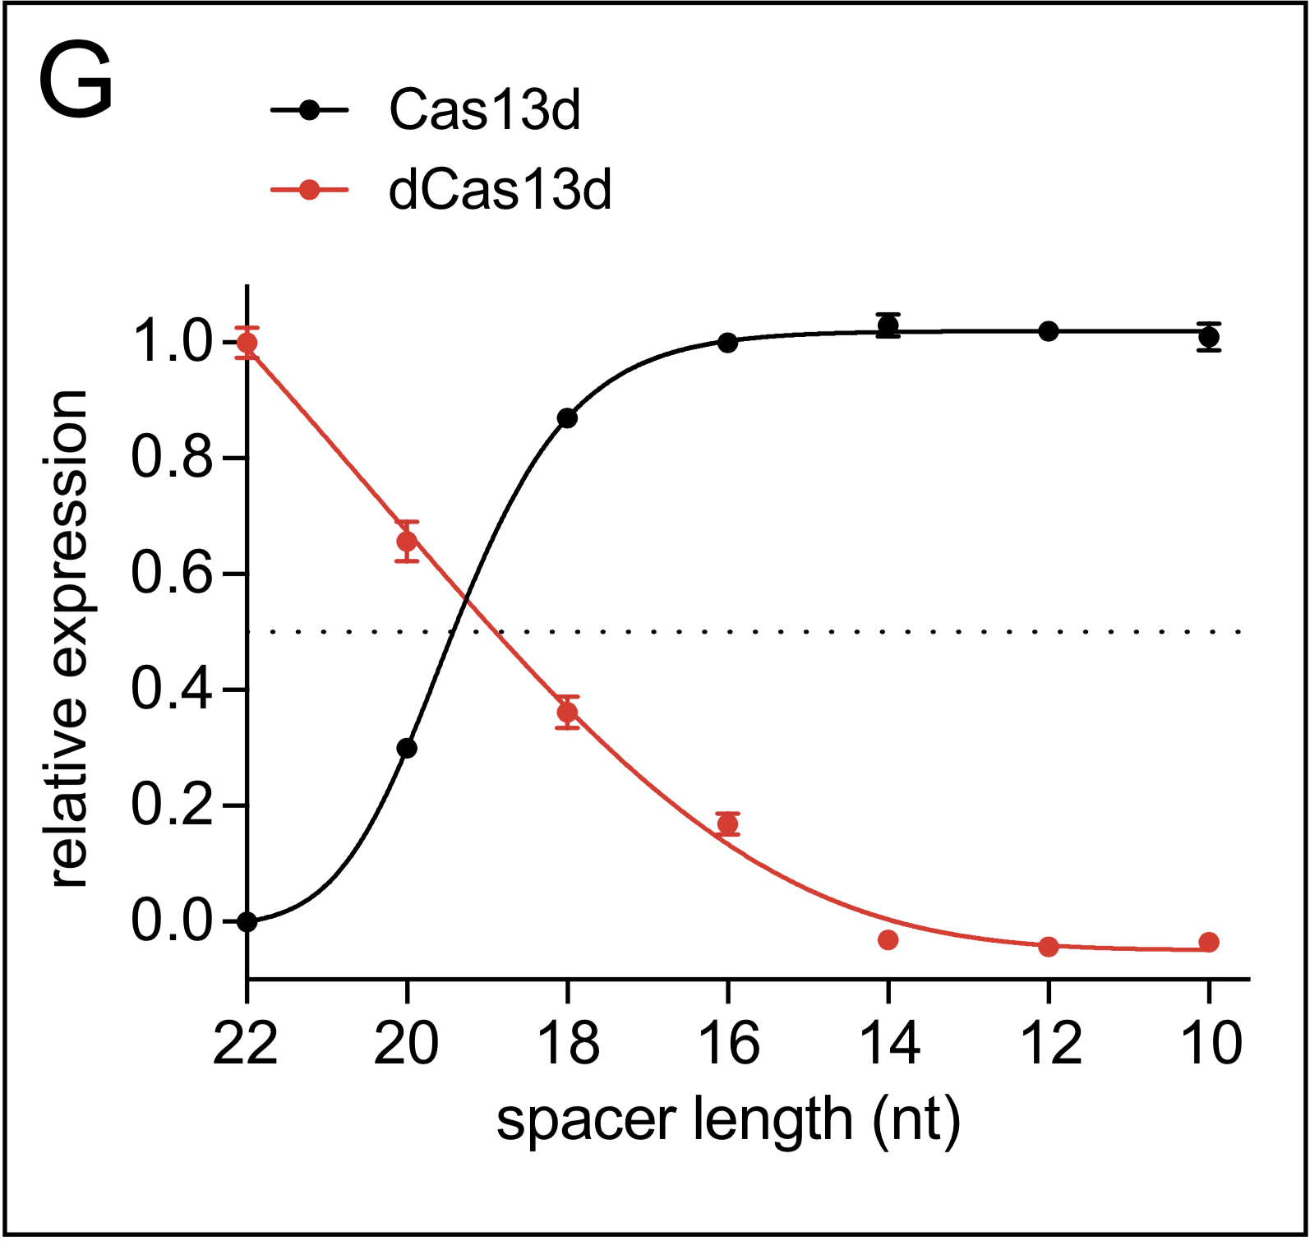
Opportunities of transcript targeting: dose control and reversibility
WPRE
2A
CasRx
TRE
U6
EF1⍺
rtTA
Puro
Linking transcript dose and timing to signaling events and phenotypes
Zhang*, Konermann* et al. Cell 2018 and unpublished data
Notes:
precisely tune transcript and isoform levels. recently shown as part of a collaboration on the structural mechanisms of RNA targeting.
ability to control timing of transcript knock-down: shown here chemical control of stably integrated CasRx

Slide 34
Overview
Targeting transcription at the level of DNA at genome scale
Direct targeting of RNA to modulate knock-down and splicing
Building human brain model systems to interrogate LOAD and other complex neurological diseases
Building Arc Institute as a new structural model to enable the study of complex diseases more broadly

Slide 35

Part 2: Building diverse brain cell types from hESCs
Starting point: ability to make excitatory neurons at scale with high purity
Challenge: >90% of GWAS late-onset AD risk genes are expressed in glia
Based on: Zhang et al., Neuron, 2013

Slide 36

Building diverse brain cell types from hESCs
Achieved by systematic, combinatorial manipulation of cell signaling pathways via
cytokines, small molecules and transcriptional activation
Yield and purity (lack of sorting steps) make screening feasible
unpublished

Slide 37

Ongoing project: cell type specific contributions of AD risk factors in human brain model systems
The ApoE4 allele is consistently the most important risk factor in LOAD
Modify ApoE genotype allelic series in one celltype at a time in 3D co-culture systems

Slide 38
Ongoing project: cell type specific contributions of AD risk factors in human brain model systems
Transcriptional profiling reveals significantly affected functional modules
specifically by astrocytic ApoE genotype but not by neuronal genotype
Able to profile both cell autonomous and non-autonomous effects

Slide 39

Ongoing project: dissection of AD signaling hierarchies

Slide 40

Ongoing project: dissection of signaling hierarchies
This approach lets us tackle questions like the causal link between
inflammation and abeta

Slide 41
Outlook: dissection of AD signaling hierarchies
Future: expand generalized cell-type specific transcriptional perturbation strategy
to probe key ApoE singaling nodes and AD eQTLs

Slide 42
Overview
Targeting transcription at the level of DNA at genome scale
Direct targeting of RNA to modulate knock-down and splicing
Building human brain model systems to interrogate LOAD and other complex neurological diseases
Building Arc Institute as a new structural model to enable the study of complex diseases more broadly

Slide 43


Thank you!
Postdoc work
advisor: Patrick Hsu
Peter Lotfy
Nick Brideau
Jennifer Oki
Cas13d CryoEM
Dmitry Lyumkis lab
Cheng Zhang
Human Brain models
Lab of Rusty Gage, Salk
Nicole Coufal, UCSD
Lab of M. Blurton Jones, UCI
Kyle Loh, Stanford
PhD work
advisor: Feng Zhang
Notes:
Thank you for your attention

